Slide 1

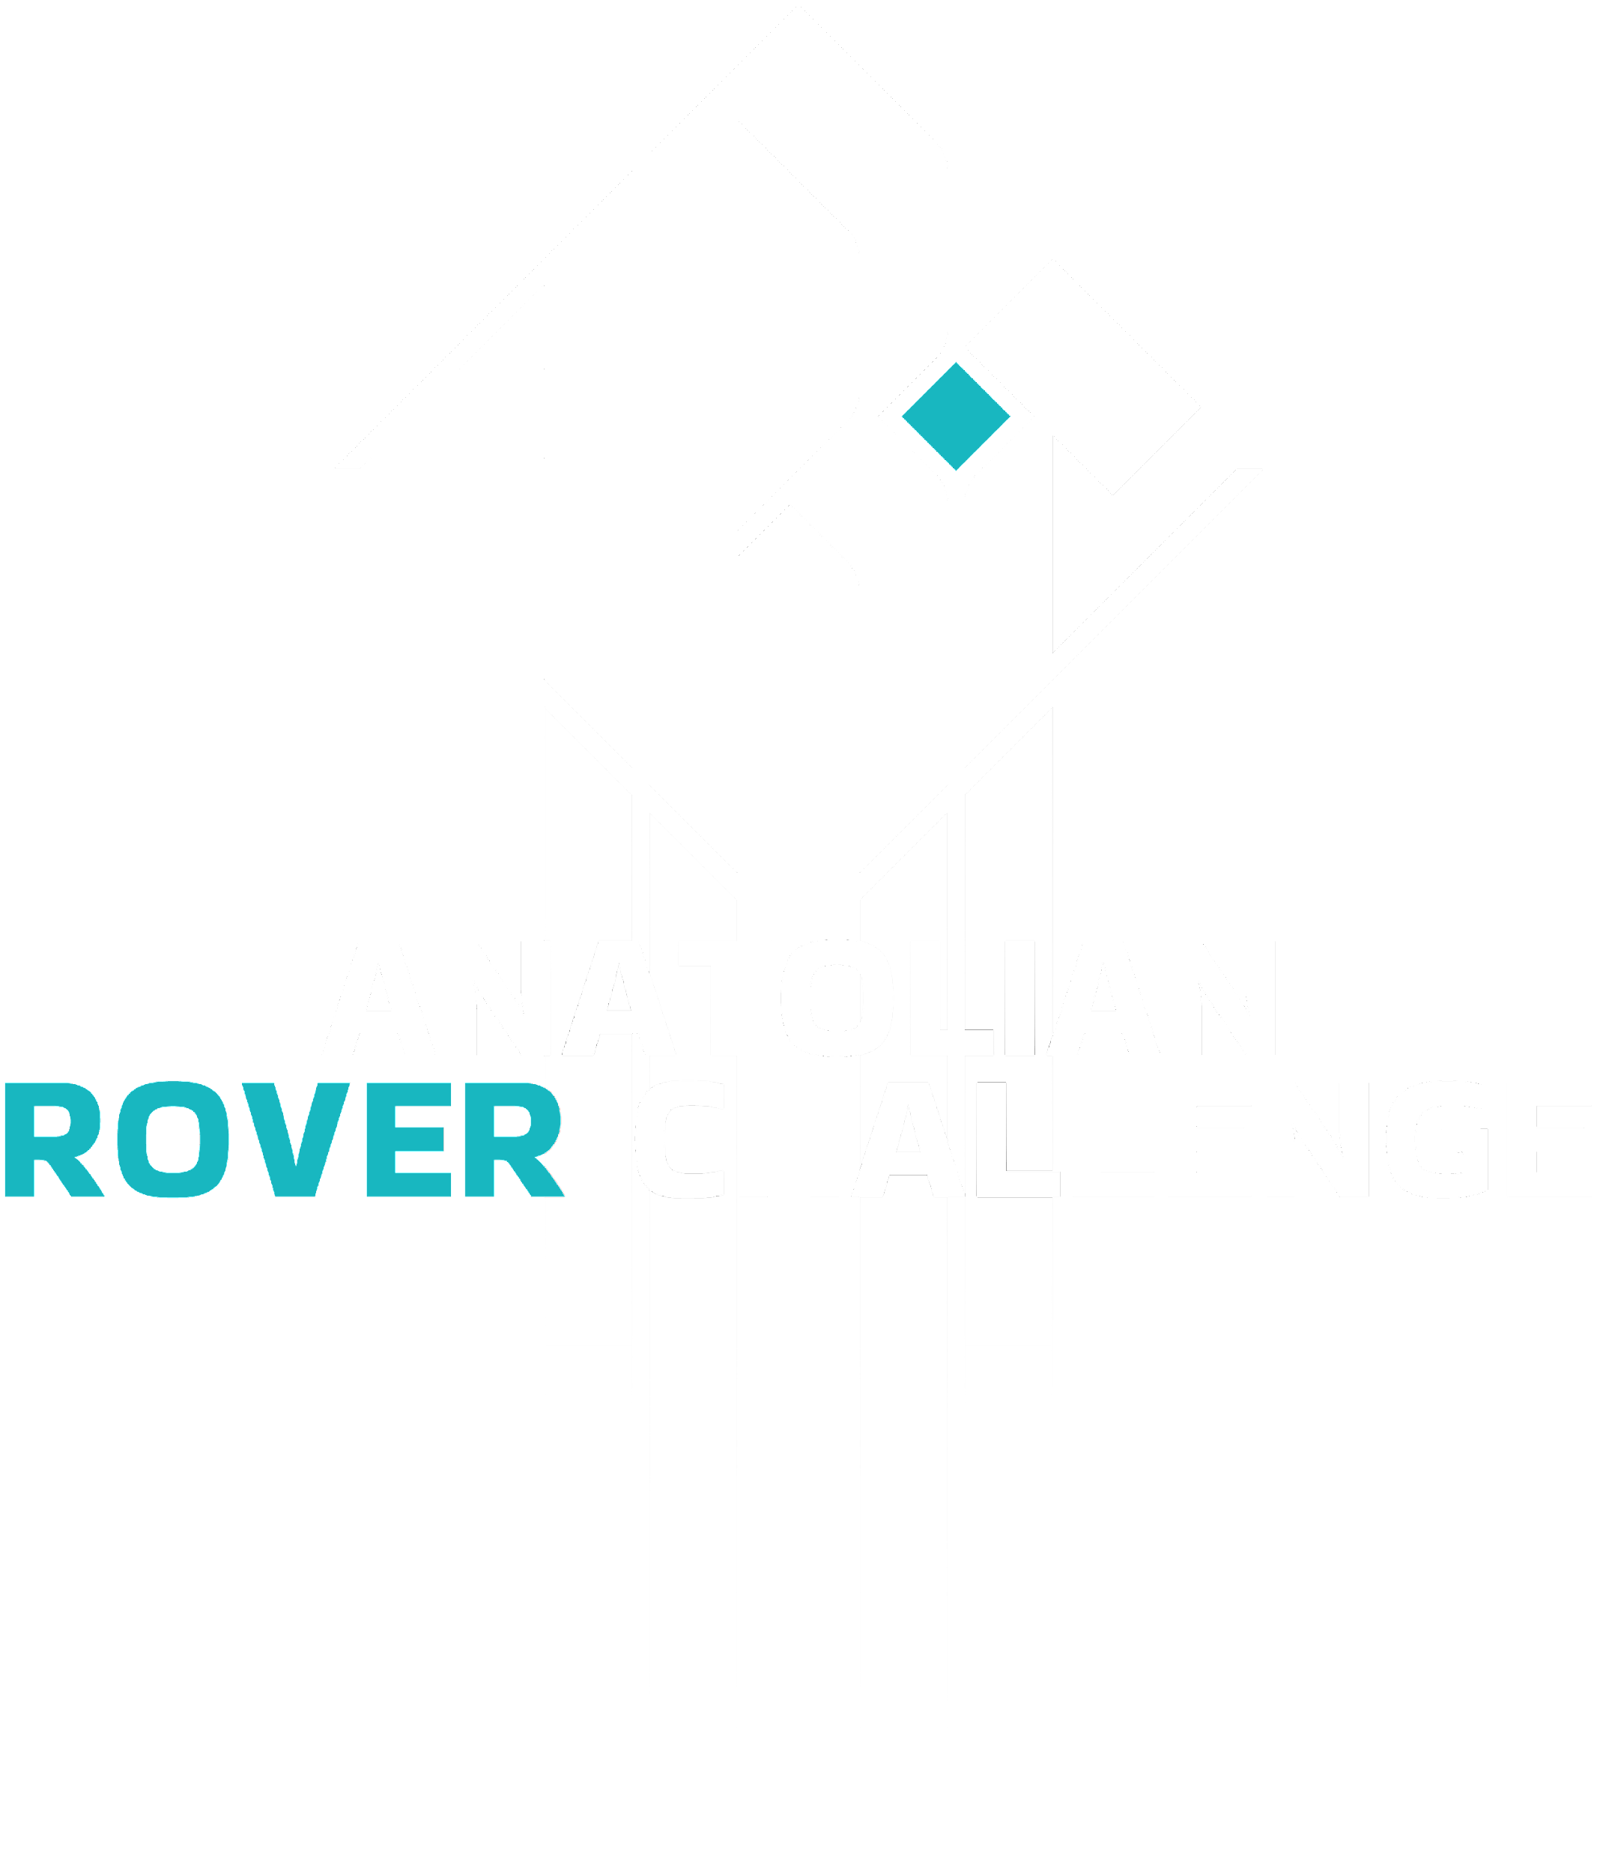
2023
Design Report

Slide 2


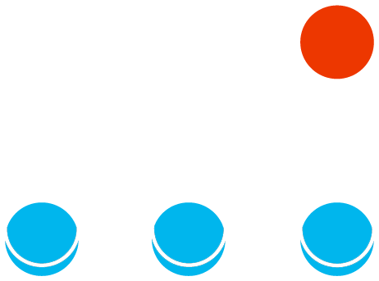
TEAM INFO
Team Name:
PCz Rover Team, Rover name: Modernity 3+
Contact:
E-mail: pczroverteam@pcz.pl
LinkedIn: https://www.linkedin.com/company/pcz-rover-team/
Instagram: https://www.instagram.com/pczroverteam/
Facebook: https://www.facebook.com/pczroverteam

Slide 3
TEAM INFO
Academic
Institution:
Czestochowa University of Technology
Academic
Consultant:
Dawid Cekus, DSc, Eng., Professor at Czestochowa University of Technology
E-mail: dawid.cekus@pcz.pl

Slide 4
TEAM INFO
History of
the Team:
The team consists near 15 students from different faculties of our University. Our team were founded in 2013. We have experience in machine design, electronics, mechanical, project management, software development, biology and artificial intelligence. We participated in almost all rover’s challenges. The team gives many presentations for young people from schools and participates in thematic events gathering science enthusiasts all around the country. Our team biggest achievement is 1st place in University Rover Challenge 2018 in the USA. Our main project is current rover. That rover is 7th vehicle of our team and is called Modernity 3. Previous ones are Modernity 2+, Modernity 2, Modernity, Infinity 3, Infinity 2, Infinity 1. In the future we would like to design an own drone. The team achivements: 1st place URC 2018,3rd place URC 2017, 4th place URC 2019, 4th place ERC 2015, 6th place URC 2015, 6th place ERC 2014, 10th place URC 2016, 10th place URC 2014, 11th place ERC 2016, 11th place URC 2022.

Slide 5
TEAM INFO
Active
Members List:
1.Cezary Kołodziejek – Team leader, PR, HR, Communication System Operator
2.Maciej Kuczyński – Vice team leader, Science mission leader
3.Łukasz Pałuszka – Engineer – Mechanic Supporter, Science mission team
4.Mateusz Tądel – Engineer – Mechanic Team Leader, Science mission team
5.Daniel Kucharski – AI developer, Autonomy mission leader
6.Antoni Wielgus – Electronic leader
7.Damian Szymanek - Programmer
8.Kacper Dziembek – Programmer
9.Kacper Kisiołek – AI developer
10.Paweł Gorzałka – PR team
11.Mateusz Nowak – AI developer
12.Jakub Moskalik – Electronic, Science mission team supporter
13.Bartosz Świtała – Programmer
14.Jakub Sroka – Graphic designer
15.Kacper Płaczkiewicz – Web developer

Slide 6
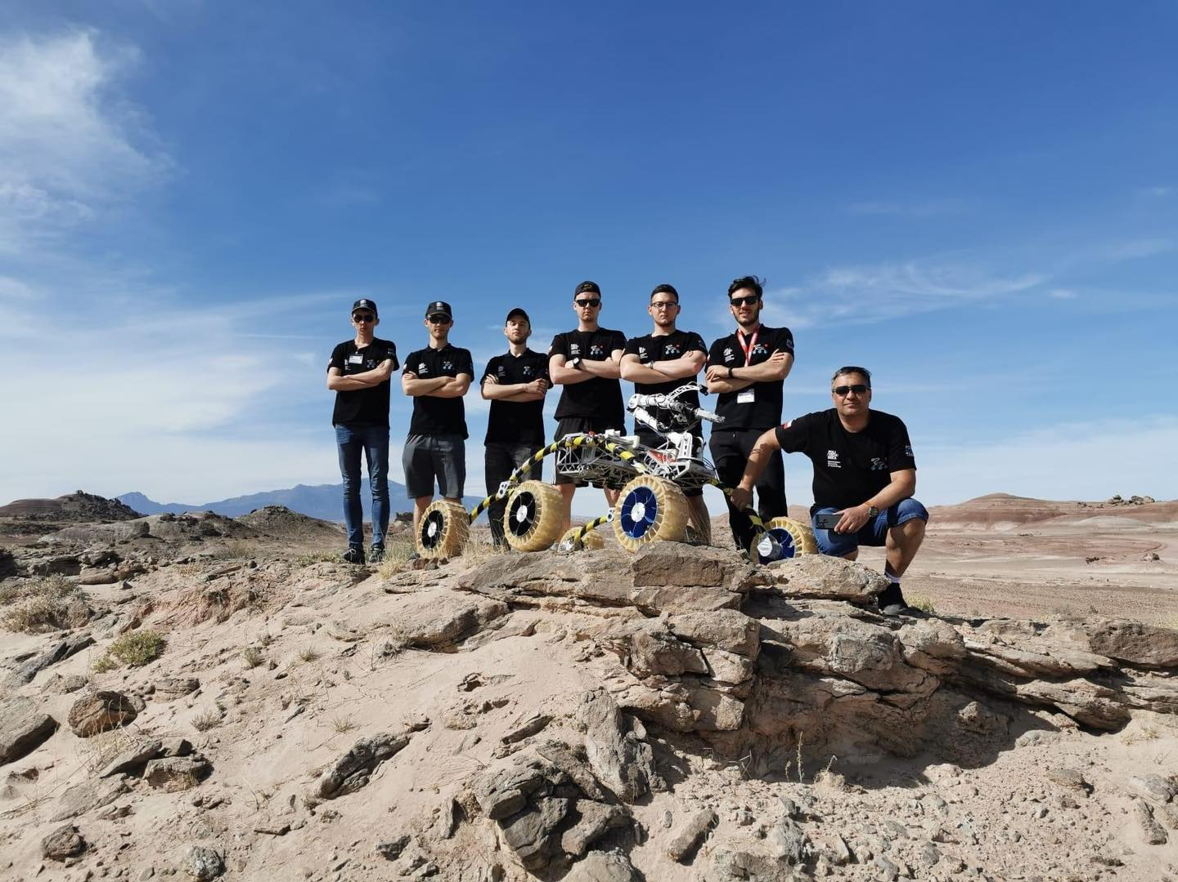
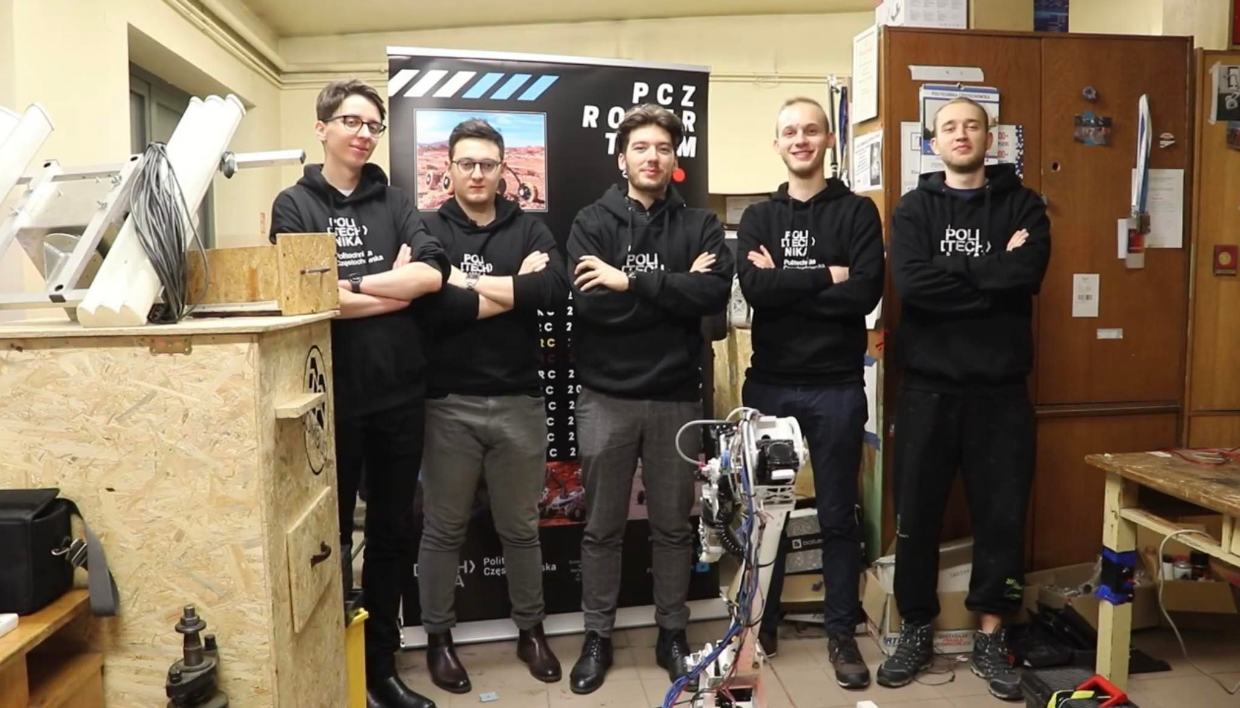
TEAM INFO
Team Photo

Slide 7

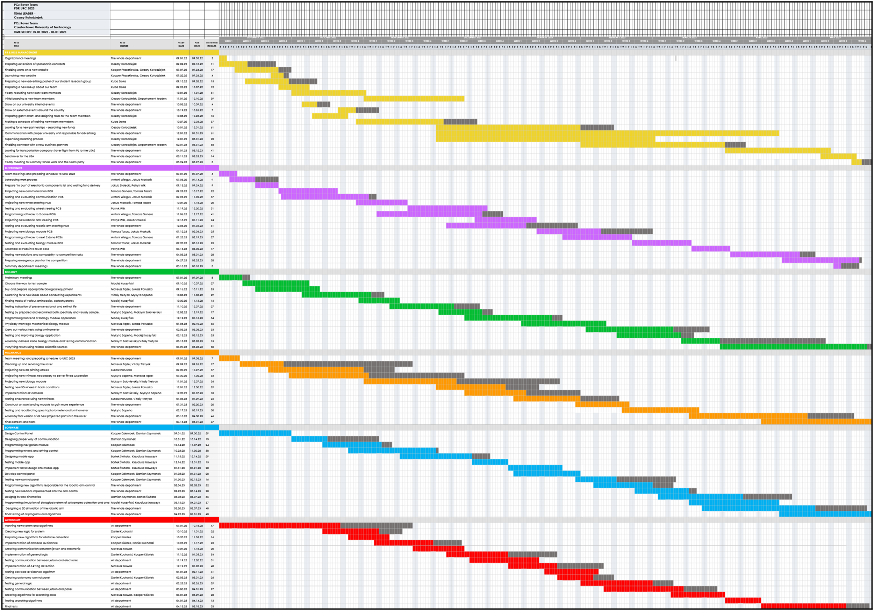
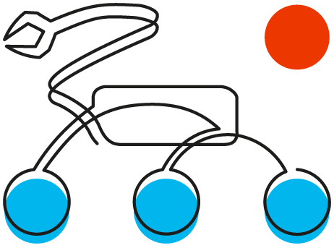
MANAGEMENT
Work Calendar:
Complete Gantt Chart which we have used in URC. Please change scale to 400% and everything should be visible. We decied to put that here because we consider that whole scope of the project with delays (gray colour) really showing complexity of the rover designing project.

Slide 8
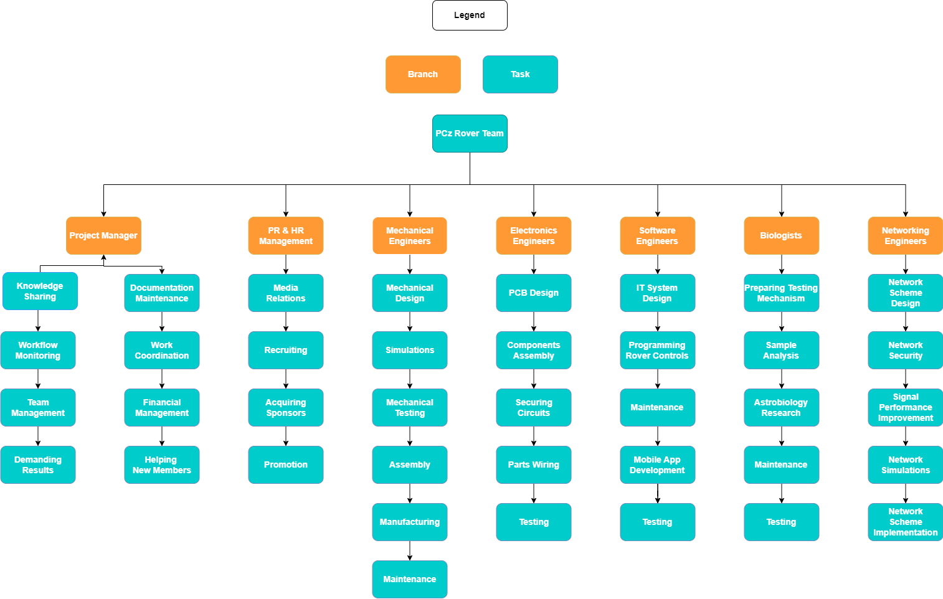
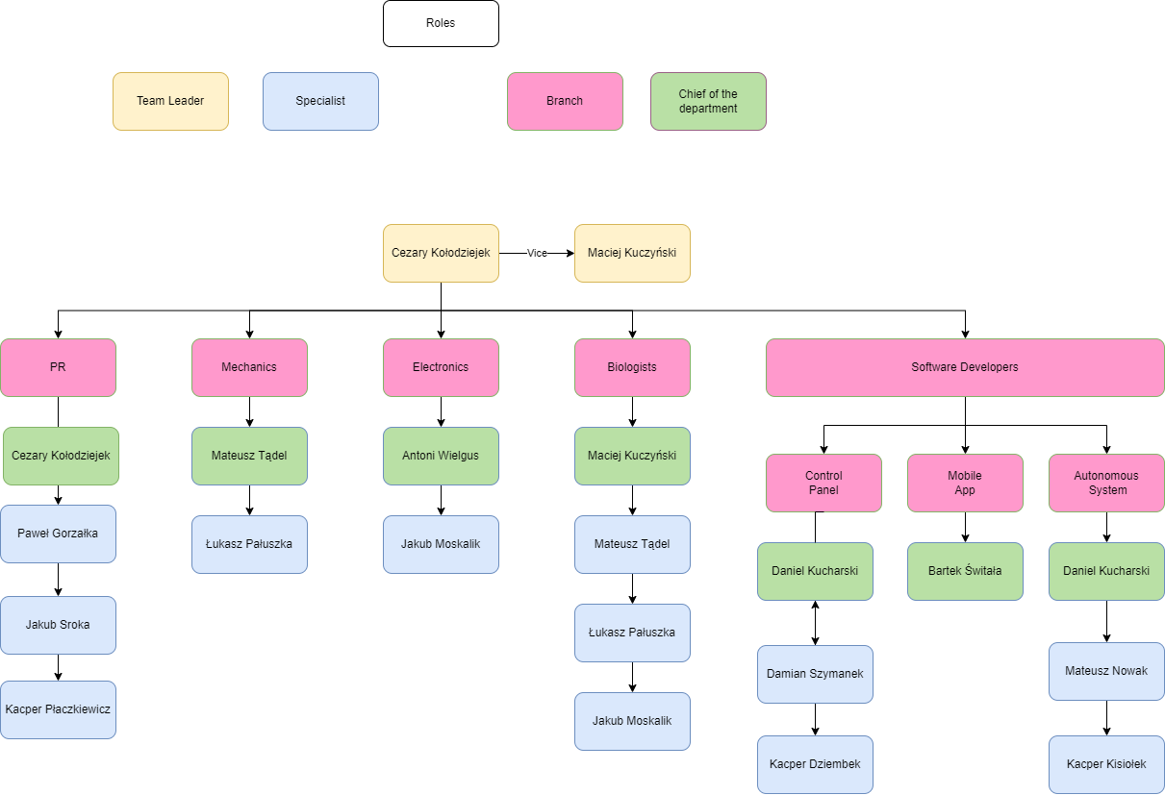
MANAGEMENT
Team Formation:
The team consists of 15 students from the Faculty of Mechanical Engineering and Computer Science, Faculty of Electrical Engineering and Faculty of Management. They have experienced in machine design, electronics, mechanical, project management ,software development, biology
and chemistry.

Slide 9
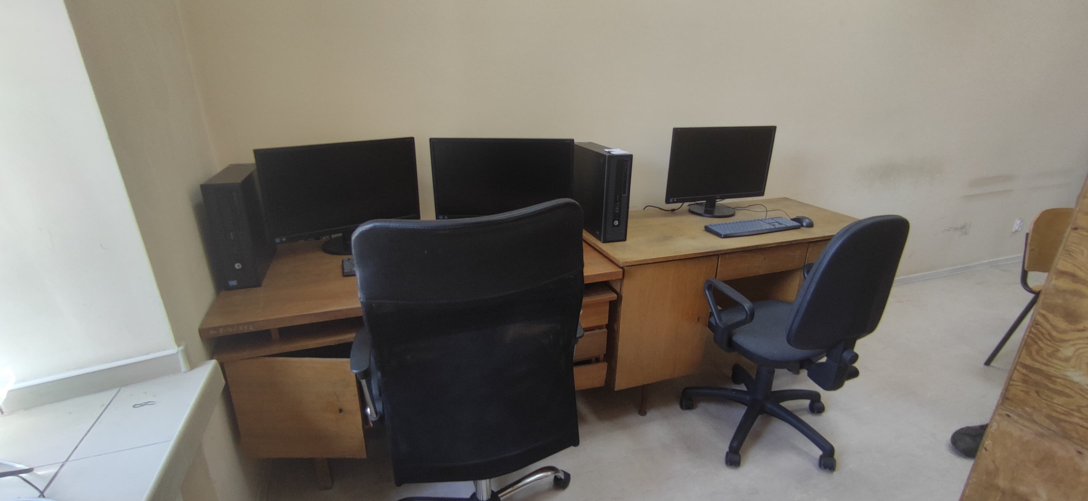
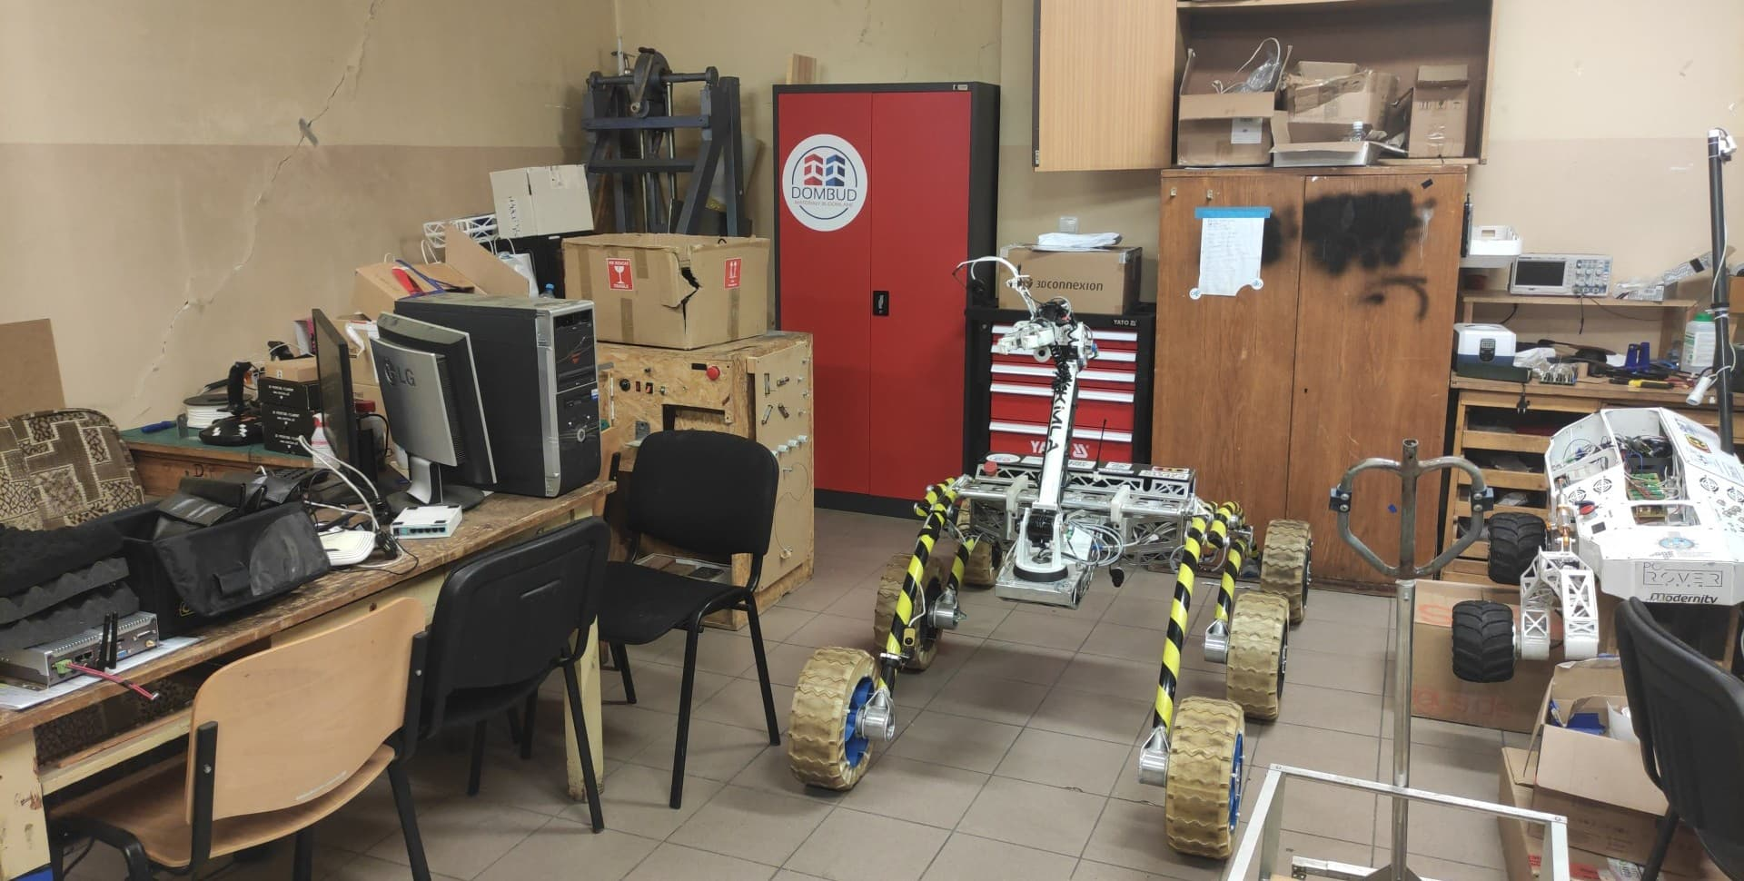
MANAGEMENT
Workplace:
We have 2 general places where we work. The forst is our garage which take place by the Faculty of Mechanical Engineering. In this garage we have plenty of mechanical and electronic tools where we do mentioned jobs. In another place is small office where programmers could work together. We also test the rover outside the garage – University parking.

Slide 10
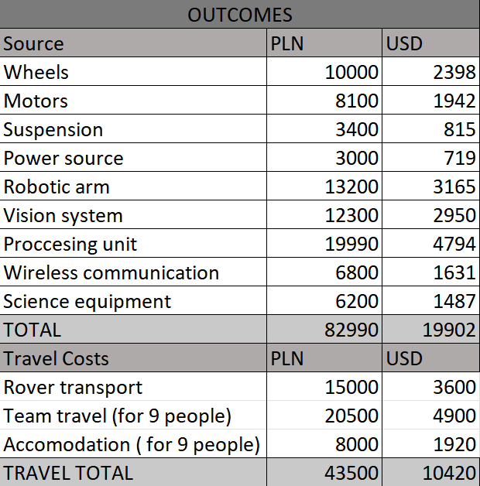
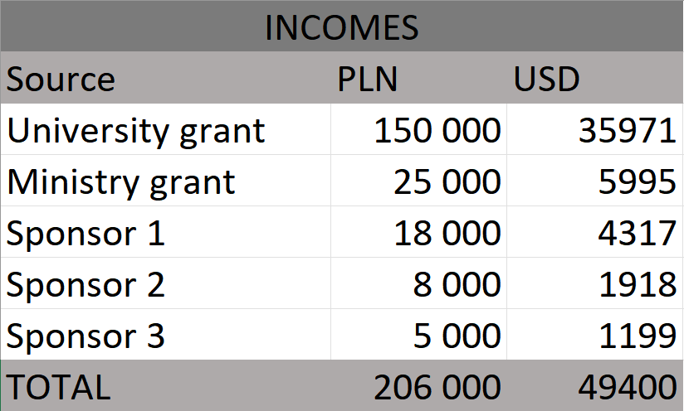
MANAGEMENT
Funding :
Main funds of the team are from the University. All the time we are striving for a new sponsors who are able to support our project and bring us money for travels to competitions. This year we are mainly focused on new wheels, electronic system and 3D vision camera. Development costs this year are focused on improvement of vision system, new 3D printed wheels and new proccessing unit and all of them are expected as 10 420$.
Exchange rate for PLN/USD: 4,17 as for 1st May 2023.

Slide 11
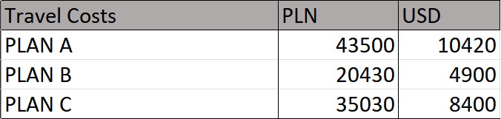
MANAGEMENT
Funding :
Travel is one of the biggest cost. We are sending 200kg box that is filled with all the necessary components like base station or spare parts and of course the rover. We send our rover via international Logistics company and the cost is near to 3600$. Team accomodation is ca. 1920$. The team will flight by the plane and It will cost ca. 4900 USD. We have prepared plan B and plan C to fit the costs to our fundings.
PLAN B: Rent 2 buses for the team and the rover allow us reduce travel cost from ca. 10420$ to 4900$ (including gas oil).
PLAN C: Sending to the competition smaller group of students: 6 instead 9 people.
It allow us reduce travel costs from ca. 10420$ to 4500$

Slide 12
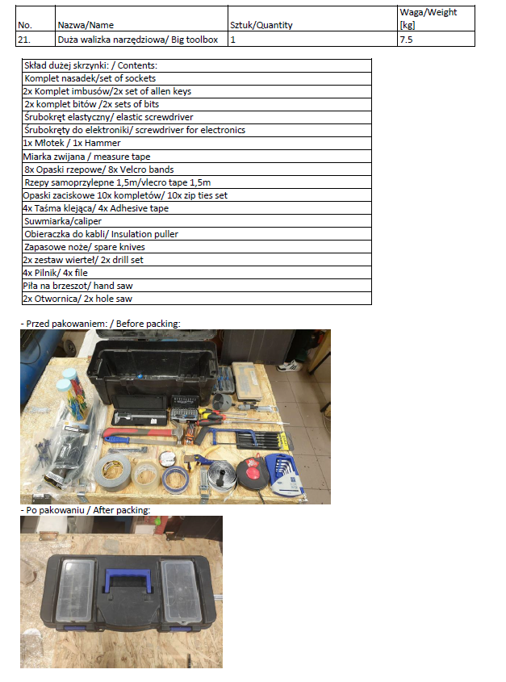
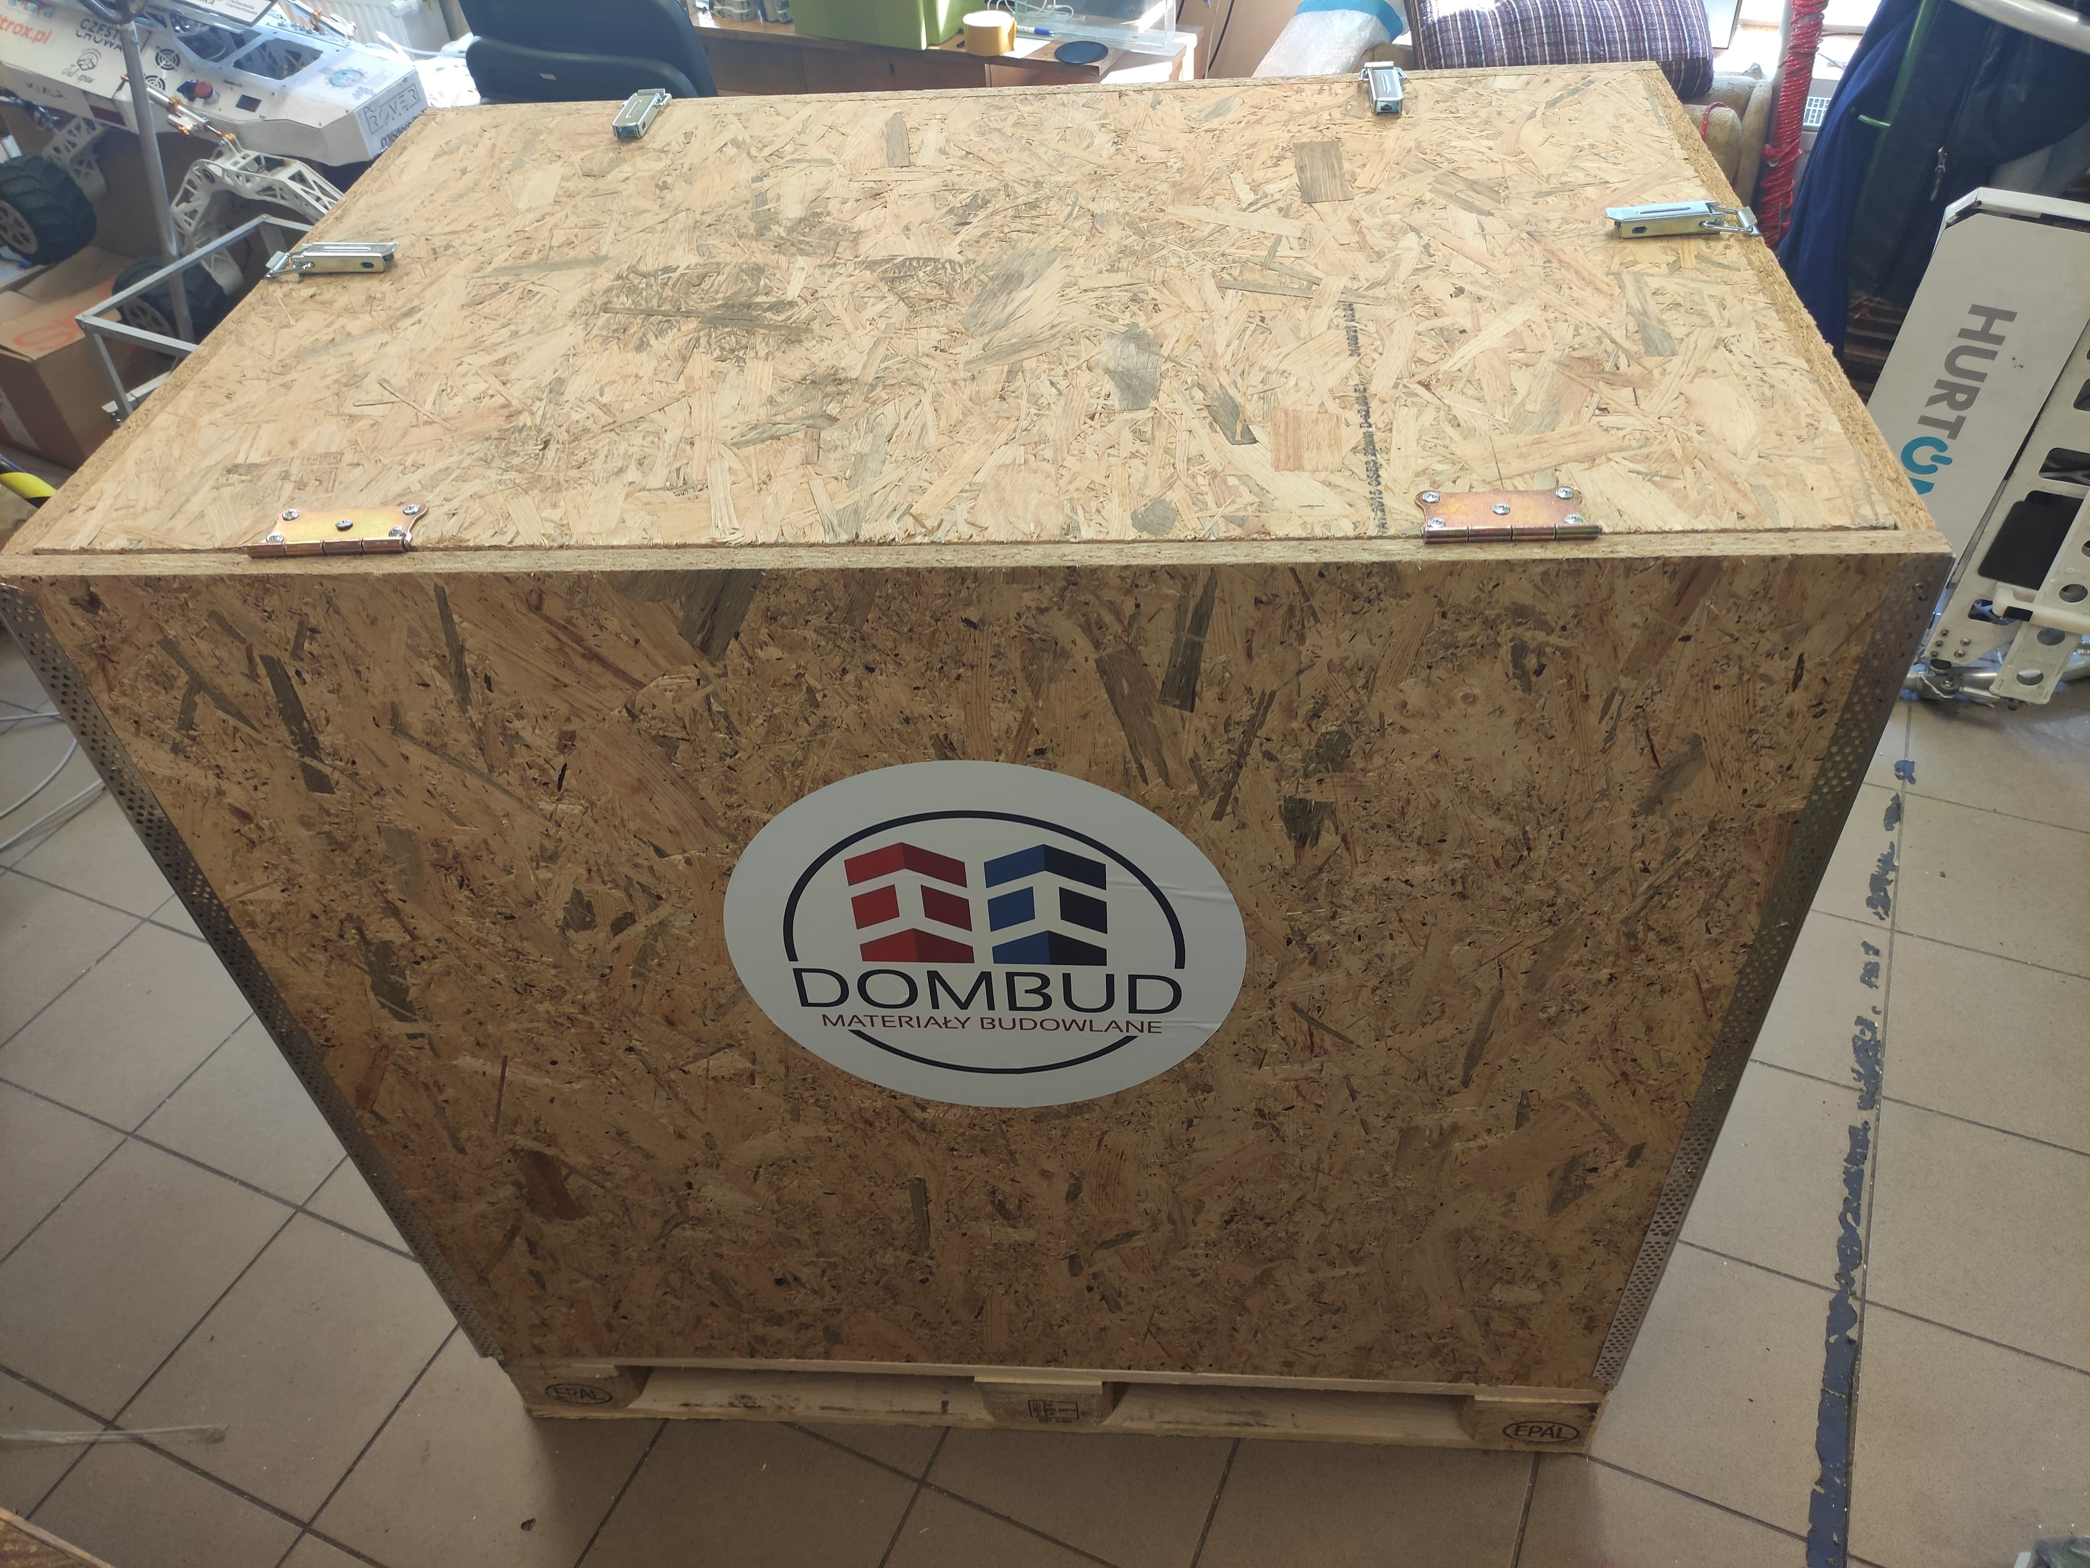
MANAGEMENT
Logistics:
We have special big box which was founded from one of our sponsors. This box will be transported by the cargo plane to the collection point in Anakara. We are going to receive the box and after that assemble all the parts together. Then we are able to come to the competiton with fully equipment.

Slide 13

ROVER DESIGN
Mobility
System:
Our rover’s construction is almost totally made of 3mm thick duralumin alloy, which seems to be a perfect compromise between durability and weight, limited by the ARC regulations. The frame was designed using the CAD 3D environment enabling us to test all its features and ensure that any imperfections, potentially limiting the rover’s abilities, have been eliminated. The frame project undergoes all static and dynamic simulations using the SolidWorks and Inventor environments. After passing the necessary mechanical tests, we hand on the frame model to be manufactured by our subcontractors, who are also often our sponsors.

Slide 14
ROVER DESIGN
Mobility
System:
We have chosen rocker-boogie suspension to prevent unpredictable flips and lack of control over the rover. This year we particularly concentrated on improving the tires and rims. They have been completely redesigned and recreated in order to reduce the weight of a single wheel by 20% without losing performance. This was achieved thanks to composing a new perfect mixture of materials used for 3D printing – ABS and PA12CF15.
Pros: lightweight, lower center of mass, very high level of stability,
Cons: Neccessary high knowledge, expensiveness, medium durability of tires (max. 2 years).

Slide 15
ROVER DESIGN
Mobility
System:
Our rover can be folded, therefore it fits easily into the dimensions of 1.2 m x 1.2 m x 1.2 m. Folding the frame enables us to apply longer rockers and the lowered center of gravity, therefore improving the rover’s stability in difficult terrain. The rover is able to ride even at a 45 degree angle. Moreover, the rover reaches the full dimensions of 1800x1150x1195mm, but thanks to the developed system of quick folding of the rocker arms and antennas mast.

Slide 16
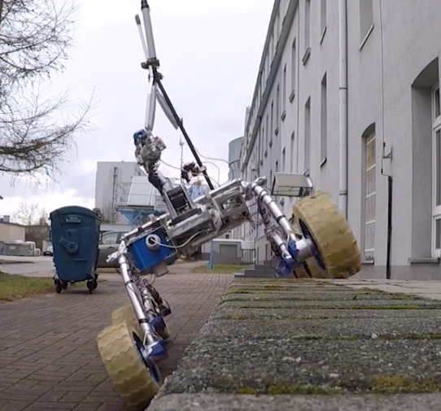
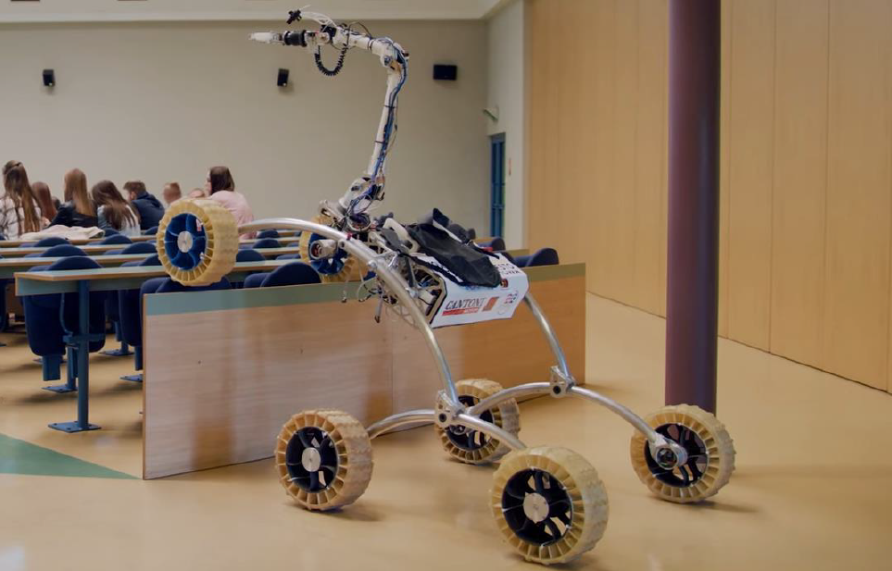
ROVER DESIGN
Mobility System:

Slide 17
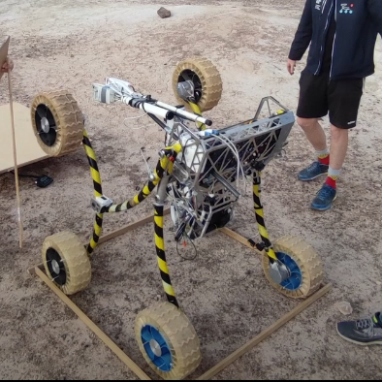
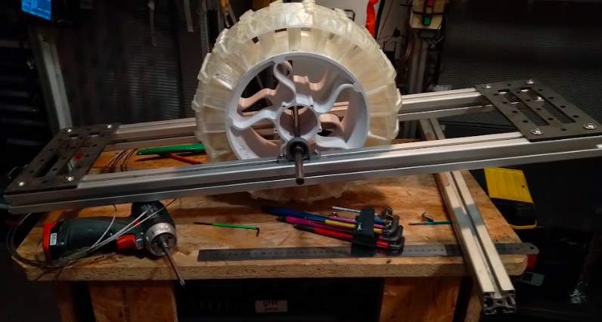
ROVER DESIGN
Mobility System:

Slide 18
ROVER DESIGN
Mobility
System:
Moreover, the rover reaches the full dimensions of 1800x1150x1195mm, but thanks to the developed system of quick folding of the rocker arms and antennas mast. It is possible to achieve the required dimensions of 1200mm x 1200mm x 12000mm box needed to weigh the rover. In the most complex configuration, the rover's weight does not exceed 48.5 kg. Rover drives using 6 independent 14-inch wheels with the ability to rotate at given speed and active blockade, for preventing rolling downhill on steep slopes. Increased stability and a good center of gravity give us high confidence to drive wherever will be needed. Moving through the rocks or driving a steep driveway is not a problem for this construction. Rover can maintain a static position during stopping thanks to PID implementation. Moreover it guarantees more controlled moves for the operator . We reached the maximum speed of roughly 18 km/h. The turning procedure of the rover is constantly based on a well-tested and reliable mechanism of the simultaneous cooperation of left and right semi-axles.

Slide 19
ROVER DESIGN
Electronics and power system:
All actions are commanded by a set of electronic modules with its own STM32 and Rapsberry Pi Pico microcontrolles managing each task. They were connected using the RS-485 interface with a proprietary communication protocol modeled based on the Modbus protocol. It includes a system for reducing interference, detecting transmission problems and automatically resuming communication following an interruption. Electronic parts are really fragile that is why we have to protect them before dust and other interruptions. It is hard to protect them before electronical surges. The boards are also sensitive for interferances so implemented good secure before that is neccesary. From the other hand we have implemented several driving algorithms for fluent direction and speed change. Thanks to the use of encoders on the motors, we are able to give the exact number of revolutions to each wheel, which, together with the appropriate speed calculation system and the PID regulator, ensures excellent grip on various types of terrain, as well as reducing the stress in the structure when turning.

Slide 20
ROVER DESIGN
Electronics and power system:
Rover navigation is based on two independent modules (GPS, Glonass, Galileo), which have a built-in compass and gyroscope. A parallel navigation system reduces the risk of losing the rover's location. The gyroscope provides information about the rover's tilt which is used to protect the rover from potential rollover by software-limiting the maximum acceptable tilt angle. All
microcontroller programs were written using embedded C along with assembler inserts. To maintain the correct torque and speed of the rover, we use brush motors with planetary gears with a ratio of 43: 1 and a power of 150 W each. Thanks to this solution, the rover has a power of 0.9kW, we achieved a torque of 7.6 Nm and a maximum speed of 11mph (18km / h).

Slide 21
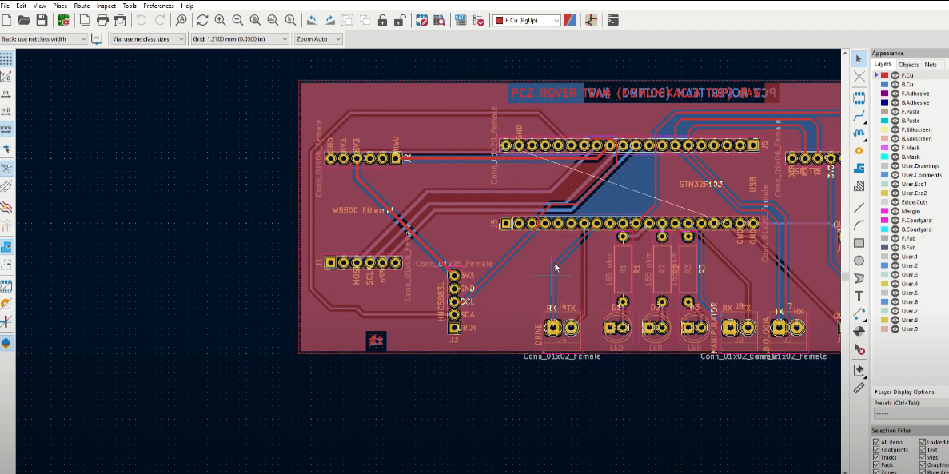
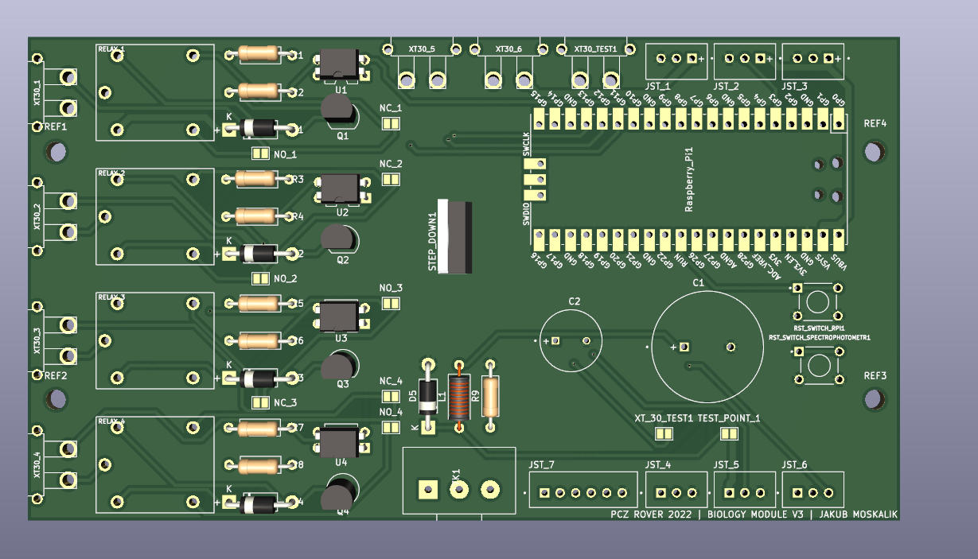
ROVER DESIGN
Electronics and power system:
Projects of new design

Slide 22
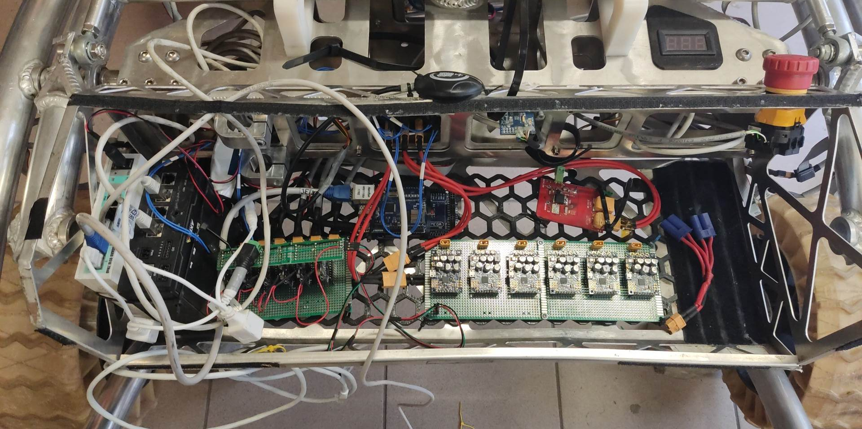
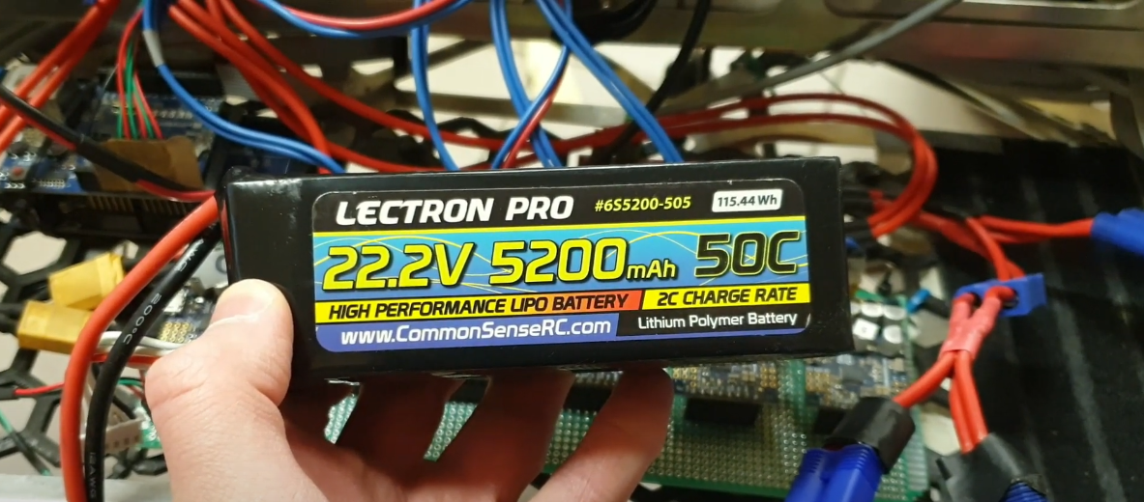
ROVER DESIGN
Electronics and power system:

Slide 23
ROVER DESIGN
Electronics and power system:
Regarding electronics, the power supply is based on 3 battery packs (3 x 5200 mAh). The lithium-polymer batteries used have a nominal voltage of 22.2V 6-Cell and have a very good power-to-weight ratio as well high current efficiency. Summary weight is ca. 1.5kg. To ensure good separation and reduce the risk of interference, we have an implementation of a paralel power supply system. One set of batteries powers the high-current parts, while the other kit feeds the digital logic part along with the main on-board computer. Our rover is equipped with a safety button that disconnects all power and stops the operation of the rover if necessary. We also use it to turn the rover on and off before connecting or after disconnecting the battery.

Slide 24
ROVER DESIGN
Manipulation system:
Our manipulator has 6 degrees of freedom and consists of 3 members. Movement of the members isdone by our duplex worm gears system powered by DC motors. This quite compact design allows us to precisely control with reduced clearances. The torques and speed of the members were chosen to provide a high load capacity of up to 8kg. Each member has additionally its own potentiometer on the axis of rotation, which enables us to create inverse kinematics and visualize the current positions of all members of the manipulator. Our goal is a continous improvement of the robotic arm. We are keeping in mind to take care about it because without the potentiometers which protect the robotic arm before the dangerous position that could cause irreversible failure. The manipulator is equippedwith a triple redundancy system that uses reed switches,potentiometers mounted in the axes of each member and current measurement from the motors. In
the event of a possible failure, we can disable any of the redundancy systems from the base.

Slide 25
ROVER DESIGN
Manipulation system:
Autonomous system running on the NVIDIA jetson Tx2 combined with convolutional neural networks in python based on Tensorflow library. ArUco tags detection and recognition were implemented due to thestereo camera and OpenCV library. Obstacle avoidance were built based on i.a. 2D occupancy gridmap built from depth sensor in 3D camera, CNN in tensorflow and A* algorithm for path planning. If an obstacle is too near to the rover, rover will execute avoiding procedure. Then rover chosing the best free path based on data from environment. Onboard sensors like GPS, IMU and compass are used for planning a straight path to the target GPS point. When rover reaches the area in legs greater than 3 the redesigned algorithm for scouting is starting. While scouting the rover is circle around GPS waypoint and trying to detect ArUco tag. Rover signalize autonomous operation and successful arrival at a post through LED indicator.

Slide 26
ROVER DESIGN
Manipulation system:
We have got our implementation of the FABRIK inverse kinematics system for quick response of the system to operator commands. Our improvement of the inverse kinematics is done by using accelerometers installed on each member. Regardless of the slope of the terrain, we can automatically set the jaw movements horizontally and vertically. This solution greatly simplifies the calculation of inverse kinematics, because the last element can be omitted in calculations

Slide 27
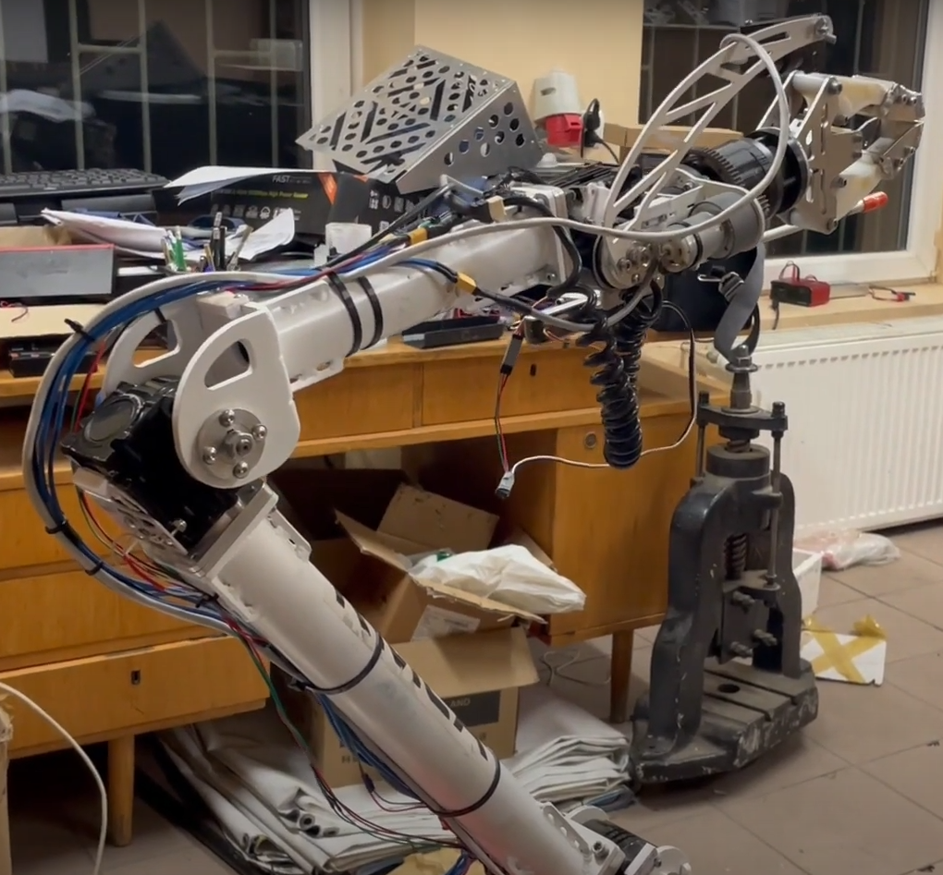
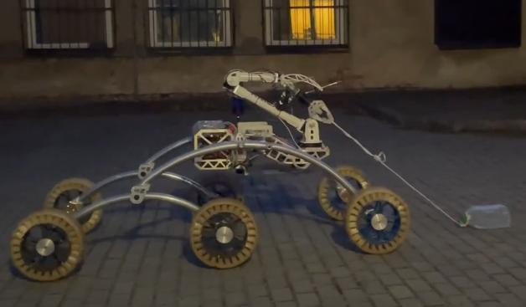
ROVER DESIGN
Manipulation system:

Slide 28
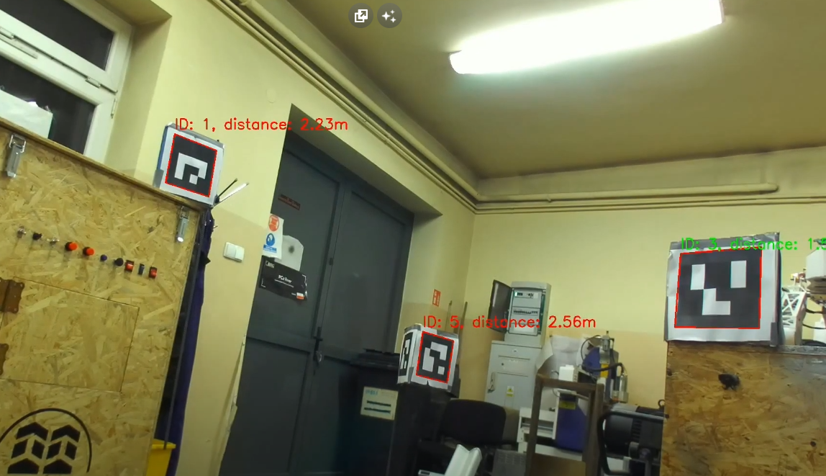
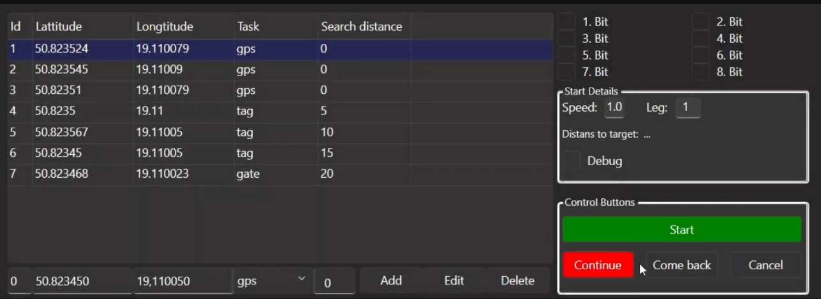
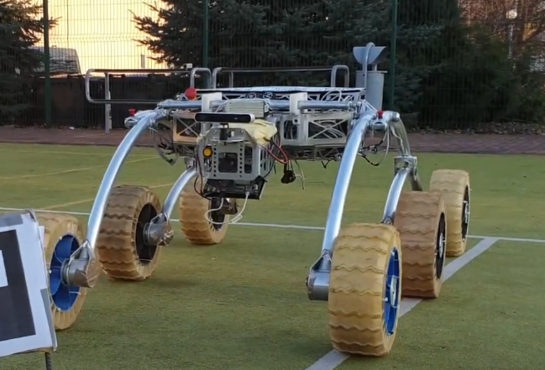
ROVER DESIGN
Manipulation system:

Slide 29
ROVER DESIGN
Manipulation system:
Each manipulator drive has its own current measurement, that allows for monitoring and reductionof the compressive force of the lifting objects. It also protects all drives and members, from collision or damage when in contact with an external object. In addition, the weight of the object being raised
can be determined by characterizing the current draw from the manipulator motors during repeatable movements. The rotation of the manipulator's wrist is realized through a set of gears, which allows an unlimitedrange of movement. Specially designed jaws can pick up objects of different shapes and sizes, including very small objects lying on a hard surface. The motor from the jaw clamp has an encoder which is used to calculate how wide the grippers need to open and indirectly allows us to determine the dimensions of the object being raised.

Slide 30
ROVER DESIGN
Manipulation system:
There are in total 4 ways to steer the rover: using desktop application, joystick, VR and 3d mouse . Of course Rover also can operate in autonomous mode, which also is supported by our Control Panel. The robotic arm is weight 14.5kg. Zed 2 Camera with Jetson Tx2 weight 1.5kg. The Mars Rover Control Panel is a desktop application written in C++ using the Qt 6.4.2 framework and QML for user interface design. The Rover Control Panel is a highly advanced software application that provides sophisticated control over a Mars rover, using a combination of C++, Qt, and QML to create a powerful and user-friendly interface for controlling the rover's movements, arm, and exploration of the Martian landscape.

Slide 31
ROVER DESIGN
Science Payload:
Biology module consists of four modules instead of three. Each one of them was designed using the SolidWorks software. Creating the model this way enabled us to use it for 3D printing, which is, along with necessary mechanical and electronic devices, the basic technique of producing the containers. The soil and rock samples are collected by the rover using the special manipulator claws resembling a digger. The sample is then placed inside one of the containers inside first module. Servomechanisms are used to control flaps opening and closing each container opening, triggered remotely using the computer control panel. The tests of physical and electronical devices, such as the spectrophotometer and luminometer are conducted, so that we are aware of using them safely.

Slide 32
ROVER DESIGN
Science Payload:
The main feature introduced this year is a fourth module – a luminometer. It will be installed outside, in an easily accessible spot onboard the rover. This device, using special swabs, indicates any presence of living matter within several minutes. The swabs will be accessible for the rover manipulator for grabbing and testing the solution. Then, they will be stuck inside the luminometer reader and analyzed. This device serves as our main indicator of living matter.

Slide 33
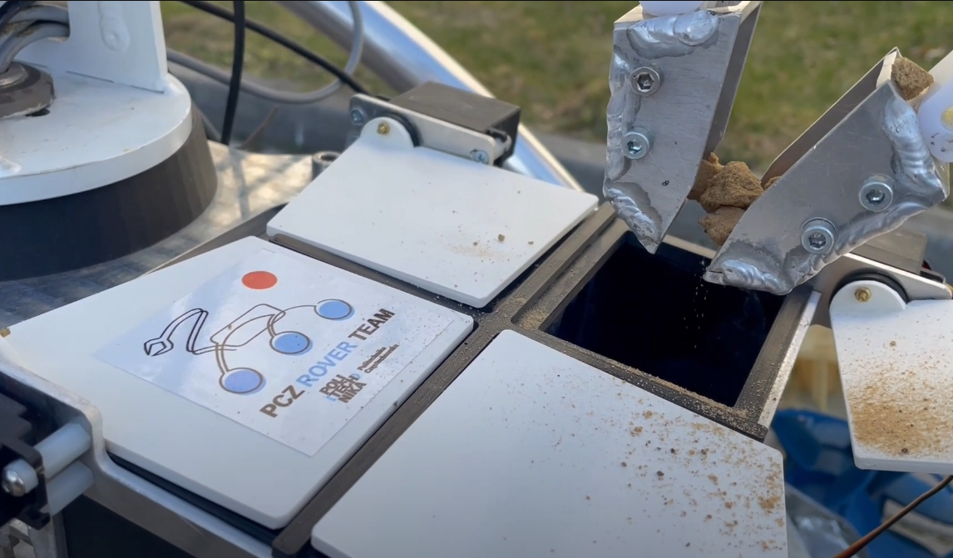
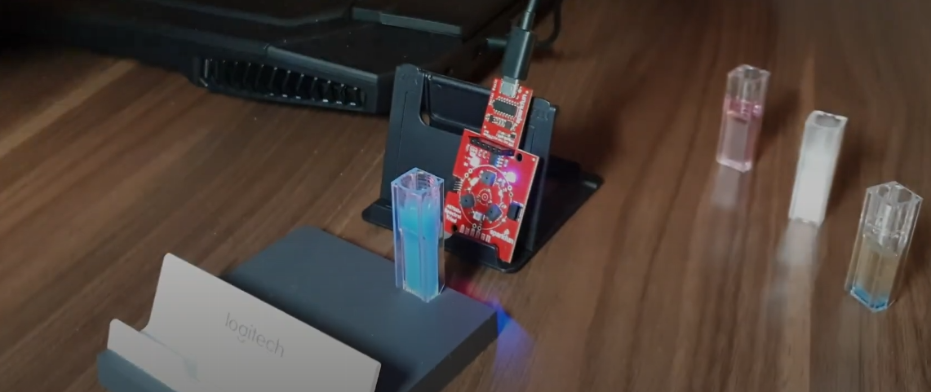
ROVER DESIGN
Science Payload:

Slide 34
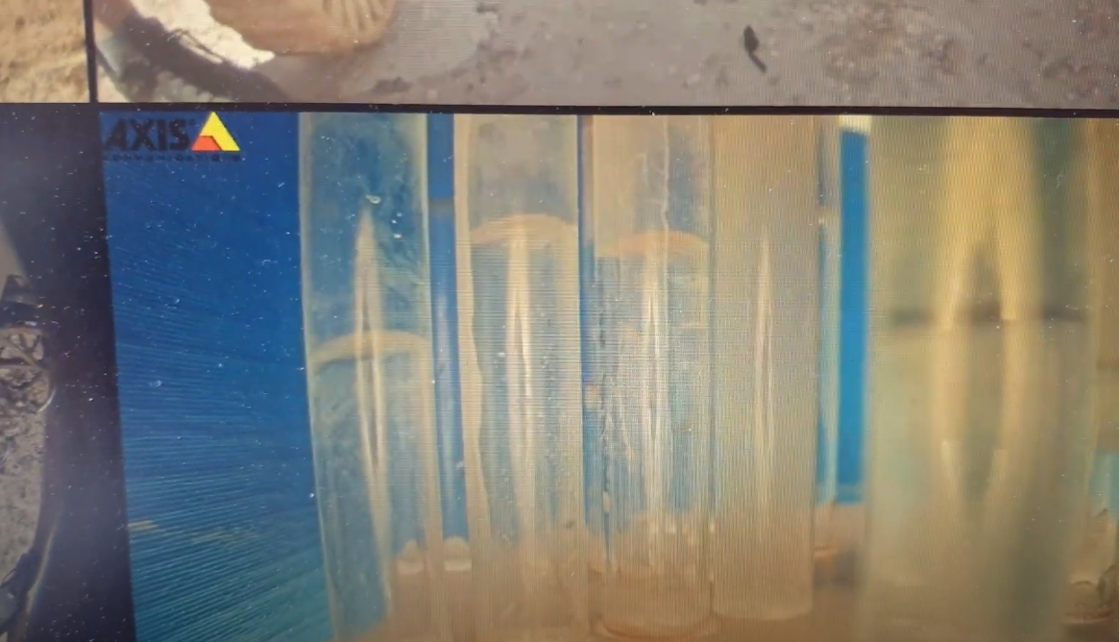
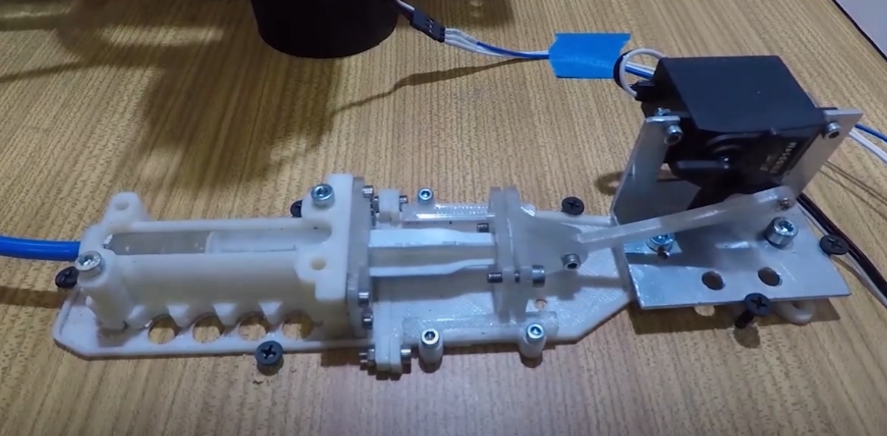
ROVER DESIGN
Science Payload:

Slide 35
ROVER DESIGN
The rotating revolver allows to centre thetubes and spectral cuvettes towards the previously calibrated spectrophotometer (SparkFun AS7265X). Inside the revoler, appropriate lightning conditions are provided with lamps and specific background colours. The signal from the spectrophotometer is received by the team member outside the rover. It allows us to compare and detect changes in the light absorbed by the solution. Each aberration from expected values signalizes changes in the components of the solution – it can, for example, contain proteins or other biomolecules. The colorimetrical analysis. Along with the spectral analysis, the colometricaltestes are conducted in designated test tubes. They will be filled with proper chemical reagentsbefore beginning the mission. Then, the solution will be introduced to them and the reaction will bewatched remotely by the team members using the IP camera installed inside the revolver. Ourplanned reactions do not require heating for safety reasons. Several reactions have been selected by far:Ninhydrin test – ninhydrin will be used to detect ammonia, amines and aminoacids. If detected, the test tube turnes distinctly Purple. We use luminomete: Ensure Hygiena model.
Science Payload:

Slide 36
ROVER DESIGN
Ground station equipment and communication system:
In order to avoid loss of connection with the rover, an intelligent system of guiding the mast towards the moving rover was created. The system is based on azimuth calculations, which are determined by the GPS coordinates of the mast and the rover. This reduces the possibility of losing communication with the rover. Communication between the base and the rover is based on three frequency bands: the main 2.4GHz and 5.8GHz (Rocket M2 and M5) and the additional 433MHz (Lora). Additional band is used in case lost connection for example when the rover is behind the mountain. Lora allow us come back to place where we see image from the cameras. Crucial thing is to secure and check if the cables are properly plug into the ports. High vibrations during overcoming obstacles could cause unplug the plant and in result immediate lose connection.

Slide 37
ROVER DESIGN
Ground station equipment and communication system:
The main frequency bands in the default mode of operation support the exchange of data between the rover's base and the transmission of images from cameras. We have implemented the functions of automatic assignment of the data transmission channel depending on the link quality of each frequency. The rover has two levels of emergency operation. The first stage allows you to control the rover with a limited data transfer bandwidth. The second stage is based on algorithms that lead the rover autonomously into the area communication when communication with the base is completely lost. In the event of a complete loss of major frequency communication, all communication will be diverted to independent emergency communication

Slide 38
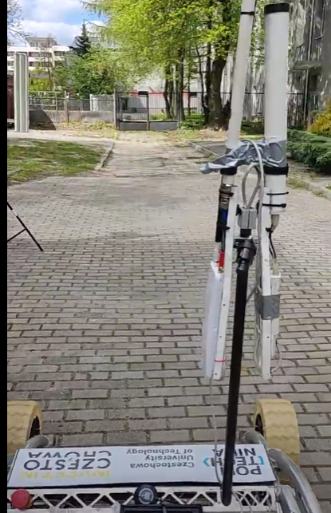
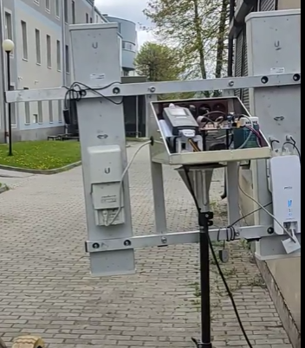
ROVER DESIGN
Ground station equipment and communication system:

Slide 39
ROVER DESIGN
Ground station equipment and communication system:
In the base station we use 3 FHD screens to get a better view form cameras. To control the rover's ride, we use a 2 joysticks, which allows for intuitive tasks execution. Controlling the manipulator with classic controllers is not an ideal solution and requires high precision and responsibility from the operator. To improve work efficiency and reduce the time needed to efficiently control the manipulator, we have created our own controller. Its mobility reflects the movements of the manipulator, which makes its operation intuitive and faster than before. Additionally, it has been equipped with haptic technology, which increases the intuitiveness of the program and improves the overall ergonomics of work. The improved wireless joystick is based on the spatial orientation of the computer and, in combination with inverse kinematics, ensures better use of the manipulator.

