Slide 1
2024
Design Report

Slide 2
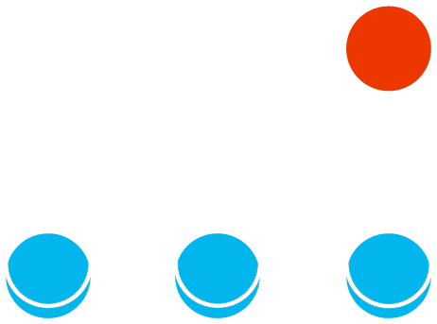
TEAM INFO
Team Name:
PCz Rover Team Rover: Modernity 3+
Name of the team and if applies,
name of the rover.
Contact:
E-MAIL: pczroverteam@gmail.com
FACEBOOK: https://www.facebook.com/pczroverteam
INSTAGRAM: https://www.instagram.com/pczroverteam/
LINKEDIN: https://www.linkedin.com/company/pcz-rover-team
Contact information and
social media links of the team.

Slide 3
TEAM INFO
Academic
Institution:
Czestochowa University of Technology
ul. J. H. Dabrowskiego 69
42-201 Czestochowa
Poland
Name and address of the affiliated academic institution.
Academic
Consultant:
Faculty of Mechanical Engineering and Computer Science
al. Armii Krajowej 21
42-201 Czestochowa
Poland
Academic Consultant:
Dawid Cekus, PhD, DSc, Professor of CzUT
dawid.cekus@pcz.pl
Name, affiliated academic institution and contact information of academic consultant.

Slide 4
TEAM INFO
The team consists of 17 students from two faculties of our University - Faculty of Mechanical Engineering and Computer Science, as well as Faculty of Environmental Engineering. Our team was founded in 2014, joining forces in mechanical design, electronics, project management, software development, biology and artificial intelligence. Throughout 10 years, we have participated in almost all rover’s challenges, including URC and ERC. Our team’s biggest achievement is 1st place in University Rover Challenge 2018 in the USA. Other notable achievements include: 3rd place at URC 2017, 4th place at URC 2019, 4th place at ERC 2015, 6th place at URC 2015, 6th place at ERC 2014, 10th place at URC 2016, 10th place at URC 2014, 11th place at ERC 2016, 11th place at URC 2022, 11th place at URC 2023 (including 3rd place in Science Mission). The team shares many presentations for students and participates in scientific events, gathering science enthusiasts from all around the country. The current rover, Modernity 3+, was first introduced in 2019. It is the 7th vehicle designed by our team. Previous ones are Modernity 2+, Modernity 2, Modernity, Infinity 3, Infinity 2, Infinity 1. This year in autumn, a completely new rover is going to be revealed, along with its own drone aircraft.
History of
the Team:
A paragraph of teams history including foundation date, attended competitions and experience.

Slide 5
TEAM INFO
Dominika Augustajtys | Biochemical Engineering, Bachelor Studies, Year 2 | Science Team
Edyta Kądzielawa, BSc | Biochemical Engineering, Master Studies, Year 5 | Science Team
Daria Sławczyk, BSc | Biochemical Engineering, Master Studies, Year 5 | Science Team
Maciej Kuczyński, BSc | Computer Science, Master Studies, Year 4 | Team Leader, HR, PR, Marketing, Science Team
Dmytro Bukovskyi | Mechanical Engineering, Bachelor Studies, Year 2 | Mechanical Engineering, Electronic Engineering
Mykyta Kyrychenko | Mechanical Engineering, Bachelor Studies, Year 2 | Electronic Engineering
Michał Pindych | Automatics and Robotics, Bachelor Studies, Year 1 | Electronic Engineering
Marcin Bocheński | Mechanical Engineering, Bachelor Studies, Year 1 | Mechanical Engineering
Mikołaj Kaźmierczak | Mechanical Engineering, Bachelor Studies, Year 2 | Mechanical Engineering
Stanislav Polekha | Mechanical Engineering, Bachelor Studies, Year 2 | Mechanical Engineering
Oliwia Pierzgalska | Law, Master Studies, Year 2 | PR, Marketing
Kacper Gutkowski | Computer Science, Bachelor Studies, Year 1 | Programming
Kacper Kisiołek | Computer Science, Bachelor Studies, Year 2 | Programming, Autonomous Drive
Mateusz Nowak | Computer Science, Bachelor Studies, Year 1 | Programming, Autonomous Drive
Mateusz Mitura | Computer Science, Bachelor Studies, Year 1 | Programming
Jakub Moskalik | Computer Science, Bachelor Studies, Year 2 | Programming, Electronic Engineering
Active
Members List:
A table of active members including following information: Name, University Major*, and duty in the team.
* University majors should be written without abbreviations.

Slide 6
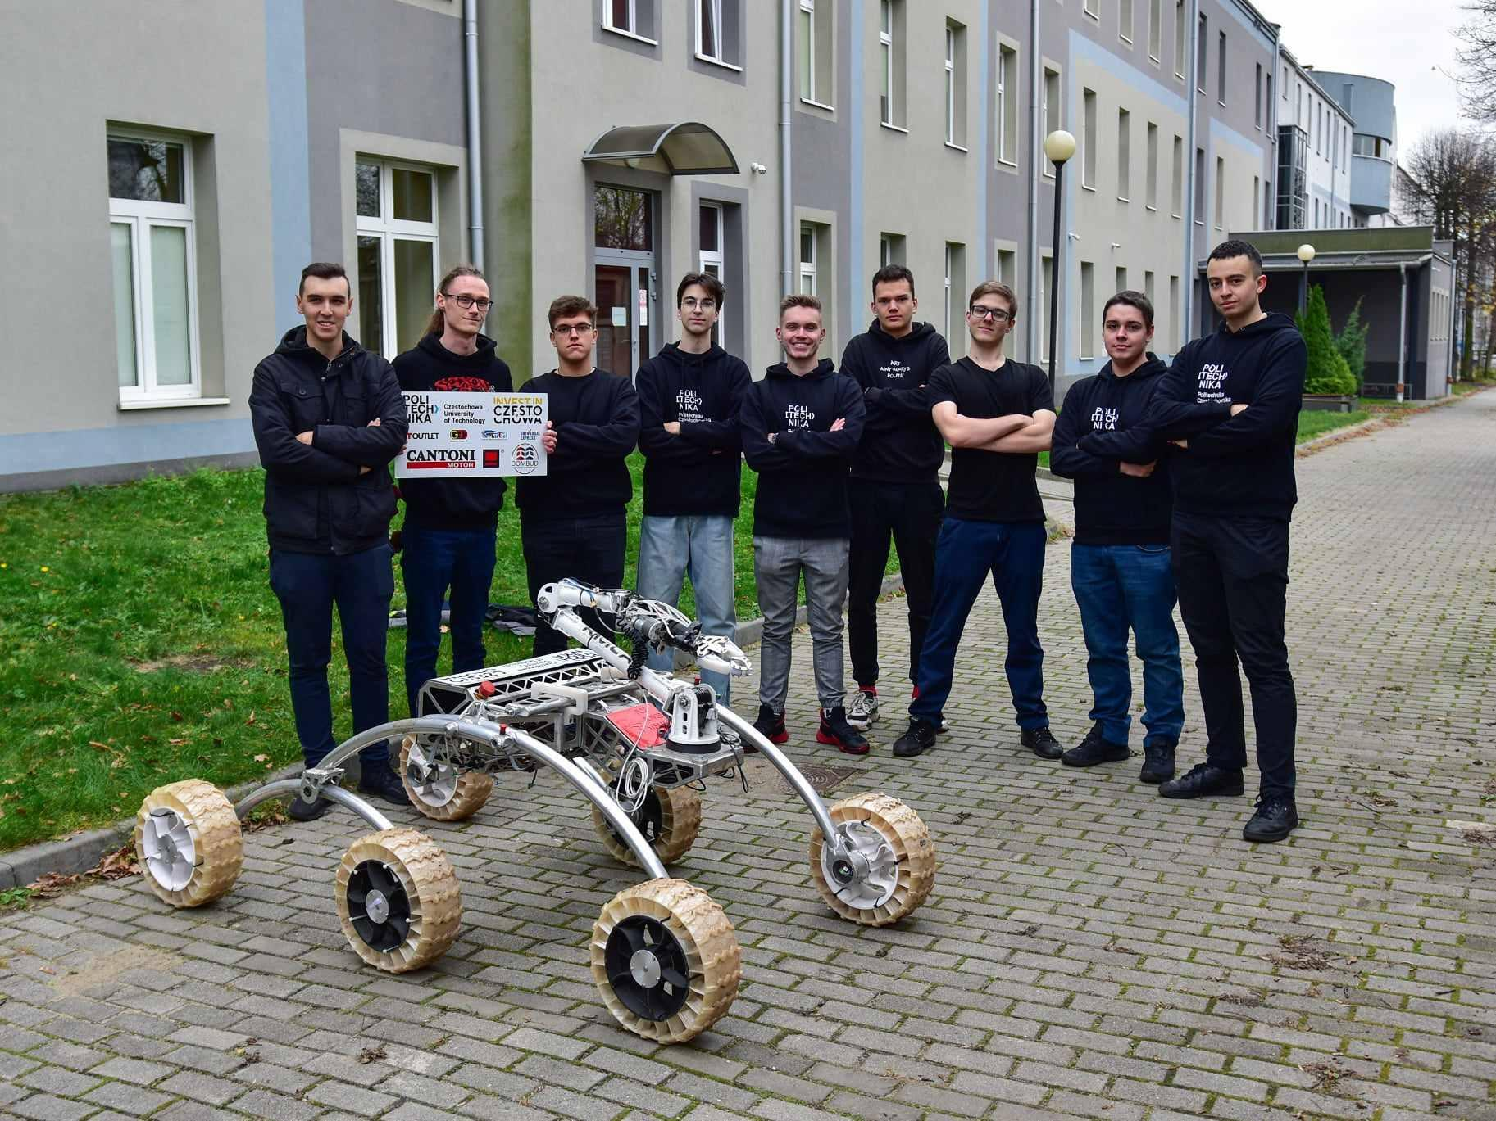
TEAM INFO
Team Photo
A photo/screenshot of the whole or part of the team.

Slide 7
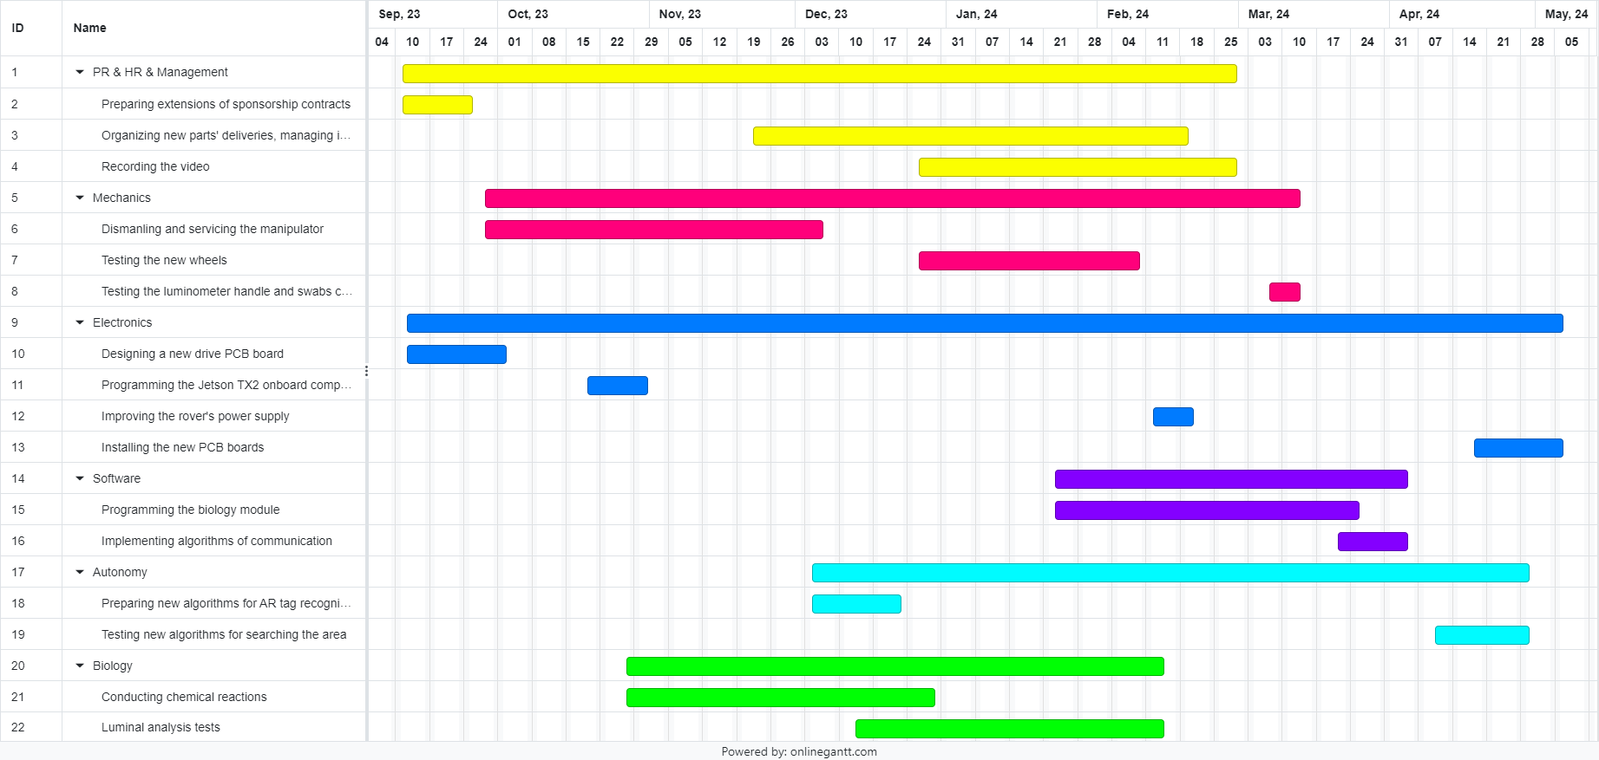
MANAGEMENT
Work
Calendar:
The project work is divided into six sectors representing each subteam. Below only an example selection of tasks is demonstrated.
Explain the work on the project by a Gantt chart. Include 10-15 items in the Gantt chart.

Slide 8
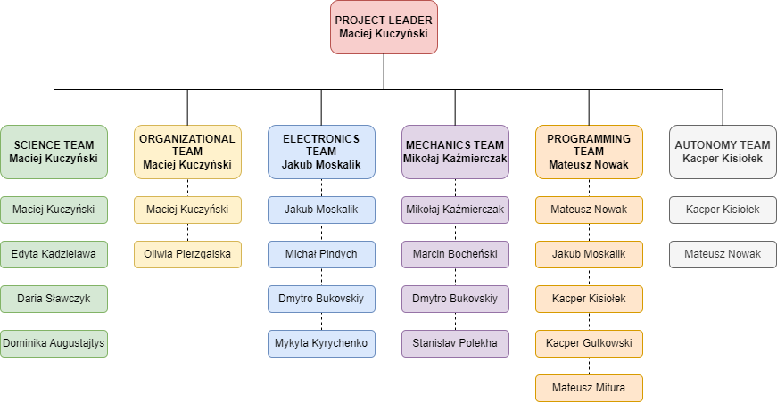
MANAGEMENT
Team
Formation:
The team is structured into six core teams, responsible for: science, electronics, mechanics, programming, autonomy and work organisation. Each team has its own leader, while one team member can belong to more than one section. The chart below presents the team organisational breakdown.
How is the team workforce structured? (2-3 sentences) Include a graphic to explain the structure as well.

Slide 9
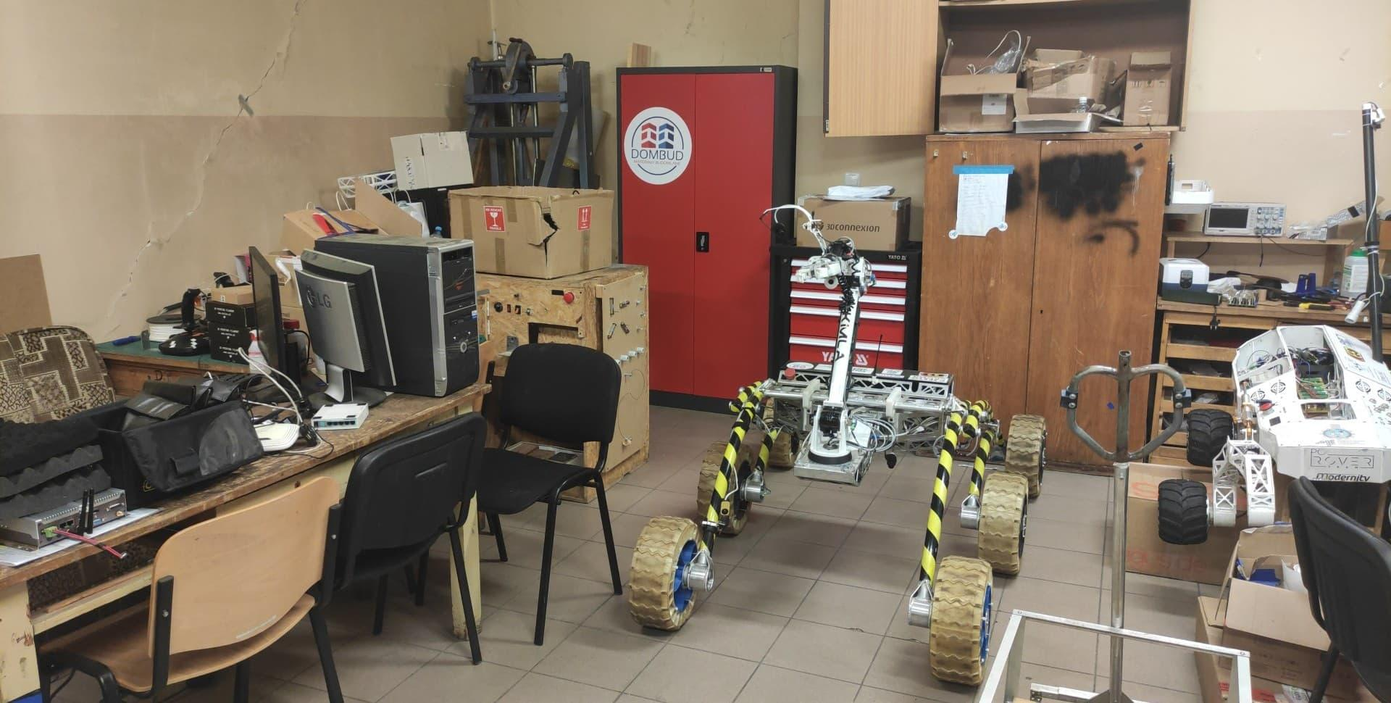
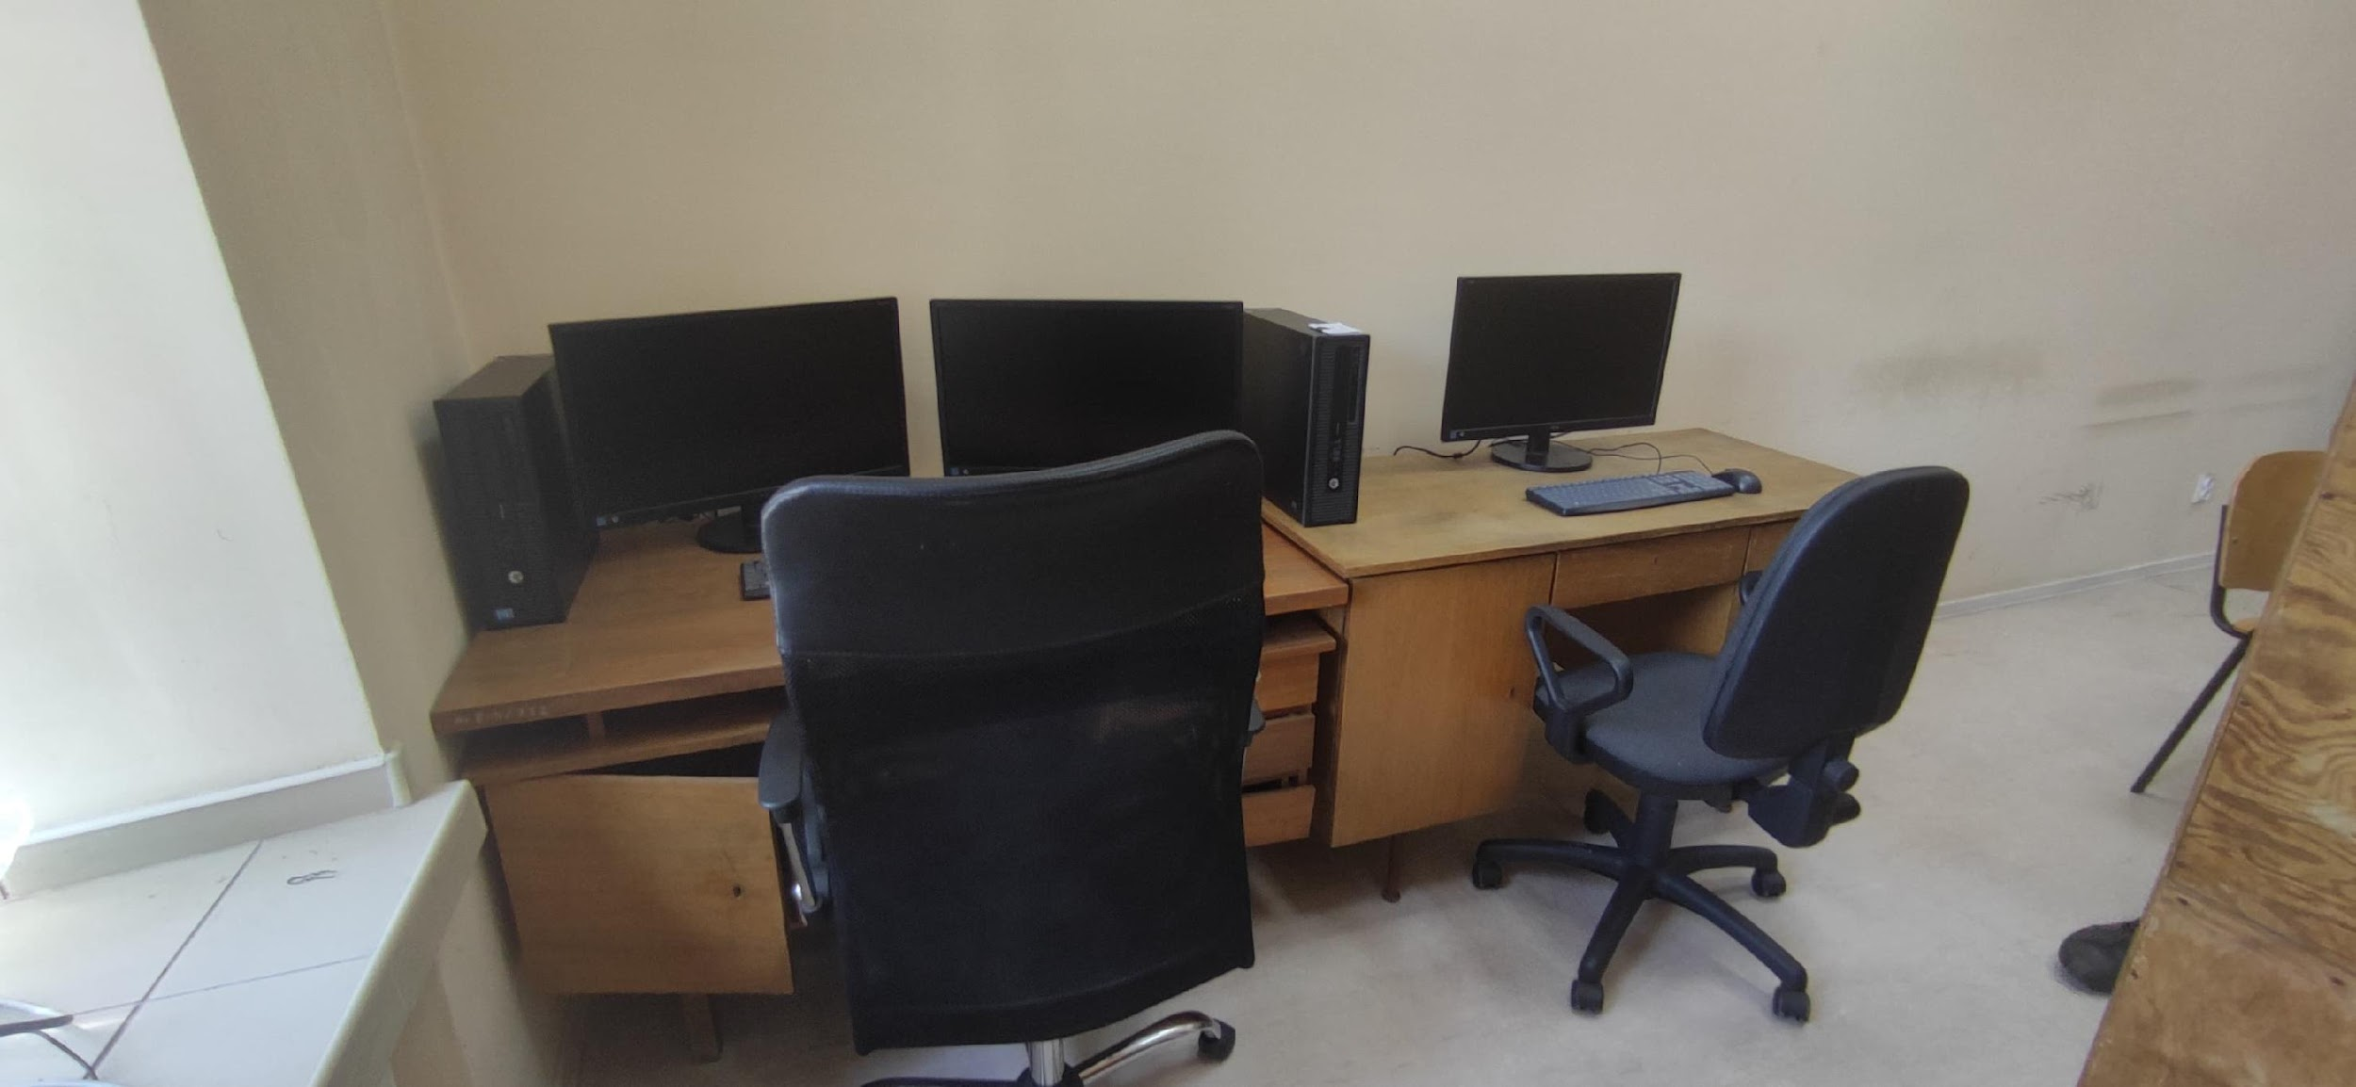
MANAGEMENT
Workplace:
The team has access to two rooms that serve as a workshop and a computer laboratory. The first one contains all necessary mechanical and electronic equipment, such as CNCs and soldering stations, while the other one is a software developments center, also capable of holding team meetings. The rover is also tested outside in the parking area, where we have access to different surface and terrain conditions, such as grass, sand, concrete and inclinations.
How the team design, build and test the rover physically? Explain the workplace. (2-4 sentences) Include a photo/screenshot of the workplace.

Slide 10
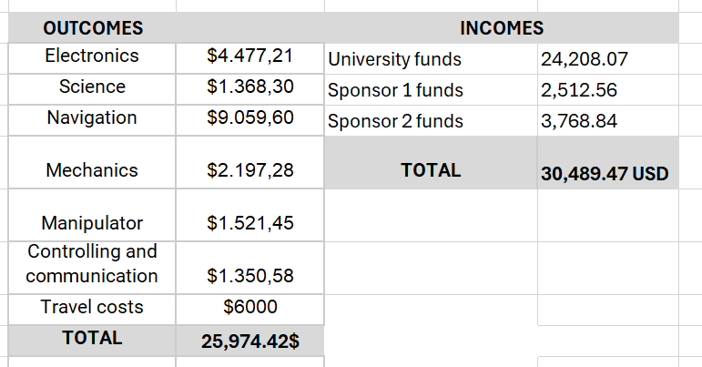
MANAGEMENT
The current funds of the team are presented in the tables below (as of May 1, 2024. 1 USD = 3.9 PLN). As we see, most of our expenses go for constructing the rover (the data provided match the financial report), as well as the estimated cost of travel to Turkey. On the other hand, we are supported financially by our university and private sponsors.
Funding :
Present the funds of the project at the time of submission of this document? (In dollar currency)

Slide 11
MANAGEMENT
Funding :
The rover development costs almost 20,000 USD. For travelling to Turkey, we have reserved 6,000 USD. This sum should cover the cost of driving to Turkey with a van - carrying a rover and 4 team members. The total duration of the stay is 10-12 days, depending on the funds. This is the first way of cutting the funds in case they are insufficient. The other way is to cut the number of participants - 4 may be enough. If our funds are sufficient, we can send other members (up to 3) by plane. The tickets from Warsaw to Istanbul cost ca. 300 USD. For accommodation, we need ca. 40 USD per person per night.
How much spending is expected for the development costs? How much spending is expected for the travel costs?
What is the team's plan in an insufficient funding situation by the competition date?

Slide 12
MANAGEMENT
Logistics:
The rover will be transported by our university van with a driver who is also the assistant supervisor. We will drive from Poland to Turkey via Slovakia, Hungary, Serbia and Bulgaria. Thanks to the fact that we do not have to come from another continent, we can save a lot of funds and effort compared to the air cargo. The van is large enough to accommodate the rover with all necessary mechanical appliances and tools, as well as 5 persons (the driver + four team members). In case we decide to bring more participants, they will come to Turkey separately with a plane.
What is the team's plan to package and bring the rover to competition site by July? (4-6 sentences)

Slide 13
ROVER DESIGN
Mobility
System:
Our rover is constructed mostly of 3 mm duralumin alloy and it seems that it is a perfect compromise between durability and weight. We focused on maximizing rover mobility performance by creating bigger frame, that should fit into 1,2 x 1,2 x 1,2 m cage. This was achieved by using the folding mechanism. By using CAD 3D software we eliminated any potential weak points of the construction. After necessary design process, we commissioned the project to the subcontractors, who are also often our sponsors.
What is used? Describe the system
(3-5 sentences)
Why the system is chosen? What are the considerations? What are weaknesses and strengths?
(3-5 sentences)

Slide 14
ROVER DESIGN
Mobility
System:
We have chosen classic rocker-boogie design that allows for creating lower center of mass without losing ground clearance. Another interesting fact about the frame is that all the cables are hidden and protected from external factors inside frame tubes. Tires and rims have been created of mixture of filaments ABS and Pa12CF15 to achieve 20% lower mass.
Pros: lightweight, high level of stability, high durability
Cons: complicated manufacturing process, limited durability of the tires (max. 2 years).
Unique points and inspirations
(3-5 sentences)

Slide 15
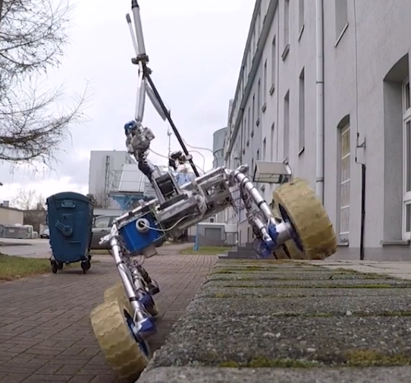
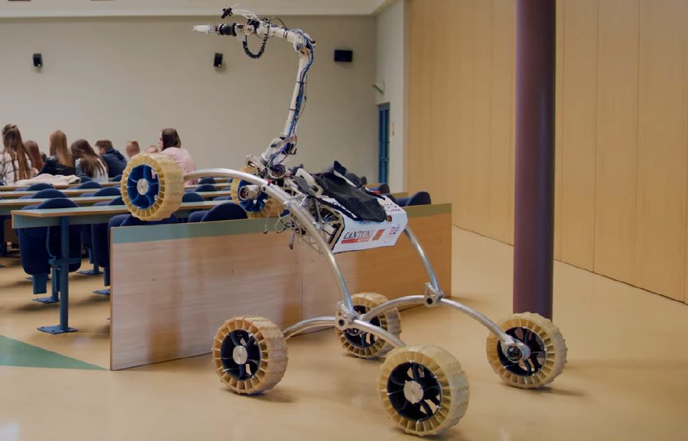
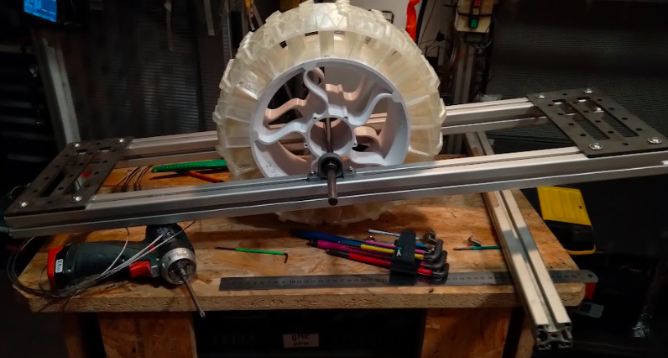
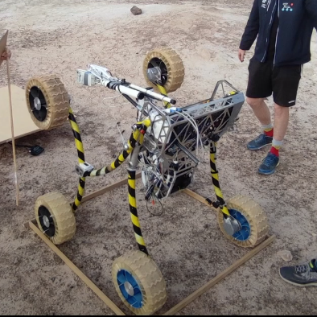
ROVER DESIGN
Mobility
System:
Visuals of the system
(2 photos/screenshots)

Slide 16
ROVER DESIGN
Mobility
System:
Rover can be folded and therefore into 1,2 x 1,2 x 1,2 m. Folding the frames enables us to apply longer rockers and lower center of gravity which allows for overcoming big obstacles without the risk of tipping over and potentially damaging expensive equipment. The rover is able to ride even at a 45 degree angle. Moreover, the rover reaches the full dimensions of 1800x1150x1195mm with possibility of using bigger wheels and folding antennas mast.
Technical Specifications including mass and size (3-5 sentences)
Discuss the system's adequacy for its role in competition missions. (3-5 sentences)

Slide 17
ROVER DESIGN
Electronics and power system:
All actions are commanded by a nVidia Jetson onboard computer. It includes a system for reducing interference, detecting transmission problems and automatically resuming communication following an interruption. Electronic parts are really fragile, that is why we have to protect them from dust and other interruptions. It is hard to protect them from electrical surges. The board is also sensitive for interferences so implemented good protection methods. On the other hand we have implemented several driving algorithms for fluent direction and speed change. Thanks to the use of encoders on the motors, we are able to give the exact number of revolutions to each wheel, which, together with the appropriate speed calculation system and the PID regulator, ensures the excellent grip on various types of terrain, as well as reducing the stress in the structure when turning.
What is used? Describe the system
(3-5 sentences)
Why the system is chosen? What are the considerations? What are weaknesses and strengths?
(3-5 sentences)

Slide 18
ROVER DESIGN
Electronics and power system:
The rover navigation relies on a dual-module approach, integrating GPS, Glonass, and Galileo for robust positioning. Each module incorporates a compass and gyroscope, ensuring independent functionality. This parallel navigation setup minimizes the likelihood of losing the rover's precise location.The gyroscope plays a pivotal role by furnishing real-time data on the rover's tilt, enabling software to preemptively restrict tilt angles and avert potential rollovers.All microcontroller programs were meticulously crafted in embedded C, supplemented by assembler inserts, ensuring optimized performance and reliability. For maintaining optimal torque and speed, the rover is equipped with brush motors featuring planetary gears boasting a 43:1 ratio. Each motor, with a power output of 150 W, contributes to the rover's overall power of 0.9 kW. This setup yields an impressive torque of 7.6 Nm and facilitates a top speed of 11 mph (18 km/h), ensuring efficient traversal across varied terrains.
Unique points and inspirations
(3-5 sentences)

Slide 19
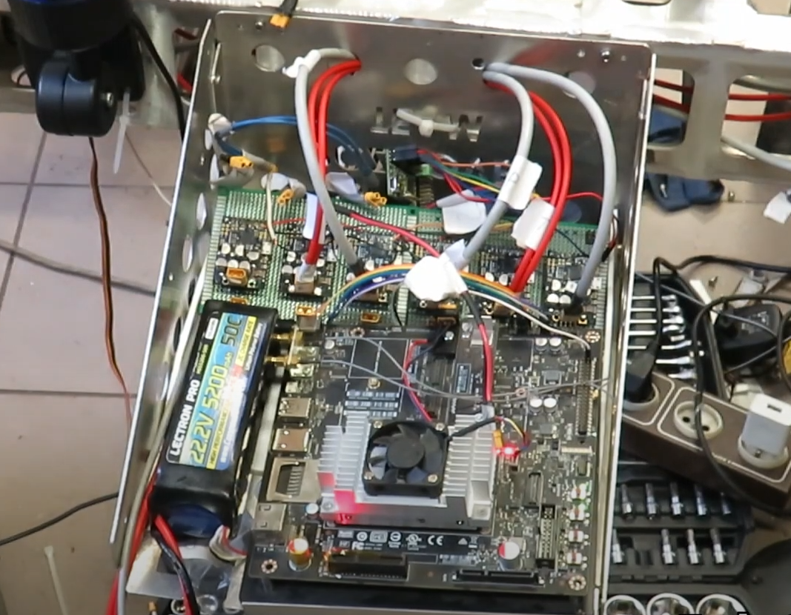
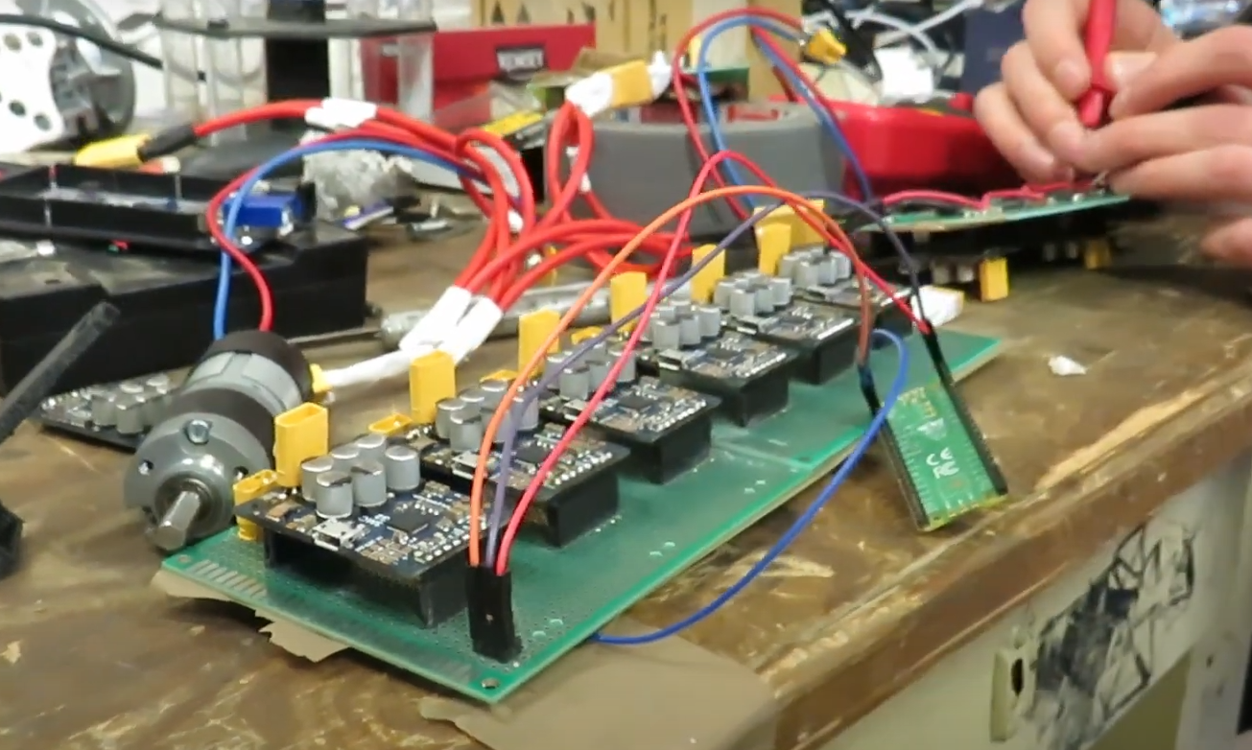
ROVER DESIGN
Electronics and power system:
Visuals of the system
(2 photos/screenshots)

Slide 20
ROVER DESIGN
Electronics and power system:
In terms of electronics, our power system relies on three battery packs, each with a capacity of 5200 mAh. These lithium-polymer batteries are designed with a nominal voltage of 22.2V (6-Cell), offering an impressive power-to-weight ratio and high current efficiency. With a combined weight of approximately 1.5kg, they provide robust energy for our rover. To ensure optimal performance and minimize interference, we've implemented a parallel power supply setup. One set of batteries is dedicated to powering the high-current components, while the other set drives the digital logic circuitry and the main onboard computer. For safety purposes, our rover features a dedicated safety button. This button serves two crucial functions: first, it acts as an emergency shutdown mechanism, instantly disconnecting all power and halting rover operations when necessary. Second, it serves as a power control, allowing us to safely switch the rover on and off before and after battery connections.
Technical Specifications including mass and battery duration (3-5 sentences)
Discuss the system's adequacy for its role in competition missions. (3-5 sentences)

Slide 21
ROVER DESIGN
Manipulation system:
Each motor has its own power draw reed allowing us to monitor force exerted on lifted objects, also protecting transmissions and engines from damage caused by collisions or other factors. Monitoring power draw allows us to determine weight of the lifted object. Rotation of the manipulator wrist is made possible by a set of conventional gears allowing unlimited rotation. We’ve designed a few sets of jaws allowing us to fulfill a wide range of tasks from lifting small parts from flat hard surfaces to digging for samples. Encoder mounted on the jaws drive allows to estimate the dimensions of the lifted object.
What is used? Describe the system
(3-5 sentences)
Why the system is chosen? What are the considerations? What are weaknesses and strengths?
(3-5 sentences)

Slide 22
ROVER DESIGN
Manipulation system:
We’re still using our implementation of the FABRIK inverse kinematics system because we couldn't find a more responsive system for operating the manipulator. Our focus was directed to improving implementation of the accelerometers on each member. We gained more precision when setting the jaw movements in each axis.
Unique points and inspirations
(3-5 sentences)

Slide 23
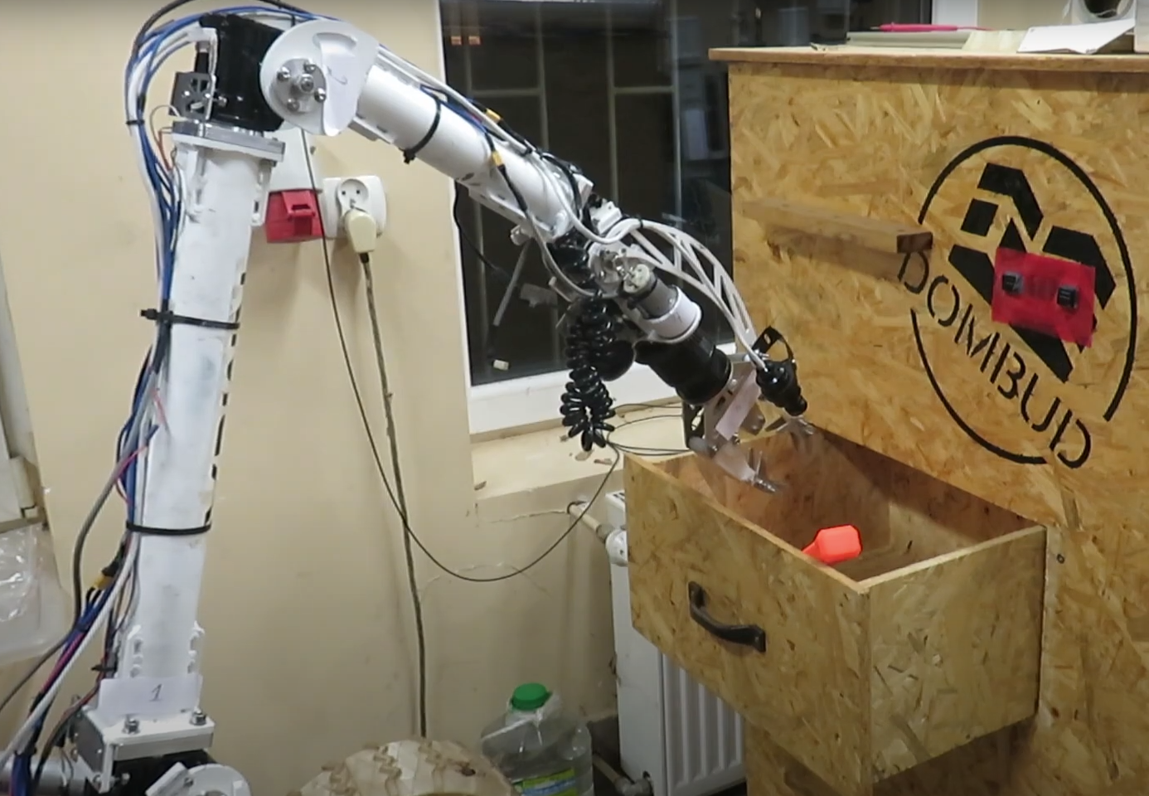
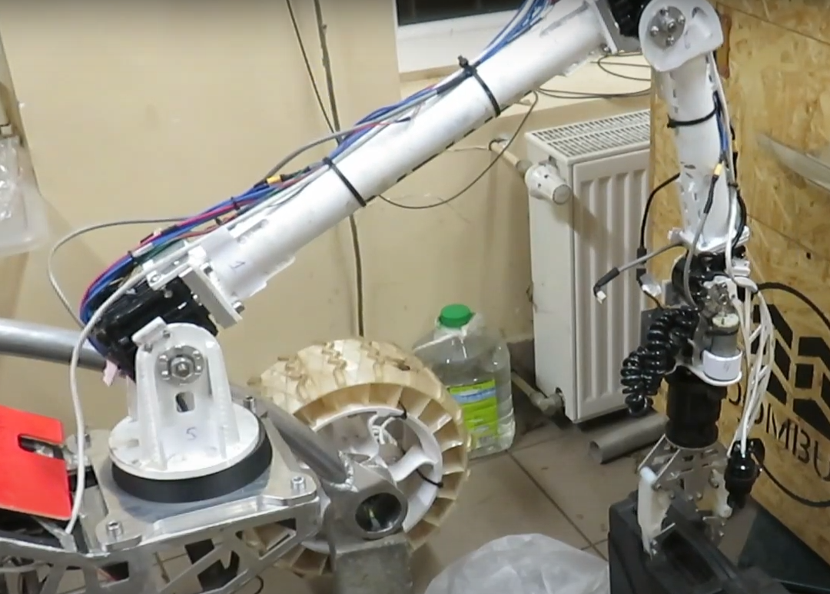
ROVER DESIGN
Manipulation system:
Visuals of the system
(2 photos/screenshots)

Slide 24
ROVER DESIGN
Manipulation system:
Manipulator consists of 3 parts and makes use of 6 degrees of freedom. Movement is achieved by utilizing worm gear transmission and Maxon DC motors with additional planetary transmissions. Despite its size our manipulator can lift and carry up to 8 kg of load. Each axis of rotation has an potentiometer which allows us to reed current positions and allows to create inverse kinematic with visualization. Our design is all the time corrected and improved with each failure and challenge we encounter. We’re also using potentiometers to protect manipulator from dangerous positions which can lead to failure or premature wear which is backed by 2 other redundant systems like magnetic endstops and constant monitoring of the power draw from engines. Each of the mentioned systems can be disabled from base.
Technical Specifications including mass, max payload and size
(3-5 sentences)
Discuss the system's adequacy for its role in competition missions. (3-5 sentences)

Slide 25
ROVER DESIGN
During the Science Mission, we use a system of four modules: a collection container, a tubes revolver, a spectrometer and a luminometer. A sample of soil is collected and placed inside one of the container’s chambers filled with distilled water, which is then filtered and the solution is pumped using servomechanisms further to three other modules. The revolver allows us to conduct several chemical reactions for detecting carbohydrates, proteins or pH, the spectrometer analysis supports the qualitative approximation of the solution, while luminometry is a state-of-the-art method of detecting traces of life. Rock recognition is also supported by the self-trained AI software.
The system is so versatile that many various chemical particle types can be detected at once, while remaining safe (there are no explosive or corrosive chemicals) and relatively easy to set up and use. All reactions and gauges occur almost immediately, therefore we do not have to wait long for the results. They can be easily analysed using computer software. The weakness of the module is that its size and mass are significant, although they still follow the competition requirements. Moreover, the luminometer was an expensive purchase.
Science Payload:
What is used? Describe the system
(3-5 sentences)
Why the system is chosen? What are the considerations? What are weaknesses and strengths?
(3-5 sentences)

Slide 26
ROVER DESIGN
Science Payload:
Using AI for rock recognition - we follow the trend of using AI for various usages and find it extremely useful and accurate. It allows the team for extending the knowledge about AI by designing and training the network by ourselves.
Using luminometry - this feature is unique in comparison to other teams and allowed us to score 3rd in Science Mission at URC 2023.
Our module is inspired by the automatisation systems present in production environments, where all processes take place with robotised and automated machines with human’s role limited to supervision and result analysis.
Unique points and inspirations
(3-5 sentences)

Slide 27
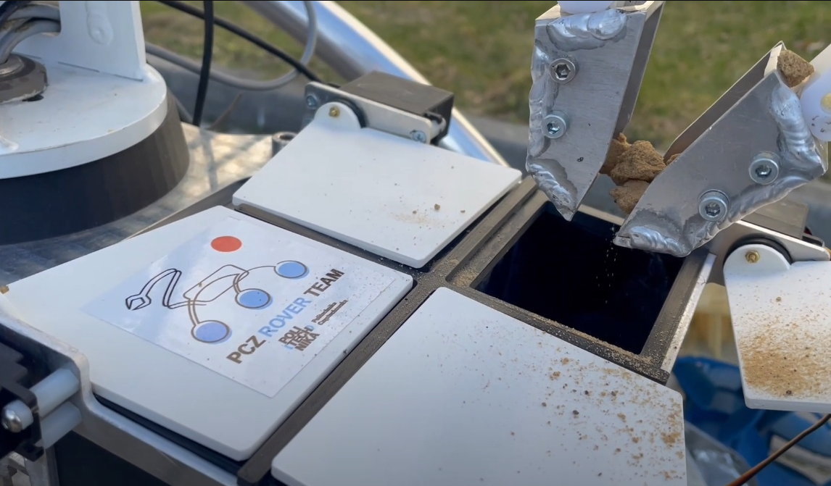
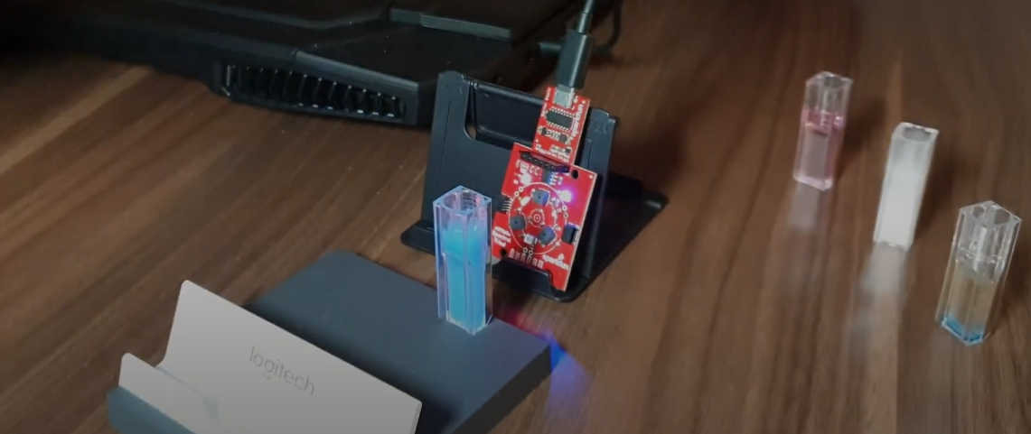
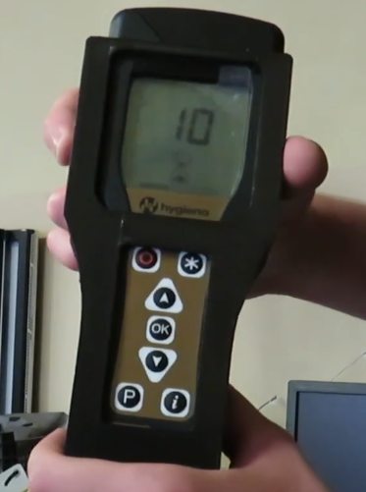
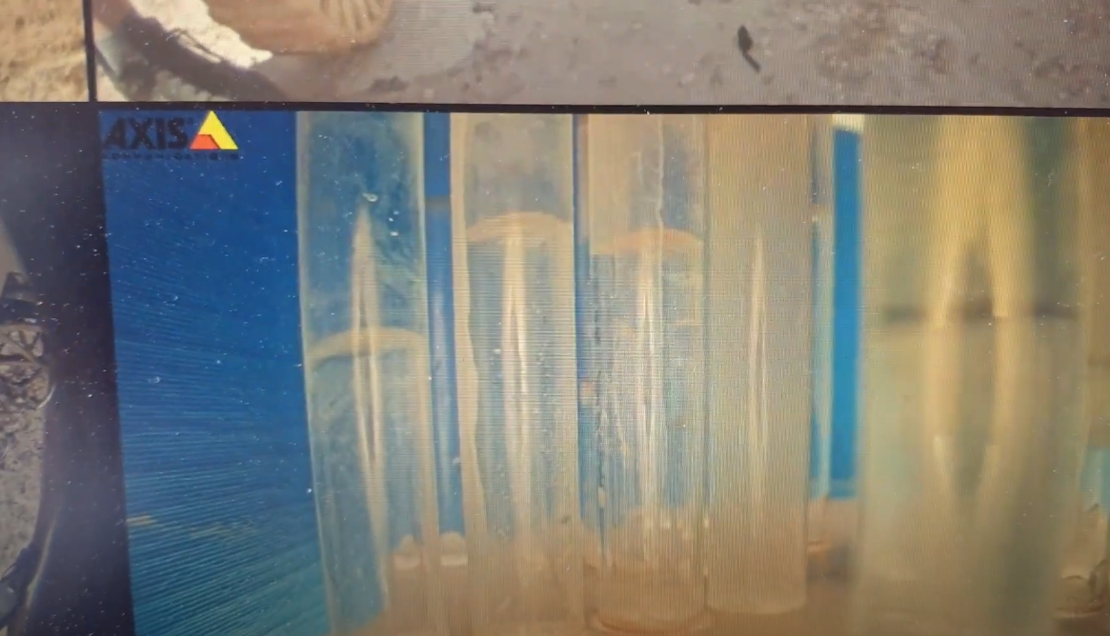
ROVER DESIGN
Science Payload:
Visuals of the system
(2 photo/screenshots)

Slide 28
ROVER DESIGN
Science Payload:
The system is powered by the same battery as the rover itself. Using two batteries will ensure the energy reserve for 90-120 minutes of operation. The whole scientific system should not exceed 3 kilograms in total.
The system is overly suitable for the mission. It is capable of conducting experiments onboard the rover, however the mission requires only delivering the samples to the base. In that case, all of the modules can be easily dismantled and used directly by team members. The samples are collected using special manipulator claws resembling a digger. The 360-degree view is available using our cameras. All chemicals will be safely delivered to the site and disposed after the competition by our university chemical facility.
Technical Specifications including mass and battery duration (3-5 sentences)
Discuss the system's adequacy for its role in competition missions. (3-5 sentences)

Slide 29
ROVER DESIGN
Ground station equipment and communication system:
To mitigate the risk of losing connection with the rover, an intelligent mast guidance system has been developed. This system utilizes azimuth calculations based on the GPS coordinates of both the mast and the rover, significantly reducing the likelihood of communication disruptions. Communication between the base and the rover operates across three frequency bands: the primary 2.4GHz and 5.8GHz (utilizing Rocket M2 and M5), and an additional 433MHz (Lora) band. The supplementary 433MHz band is crucial in scenarios where the rover might lose line-of-sight, such as when it moves behind a mountain. The Lora band enables the system to re-establish visual contact through camera feeds. It is essential to ensure that all cables are securely connected to their respective ports, as high vibrations from navigating obstacles could potentially dislodge connections, leading to immediate loss of communication.
What is used? Describe the system.
(3-5 sentences)
Why the system is chosen? What are the considerations? What are weaknesses and strengths?
(3-5 sentences)

Slide 30
ROVER DESIGN
Ground station equipment and communication system:
The primary frequency bands in the default operational mode facilitate data exchange between the rover's base and the transmission of images from cameras. We have incorporated a feature that automatically assigns data transmission channels based on the link quality of each frequency. The rover is equipped with two tiers of emergency operations. The first level maintains control over the rover with a reduced data transfer bandwidth. The second level activates algorithms that autonomously guide the rover back into a communication zone when communication with the base is entirely severed. Should there be a complete loss of communication on the main frequencies, all communications will switch over to an independent emergency communication system.
Unique points and inspirations
(3-5 sentences)

Slide 31
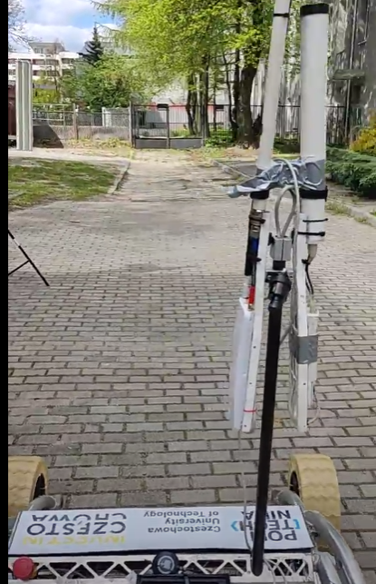
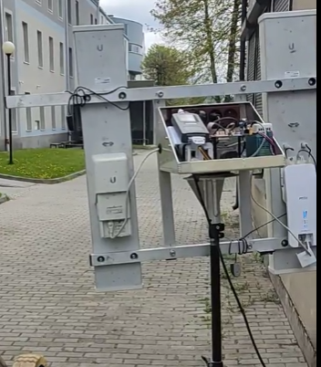
ROVER DESIGN
Ground station equipment and communication system:
Visuals of the system
(2 photos/screenshots)

Slide 32
ROVER DESIGN
Ground station equipment and communication system:
Our base station is equipped with 3 FHD screens allowing us to view feeds from all cameras all at the same time. To control the rover's drive we’re using a conventional 2 joystick controller allowing for precise and intuitive control. For controlling manipulator we created our own controller because using conventional joystick controllers is not intuitive and tedious making operators work unnecessary hard. Our in-house design is also using haptic feedback which makes operators job even more intuitive, improving efficiency combined with inverse kinematic and visualization ensures precise use of the manipulator.
Technical Specifications including resilience to noise and communication range (3-5 sentences)
Discuss the system's adequacy for its role in competition missions. (3-5 sentences)

