Slide 1


2024
Design Report
‹1›

Slide 2



TEAM INFO
Team Name:
Legendary Rover
Contact:
Team Lider contact
Email: Radawiec.legendary@gmail.com
Links:
https://www.facebook.com/legendaryrover
https://www.instagram.com/legendaryrzeszow/
https://pl.linkedin.com/company/legendary-rover-team
‹2›

Slide 3
TEAM INFO
Academic
Institution:
Rzeszów University of Technology
Aleja Powstańców Warszawy 12, 35-959 Rzeszów
Academic
Consultant:
PhD Tomasz Lis
Email: list@prz.edu.pl
‹3›

Slide 4
TEAM INFO
Science club was founded in 2011 starting with the university rover challange competition. Currently, in addition to taking part in competitions, we carry out popular science activities, promoting space and robotics to children and young people at various events. Throughout our history we can boast :
History of
the Team:
  International Rover Design Challenge (IRDC) organised by Mars Society South Asia - 2nd place in 2021 and 6th place in 2022.
  International Planetary Aerial Systems Challege (IPAS) organised by Mars Society South Asia - 1st place in 2021.
  University Rover Challenge (URC) organised in the USA by The Mars Society - we won first place twice in 2015 and 2016 and in 2014 3rd place.
  Sumo Challenge in Łodz - III place in 2018r.
  Robotic Arena 2020 in Wrocław- IV place in freestyle category
  Pro Defence organised in Ostróda by the Polish Space Agency - we won first place in 2017.
‹4›

Slide 5
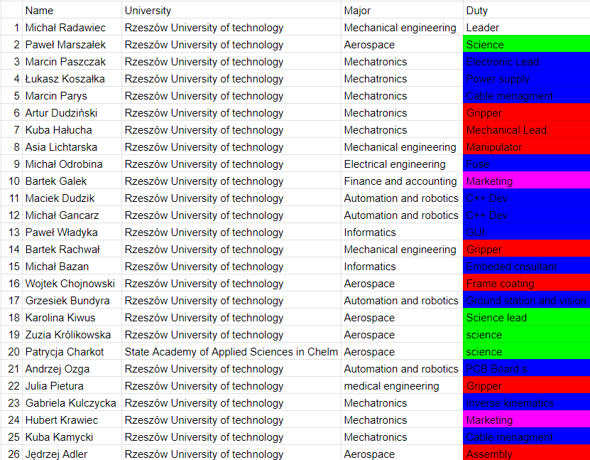
TEAM INFO
Active
Members List:
‹5›

Slide 6
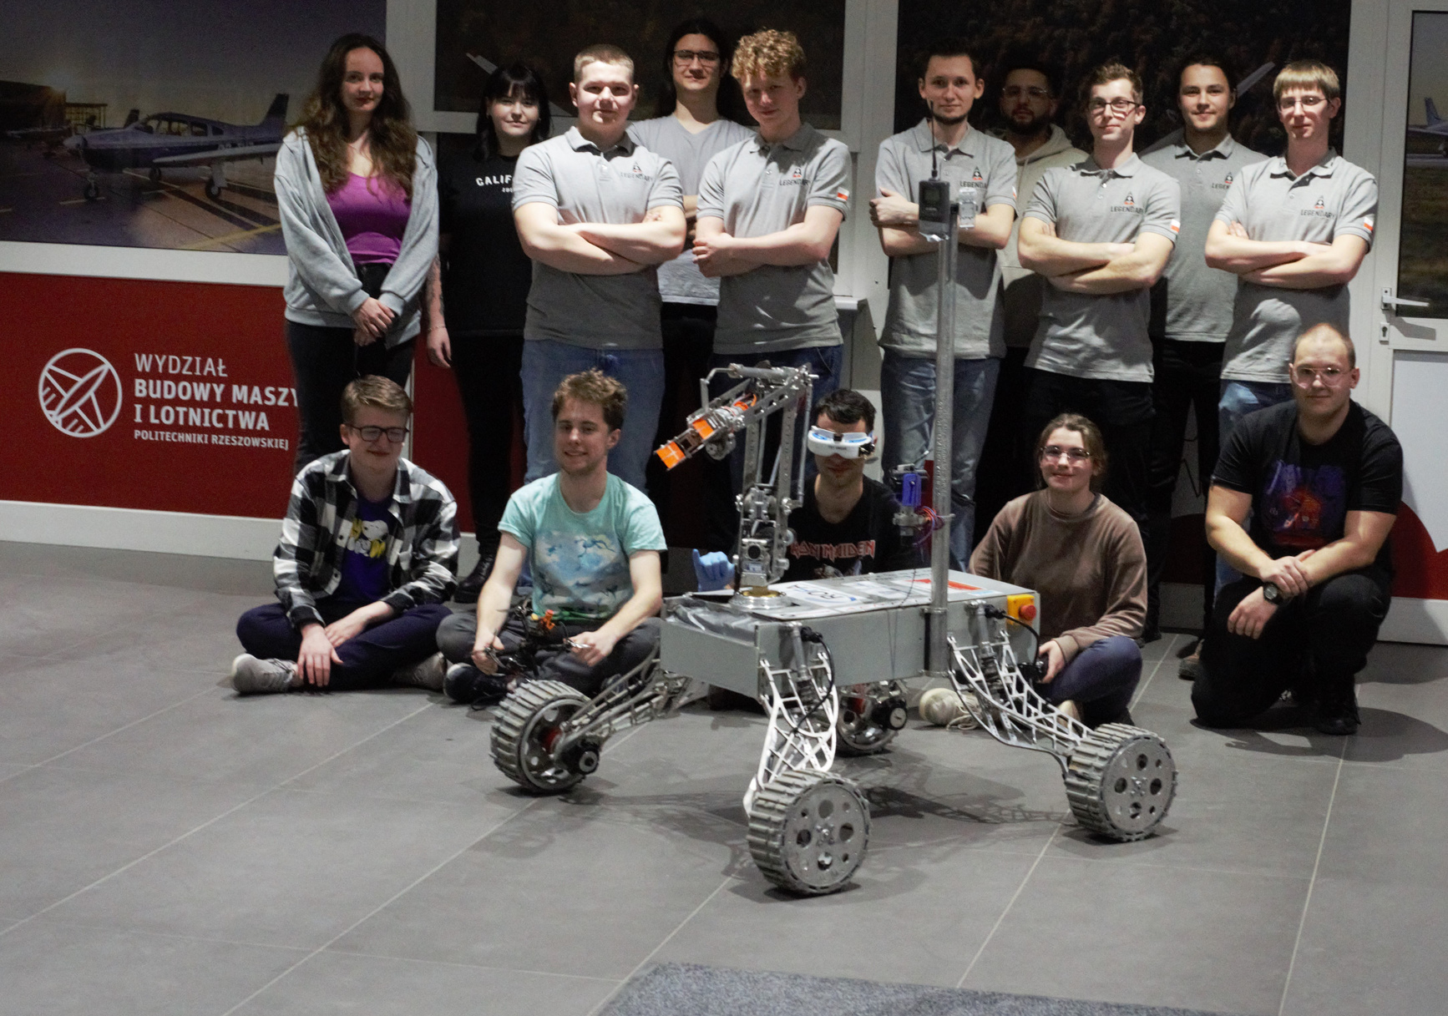
TEAM INFO
Team Photo
‹6›

Slide 7

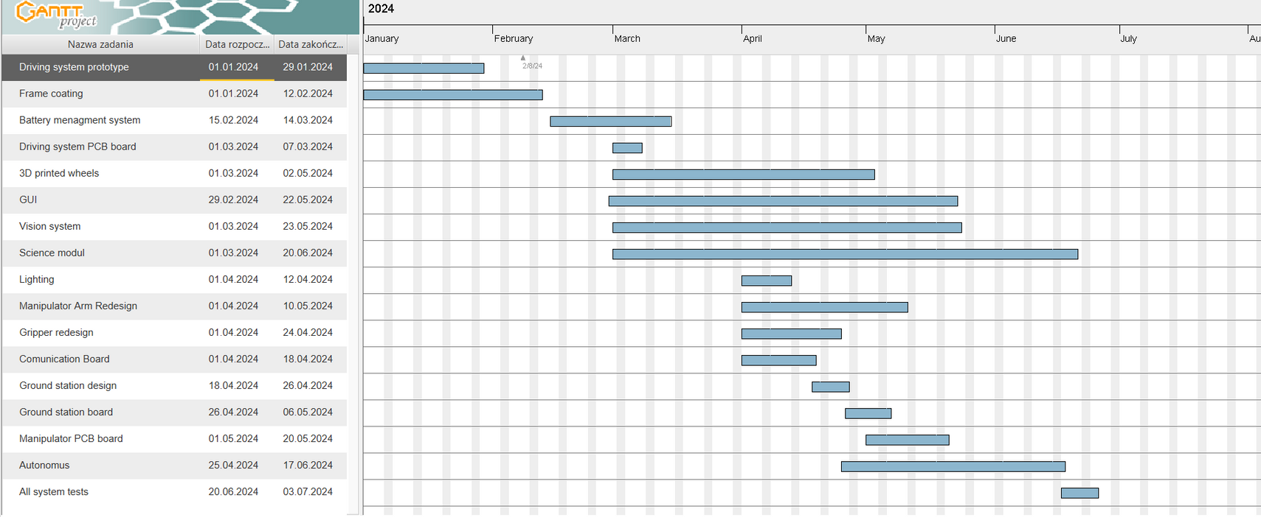

MANAGEMENT
Work
Calendar:
‹7›

Slide 8
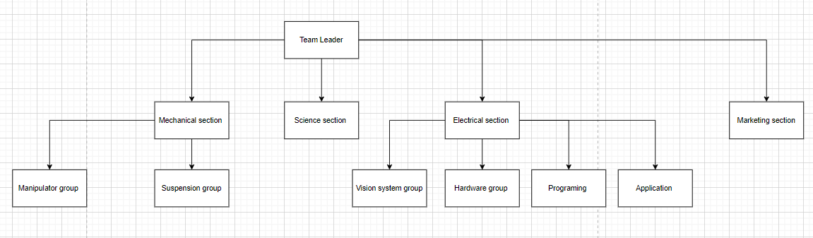
MANAGEMENT
Initially, the team leader together with the section leaders plan the project long-term, then at weekly meetings they distribute the tasks to the individuals. The meetings also include a review of previously assigned tasks and a discussion of any problems encountered.
Team
Formation:
‹8›

Slide 9
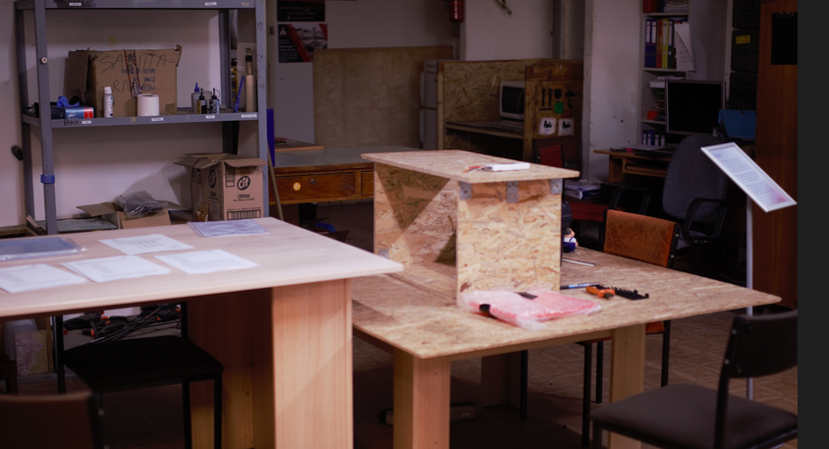
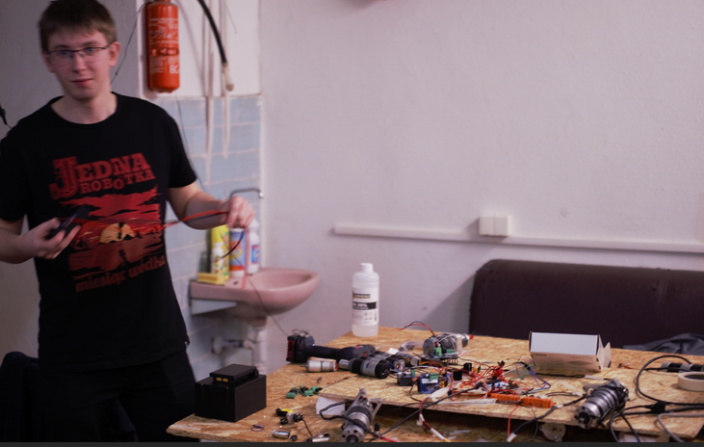
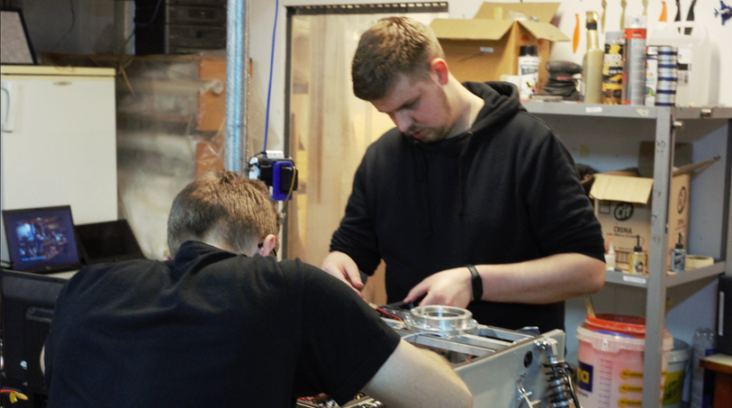
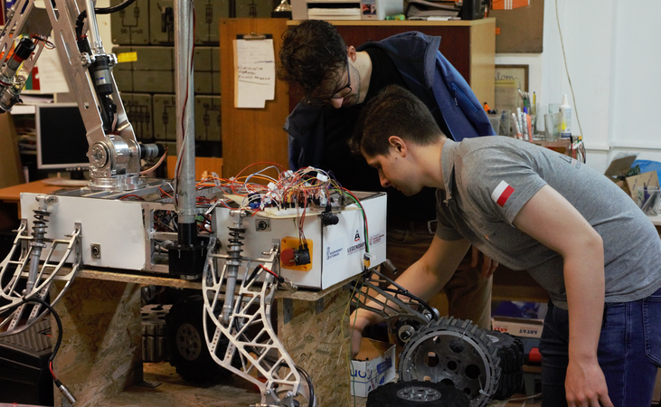
MANAGEMENT
Cad projects, schematics and code are often designed individually at home, while integration and testing are organised in the workshop in the basement of the mechanical and aeronautical engineering department, where we have a small workshop, a soldering station and a corridor where we carry out simple tests.
Workplace:
‹9›

Slide 10
MANAGEMENT
Funding :
Funds on the day of project submission :
Rector's grant : 2500 Dollars
Dean's grant : 1500 Dollars
City of Rzeszów Grant : 2500 Dollars
Most of the rover has already been finished and the more expensive semi-finished components were purchased as recently as last year. Of the stuff left to order, it's mainly finished PCBs, small dc motor electrics and 3D printing Filament for the housings and minor improvements.
The expected amount is in the region of $800
Travel costs :
Fuel: 800 dollars x3= 2400dollars
Food for team members during the competition : 750 dollars
Housing costs : $850
If it is not possible to finance the trip from the university's fund
We would like to seek help from our partners and additionally organise a fundraiser for this purpose. We are also considering funding from private money.
‹10›

Slide 11
MANAGEMENT
Unfortunately, air transport is quite expensive in our case, which is why, if we qualify for the competition, we would like to get there in several cars or make a deal with another team from Poland and rent a bus together.
If travelling by car, we will leave in three cars, in a 12-person crew
In the case of a critical breakdown of one of the cars, the other 2 will be able to get to the site with the necessary equipment. The rover will be transported in parts and the equipment will be divided equally between all vehicles.
‹11›

Slide 12

ROVER DESIGN
Mobility
System:
We use 4 wheel independent suspension system based on 2 wishbones to damp low-frequency vibrations. Our wheels are powered by DC motors, which ensures high torque. 3D printed TPU wheels can damp high-frequency vibrations, and provide us well traction. Our threaded shock absorbers let us adjust stiffness of each wheel separately.
We choose this mobility system due to simplicity of construction, and low mass. As our weakness we can admit balance, because it’s hard to balance manipulator in front of frame with rest of the rover body. This causes our rover to drive leaning forward.
‹12›

Slide 13
ROVER DESIGN
Mobility
System:
As our unique point we can consider our wheels ,which are made with special TPU filament. The material we use, provide us good coefficient of friction with variable surfaces. Our tread is inspired by agricultural tires, which provide well traction on rough terrain.
Tire filling is based on honeycomb pattern, which should provide well damping while keeping well tire stiffness.
Independent suspension brings the benefit of even distribution of forces acting on individual elements, which can contribute to increasing the durability and strength of the vehicle.
‹13›

Slide 14
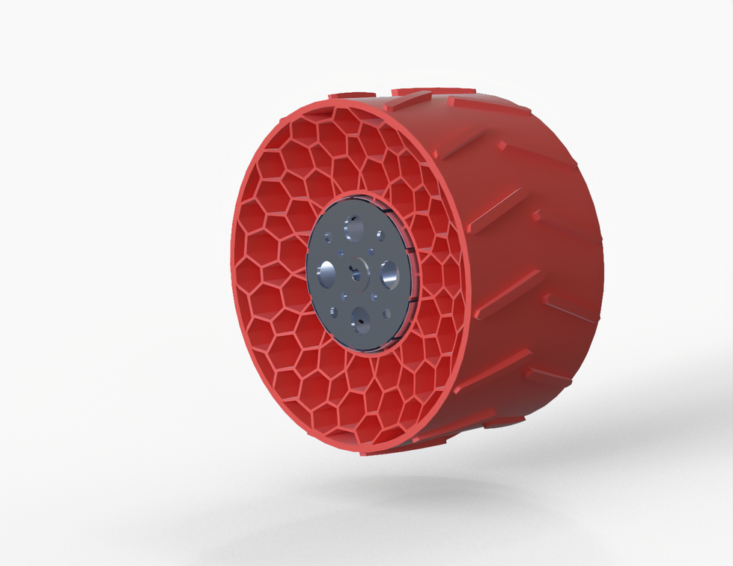
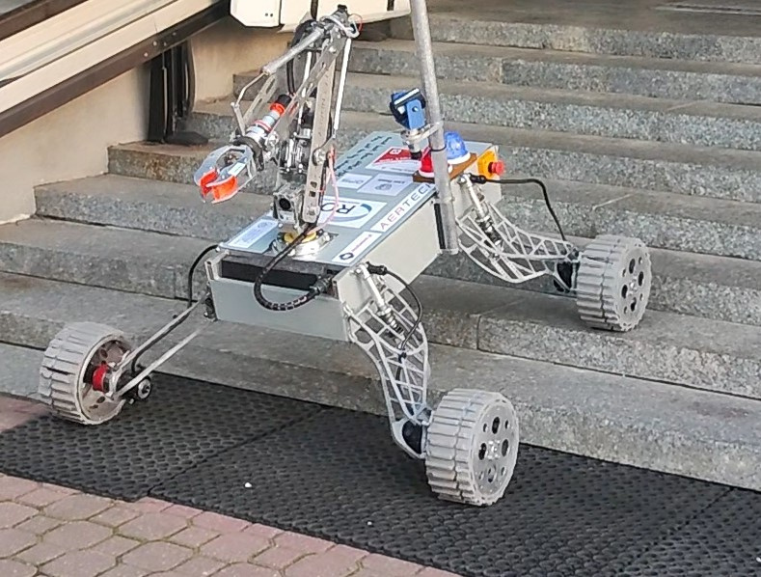
ROVER DESIGN
Mobility
System:
Our new wheel:
Our suspension system:
‹14›

Slide 15
ROVER DESIGN
Mobility
System:
The mass of entire mobility system is about 32 kg, wheelbase is 0,92 m and width is 1,2 m in task configuration. Diameter of our wheel is 265 mm what should provide well torque and speed of our rover.
Based on our tests, system should work well in competition missions. Our wheels provides enough traction and motors ensures well torque. Suspension system enables us to traverse various obstacles. Our way of turning provide us well mobility in competition missions, due to ability of rotating in place.
‹15›

Slide 16
ROVER DESIGN
Electronics and power system:
The electronics system consist of:
  Nucleo board STM32-L152RE clipped to specific main board
  wheel and manipulator engine drivers
  switches connectedto relays to all segments of system and killswitch.
  NRF24 communication module
  ATX power supply
Strengths:
  easy way to change microcontroller board, what causes restoring functionality after fault,
  safety of system with killswitch
  modular system
Weakness:
  vibration, because when we connect all pins in nucleo board is not stable communication
  limitations resulting from nucleo board
  high susceptibility to interference of NRF24
‹16›

Slide 17
ROVER DESIGN
Electronics and power system:
Our electronics system is easy to adapt and improve. All modules are located on countertop, what is extendable on runners. System have killswitch, what improve safety and power off all electronic devices inside. Batteries have mechanism what allow to fast swap dead accumulator to charged one. STM32 Nucleo Board can be changed to another one with the same code or different due to requirements without changes in cable connections. That can help also while shorted circuit of main microcontroller. We can easily change to another one and do a diagnostics of broken one.
‹#›

Slide 18
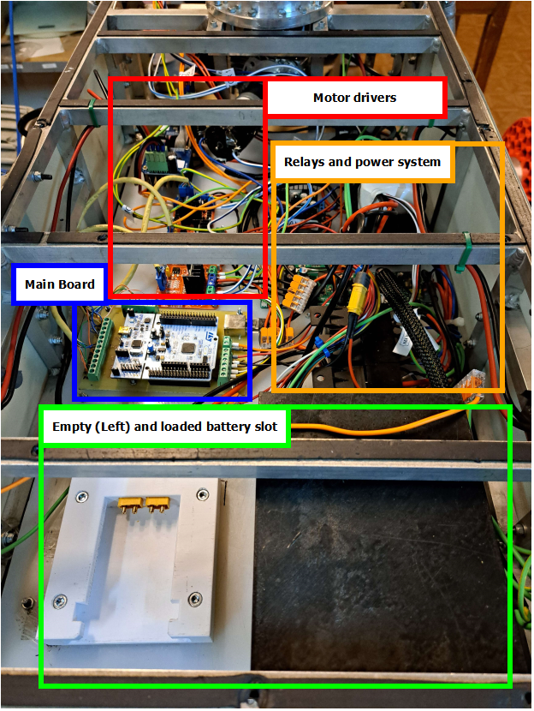
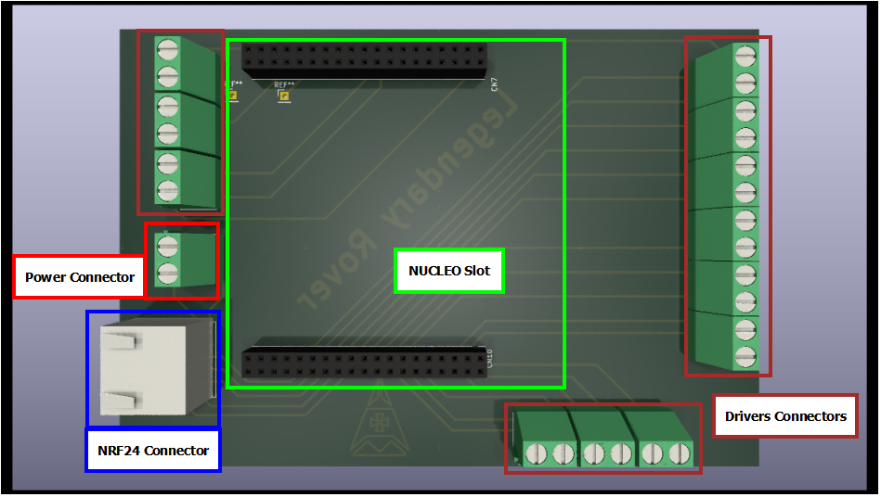
ROVER DESIGN
Electronics and power system:
‹#›

Slide 19
ROVER DESIGN
Electronics and power system:
Our power system based on:
  Two 24V LiFePO4 8S2P batteries with hotswap, first powers front wheels and second - rear wheels. One of batteries additionally supports relays and ATX. These batteries have high current ability and capacity.
  One 12V Li-Ion battery 3S3P to manipulator drivers and engines to reduce weight.
On main batteries we can handle above 1 hour of driving in demanding conditions. We can improve time with easily changeable lithium battery packs. That solution increase our time of movement and rover work.
The weight of the battery and all electronics is approximately 10 kg.
‹#›

Slide 20
ROVER DESIGN
Manipulation system:
Our robotic system is mainly based on dc motors coupled to a planetary gearbox and a second stage worm gearbox (Turntable, 1st stage, 2nd stage) or screw transmission (3rd stage, gripper).
And a toothed gear (rotation of the gripper).
The structure will be made of bent aluminium sheet 3mm thick.
And the joints are connected by steel shafts on ball bearings.
We chose this configuration because of its strength, worm gears have the ability to handle high loads due to their haracteristics, as do screw transmissions. The weakness of this solution is the relatively high weight.
By carefully selecting the gear ratios and motors with encoders, we were able to achieve sufficient accuracy to fulfil all tasks at the competition
‹20›

Slide 21
ROVER DESIGN
Manipulation system:
In designing the new manipulator, we were inspired by the designs created by our older colleagues while testing new solutions.
The unique point of our manipulator is the use of bent aluminium sheet for the support structure. This ensures a low manufacturing price and correspondingly high stiffness without the need for a large number of fasteners.
‹21›

Slide 22
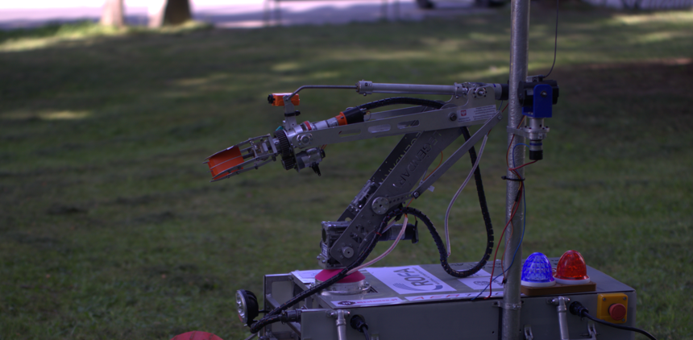
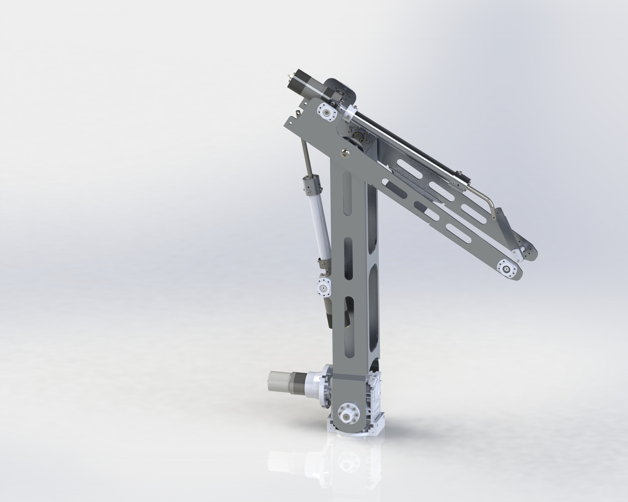
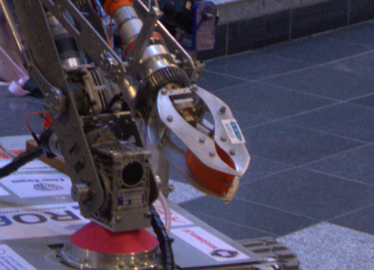
ROVER DESIGN
Manipulation system:
‹22›

Slide 23
ROVER DESIGN
Manipulation system:
The task-ready manipulator measures 600x750x130 [mm].
Can lift up to 6Kg
With a manipulator weight of 9.78 Kg (Weight of current design)
The target weight of the manipulator after modifications should be around 8 Kg
Our Robotic arm was designed to easily replace a human hand.
There is no problem with opening or closing containers, gripping handles or turning levers or pressing buttons.
‹23›

Slide 24
ROVER DESIGN
Science Payload:
The science payload consists of:
  A collector attached to the robotic arm for collecting soil
  Containers for storing soil samples attached to the top of the rover.
  On-board sensors for temperature, Ph-metr, humidity and atmospheric pressure
  The team is currently working on features to prevent contamination of the collection container and is determined to improve the software for visually displaying the results of collected samples.
Strengths
  High sampling speed.
  Minimal risk of contamination.
  High sample storage capacity.
  Light weight and ease of expansion and change through the 3D printing technology used.
Limitations
  Limited sampling depth.
  Works best with loose soil -cannot penetrate extremely hard, rocky soil surfaces.
‹24›

Slide 25
ROVER DESIGN
Science Payload:
  Instead of using another load to collect soil, the Rover arm is used to collect soil, reducing weight.
  As one of the objectives was to collect soil samples repeatedly, the possibility of cross-contamination was taken into account. Thus, the scientific load system was designed in such a way that cross-contamination could be avoided.
  Each payload component is modular and easily replaceable.
  The use of 3D printing allows rapid interchangeability and the application of design amendments
‹25›

Slide 26
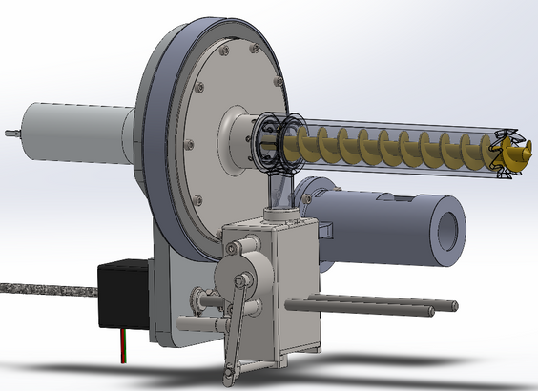
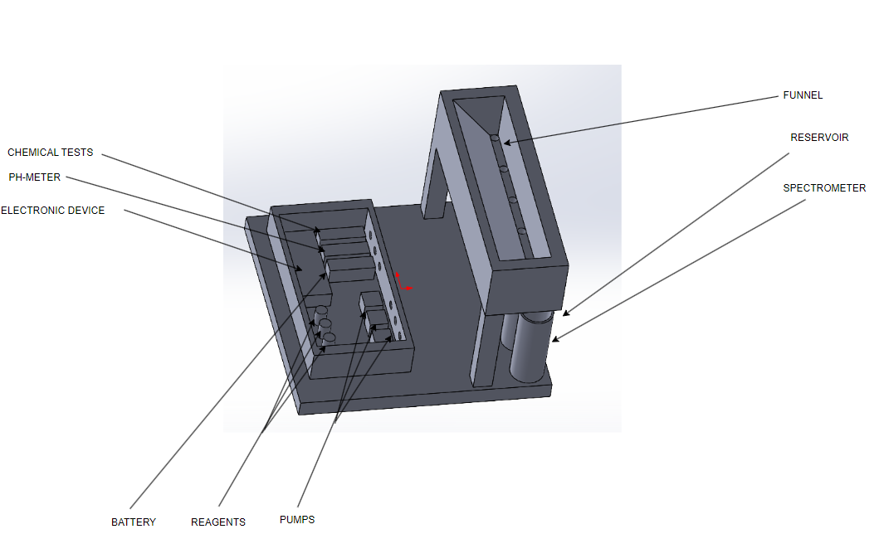
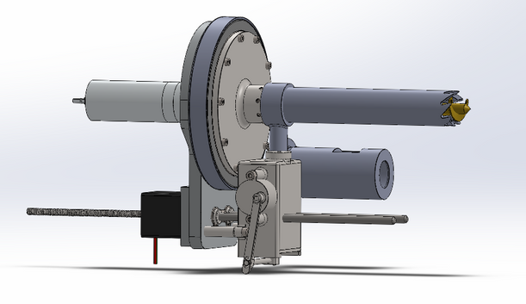
ROVER DESIGN
Science Payload:
‹26›

Slide 27

ROVER DESIGN
To confirm the results of the soil analysis, multiple testing methods will be employed on various soil samples. Real-time data such as soil humidity, temperature, and pH will be gathered using on-site sensors. Soil samples can be collected from a depth of 5-8 cm. Implementing these measures will ensure the adequacy of soil quality.
Components/Parts | Specification | Weight(in grams) | Duration
CHEMICAL TESTS | Nitrogen(NO3;NO2)Test; Phosphorus PO4 Test; Potassium K Test | 500g | The rover can operate for approximately 1 hours using its onboard power unit for Science mission.
PH-METER | DFRobot Gravity 5V | 99g | The rover can operate for approximately 1 hours using its onboard power unit for Science mission.
ELECTRONİC DEVİCE | 2x Ardnuino uno R4 Wifi Board 5V; Raspberry Pi 4 Model B 5V | 118g | The rover can operate for approximately 1 hours using its onboard power unit for Science mission.
BATTERY | LiFePo4 8S1P 24V | 190g | The rover can operate for approximately 1 hours using its onboard power unit for Science mission.
REAGENTS | 2xTest tubes 50ml one tank 300ml | 200g | The rover can operate for approximately 1 hours using its onboard power unit for Science mission.
PUMPS | 3xVMA447 PUMP Flow rate;>=39ml/min Power supply: 6V DC/5W | 387g | The rover can operate for approximately 1 hours using its onboard power unit for Science mission.
FUNNEL | 3D printed PLA | 900g | The rover can operate for approximately 1 hours using its onboard power unit for Science mission.
RESERVOIR | 3D printed PLA | 500g | The rover can operate for approximately 1 hours using its onboard power unit for Science mission.
SPECTROMETER | AS7341 Visible Light Sensor 5V | 7g | The rover can operate for approximately 1 hours using its onboard power unit for Science mission.
‹27›

Slide 28
ROVER DESIGN
Ground station equipment and communication system:
Communication system consist of NRF24 transceiver and receiver to communicate with rover. At the operator station, we use a Python application and Xbox controller for rover control. Data is sent from the application to the rover via COM port. The rover's visual section collects video data from two cameras, aiding in mission tasks. Additionally, an analog video transmission system can also be used at the 5.8 GHz frequency. This system was chosen because it fully meets the required assumptions and, at the same time, is a great development platform for further work. The advantage of the system is good performance and low power consumption. The disadvantages, however, are difficult configuration and the possibility of interference with other devices in the 2.4 GHz and 5.8 GHz bands.
‹28›

Slide 29
ROVER DESIGN
Ground station equipment and communication system:
The basis for the creation of the communication system and ground station was to create a system that would meet the set requirements for coverage, while being easy to use and create the system and software. In addition, our priority was to create the system in such a way that it would be easily expandable. The application was created so that it would be pretty and display as much of the necessary information used to control the rover's analog from the operator station as possible.
‹29›

Slide 30
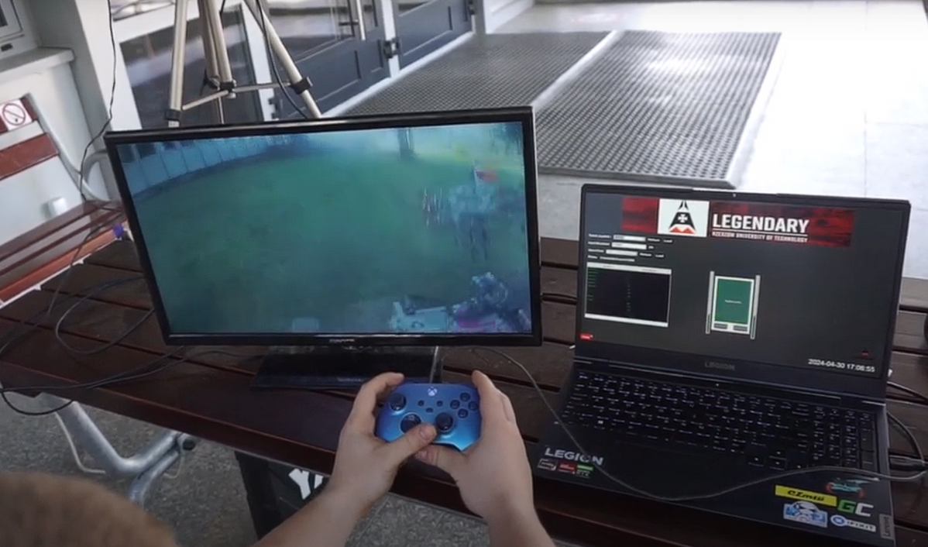
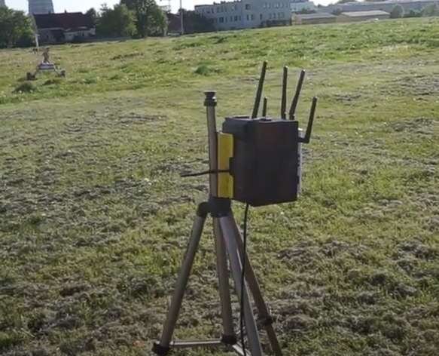
ROVER DESIGN
Ground station equipment and communication system:
Visuals of the system
(2 photos/screenshots)
‹30›

Slide 31
ROVER DESIGN
Ground station equipment and communication system:
The NRF24 communication module operates at 2.4 GHz. The range stated by the manufacturer is specified up to 1km, in reality it is a little less. In a video system, the working range is about 200m in clear space. It operates at a frequency of 5.8 GHz.
The communication system and operator station is very important in the execution of the mission, because all the commands executed by the rover, are disposed by the operator at the operator station. Vision for the operator station is crucial in covering the route, due to the need for the rover to move remotely without a view of its behavior. The operator can only judge this from the camera images.
Technical Specifications including resilience to noise and communication range (3-5 sentences)
Discuss the system's adequacy for its role in competition missions. (3-5 sentences)
‹31›

