Slide 1


2024
Design Report

Slide 2



TEAM INFO
Team Name:
Team: Project Kratos | Rover name : Kratos Mark IV
Name of the team and if applies,
name of the rover.
Contact:
kratosbitsgoa@gmail.com
Instagram: https://www.instagram.com/kratosbitsgoa/
YouTube: https://www.youtube.com/@kratosbitsgoa
Contact No. : +91 70438 33651
Contact information and
social media links of the team.

Slide 3
TEAM INFO
Academic
Institution:
BITS Pilani K K Birla Goa Campus
Address: NH 17B, Bypass, Road, Zuarinagar, Sancoale, Goa 403726
Name and address of the affiliated academic institution.
Academic
Consultant:
Prof. Toby Joseph, BITS Pilani, K.K. Birla Goa Campus
Contact No. : +91 94032 70043
Name, affiliated academic institution and contact information of academic consultant.

Slide 4
TEAM INFO
History of
the Team:
Project Kratos was established on 12th May, 2018 by a group of students from various academic disciplines. The project has participated in the Indian Rover Challenge 2020, the International Mars Hackathon (IMH) conducted by MSSA,International Rover Design Challenge (IRDC) 2021 and URC 2022. At the
International Rover Challenge 2020, Project Kratos had qualified top among the new teams and has also won the overall excellence award in the 2023 edition of the same competition.
In the University Rover Challenge (URC 2022) which takes place annually at the Mars Desert Research Station in Utah USA, the team placed 1st in India, 2nd in Asia, and 20th globally.
In the Anatolian Rover Challenge’22 (ARC) which was held in Istanbul, Turkey. The team secured 2nd place overall and missed out on 1st position only by a difference of 2 points. The team was also awarded the best ‘Autonomous and Controls Vertical’ and the best ‘Science Vertical’.
A paragraph of teams history including foundation date, attended competitions and experience.

Slide 5
TEAM INFO
Name | University Major | Team Designation
Vyomesh Bhatt | Mathematics+ Electronics | Team Lead
Akash Bhosale | Electronics | Vice-Lead
Himanshu Kuril | Mechanical | Operations Lead
Manan Agarwal | Physics+ Electronics | Controls Lead
Kaustubh Saoji | Biology + Electronics | Science Lead
Sohil Khan | Electronics | Autonomous Lead
Shiven Upadhyay | Electronics | Electronics Lead
Jai Aditya | Electronics | Electronics Lead
Samar Siddiqui | Computer Science | Mechanical Lead
Arnav Deshmukh | Mechanical | Mechanical Lead
Rajiv Galgali | Electronics | Power Lead
Active
Members List:
A table of active members including following information: Name, University Major*, and duty in the team.
* University majors should be written without abbreviations.

Slide 6
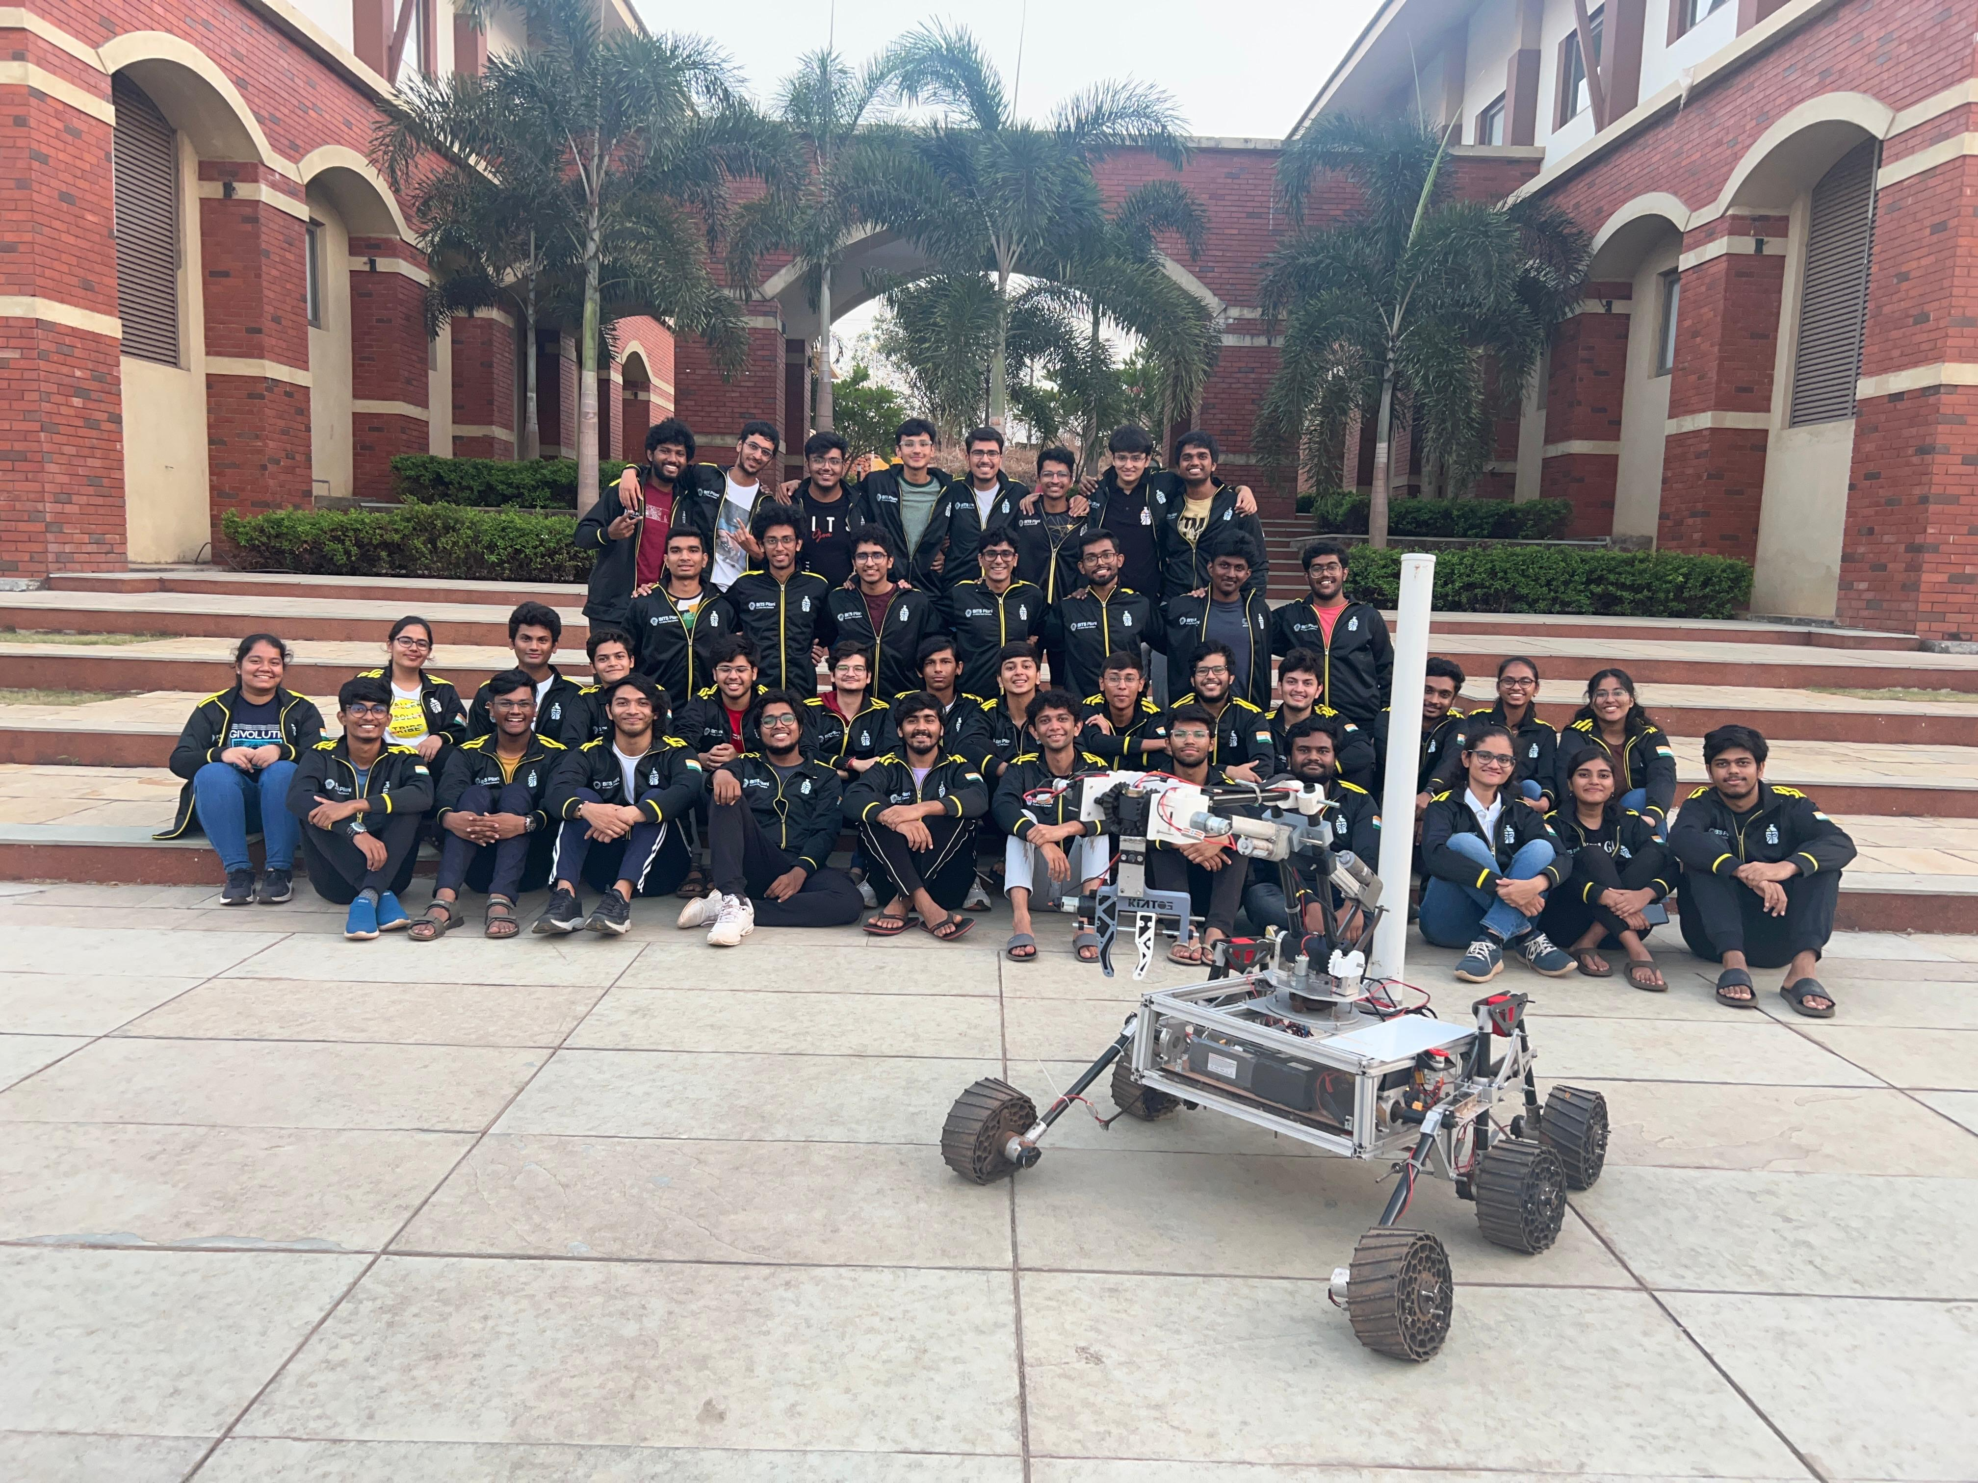
TEAM INFO
Team Photo
A photo/screenshot of the whole or part of the team.

Slide 7

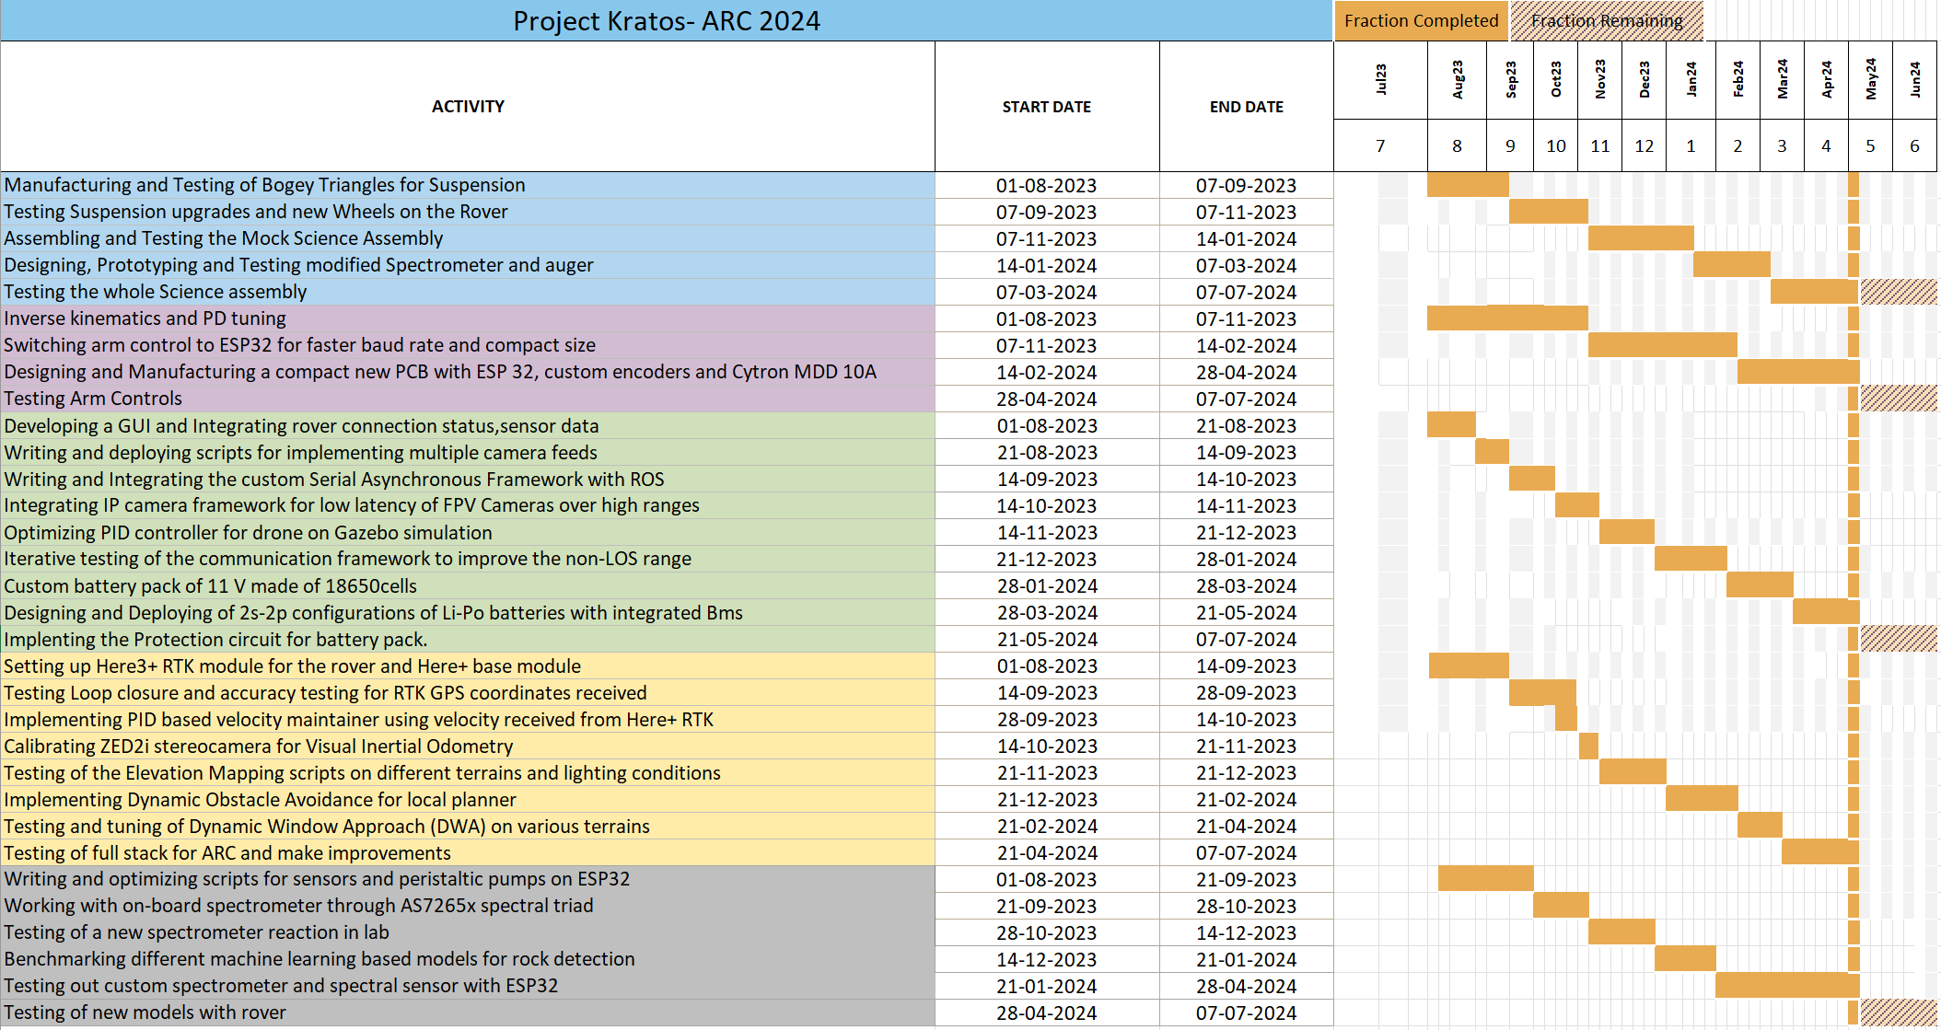

MANAGEMENT
Work
Calendar:
Explain the work on the project by a Gantt chart. Include 10-15 items in the Gantt chart.

Slide 8
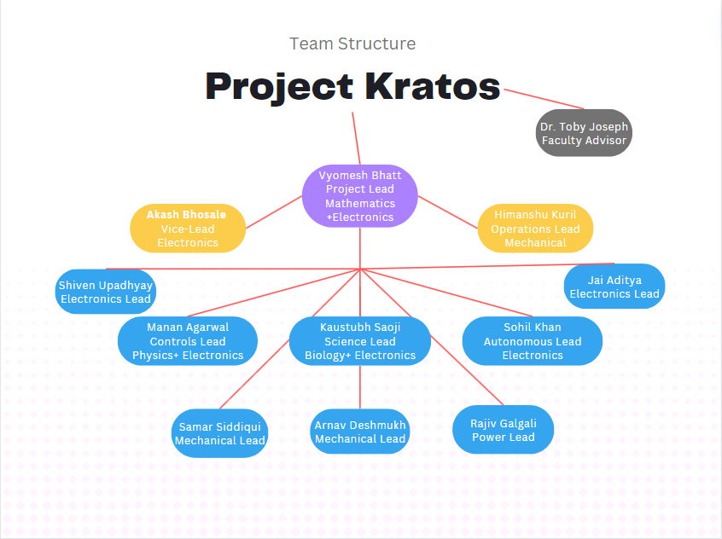
MANAGEMENT
Team
Formation:
Our team of 50+ students is further divided into 6 subsystems - Mechanical, Controls, Electronics, Autonomous, Science and Power. The subsystem leads are responsible for the design and development of their individual subsystems. The Team leads are committed to overall development, finances and co-ordination among the subsystems.
How is the team workforce structured? (2-3 sentences) Include a graphic to explain the structure as well.

Slide 9
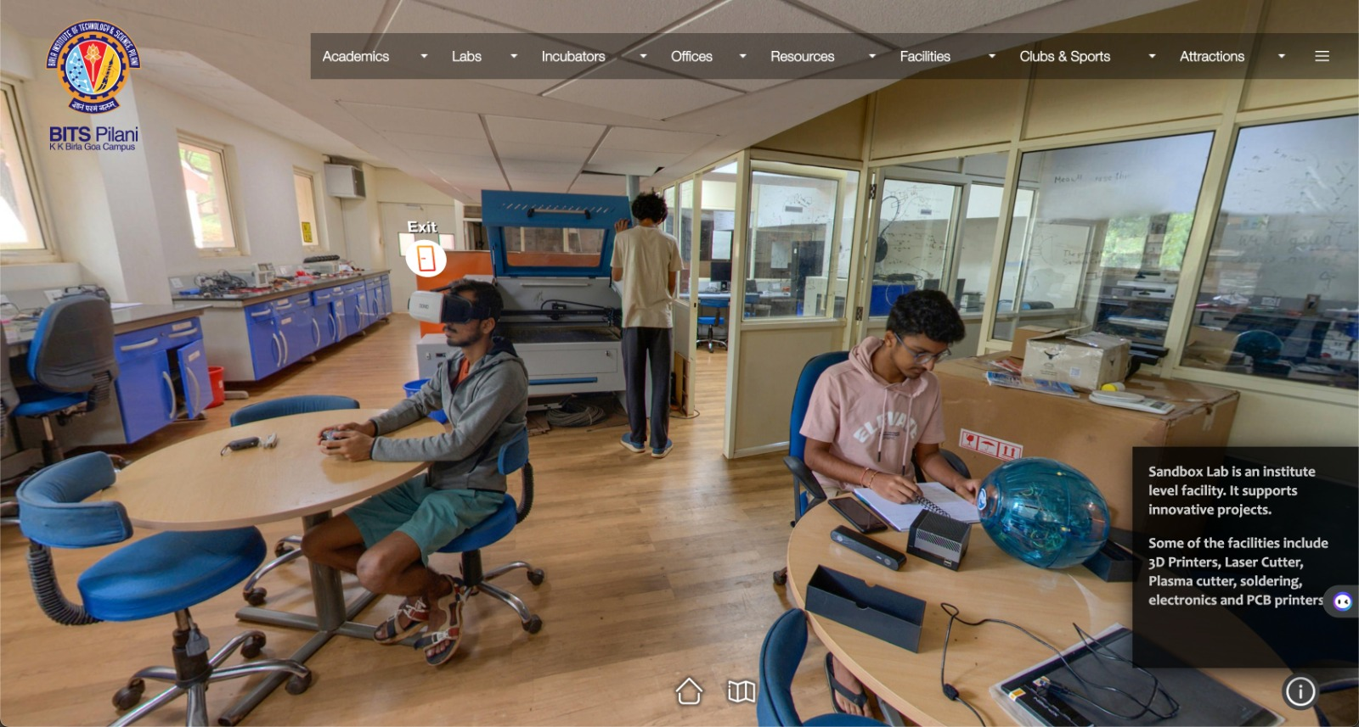
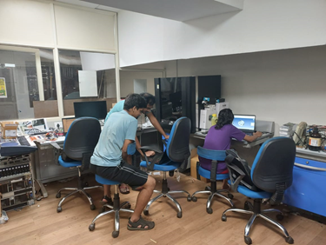
MANAGEMENT
Workplace:
All subsystems work in a Students Robotics Lab provided by the institute, we use this lab to house all our equipment and rover components such as 3d printers, motor drivers, CNC parts etc. The mechanical parts are manufactured using jobs like CNC, Lathe etc, this is done in an in-house workshop.
The testing of all rover components is done on various nearby terrains including rocky, sandy, gravel, smooth tiles, grass, stairs and on roads.
How the team design, build and test the rover physically? Explain the workplace. (2-4 sentences) Include a photo/screenshot of the workplace.

Slide 10
MANAGEMENT
Funding :
The project receives constant financial support from the university and our alumni network.
Apart from this we also gather support from crowdfunding and by selling our own merchandise across campus.
Our project also has some reserve funds for unforeseen situations that can be used when required.
The university also grants funds in such cases of emergency and we receive funds from our institute based academic departments for developments.
As a last resort, the team members can also contribute an amount that can later get reimbursed by the university.
Present the funds of the project at the time of submission of this document? (In dollar currency)
How much spending is expected for the development costs? How much spending is expected for the travel costs?
What is the team's plan in an insufficient funding situation by the competition date?

Slide 11
MANAGEMENT
Logistics:
The rover is designed to be modular and can be carried in smaller components which makes it easier to package and transport. To save costs, we pack the rover in multiple check-in baggages which weigh under our travel limitations.
We have in-house designed and assembled a 2S2P configuration Li-Po battery to fit within the international travel limitations such that it also meets our specific rover requirements and for efficient power transmission.
In order to avoid confusion with authorities during transit, we plan to carry a checklist which includes every rover part along with their picture.
What is the team's plan to package and bring the rover to competition site by July? (4-6 sentences)

Slide 12

ROVER DESIGN
Mobility
System:
• For the suspension, a modified double lambda rocker bogie is used to navigate through rough terrain.
• Suspension is mostly made up of carbon fiber rods and aluminum metal for lighter weight and increased strength.
• This system is effective in navigation on rough terrain and provides stability at uneven surfaces due to its mechanism which allows any 5 wheels to be in contact with surface at any given time.
• Due to this design there is a speed limit on the rover. The carbon fiber rods can twist due to pressure.
• 3D printed wheels are used with modified honeycomb support patterns improved the shock absorbance. Grousers printed on the wheel provide grip on loose sand.
What is used? Describe the system
(3-5 sentences)
Why the system is chosen? What are the considerations? What are weaknesses and strengths?
(3-5 sentences)

Slide 13
ROVER DESIGN
Mobility
System:
• The chassis is made up of aluminum t-slots which gives freedom to mount other payloads at any location on chassis, increasing the modularity of the rover.
• Rover uses a differential mechanism for balancing on uneven surfaces and helps in climbing staircase
Unique points and inspirations
(3-5 sentences)

Slide 14
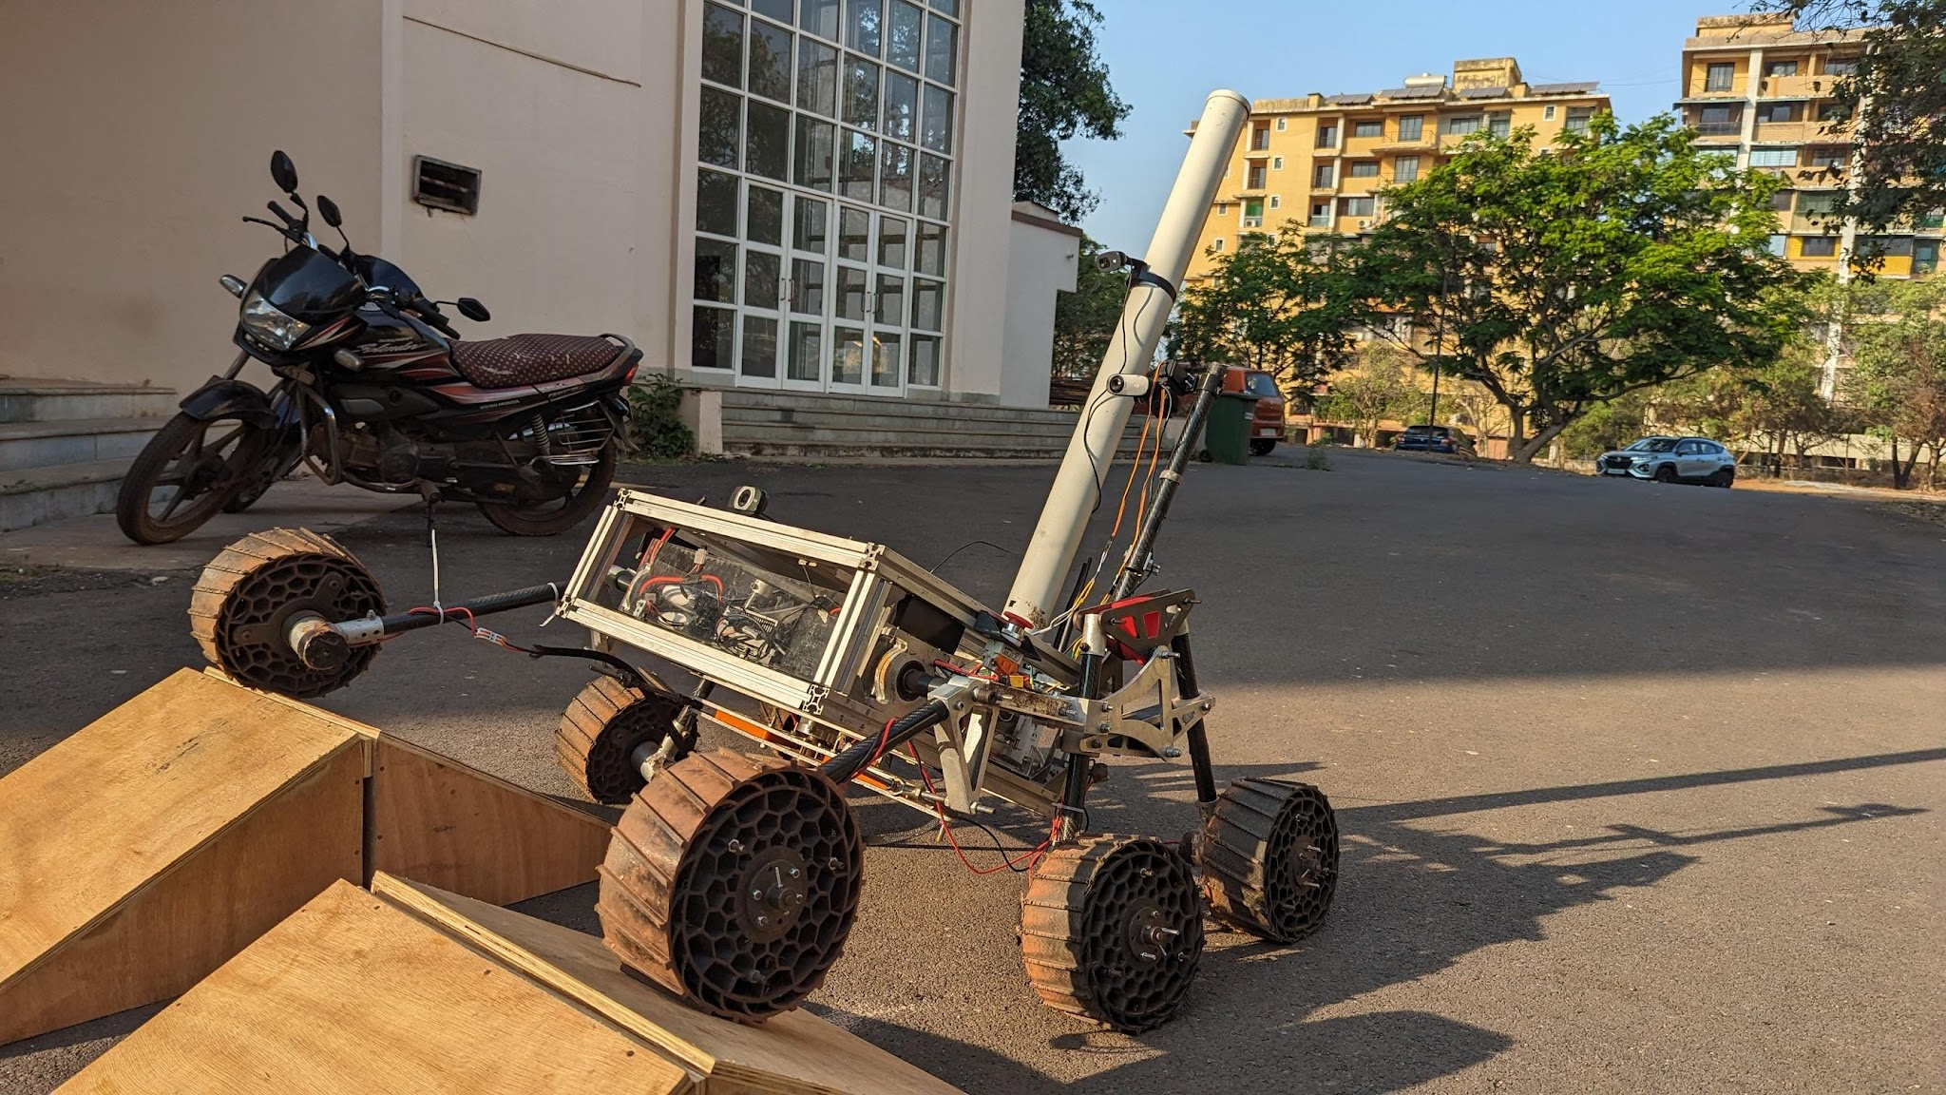
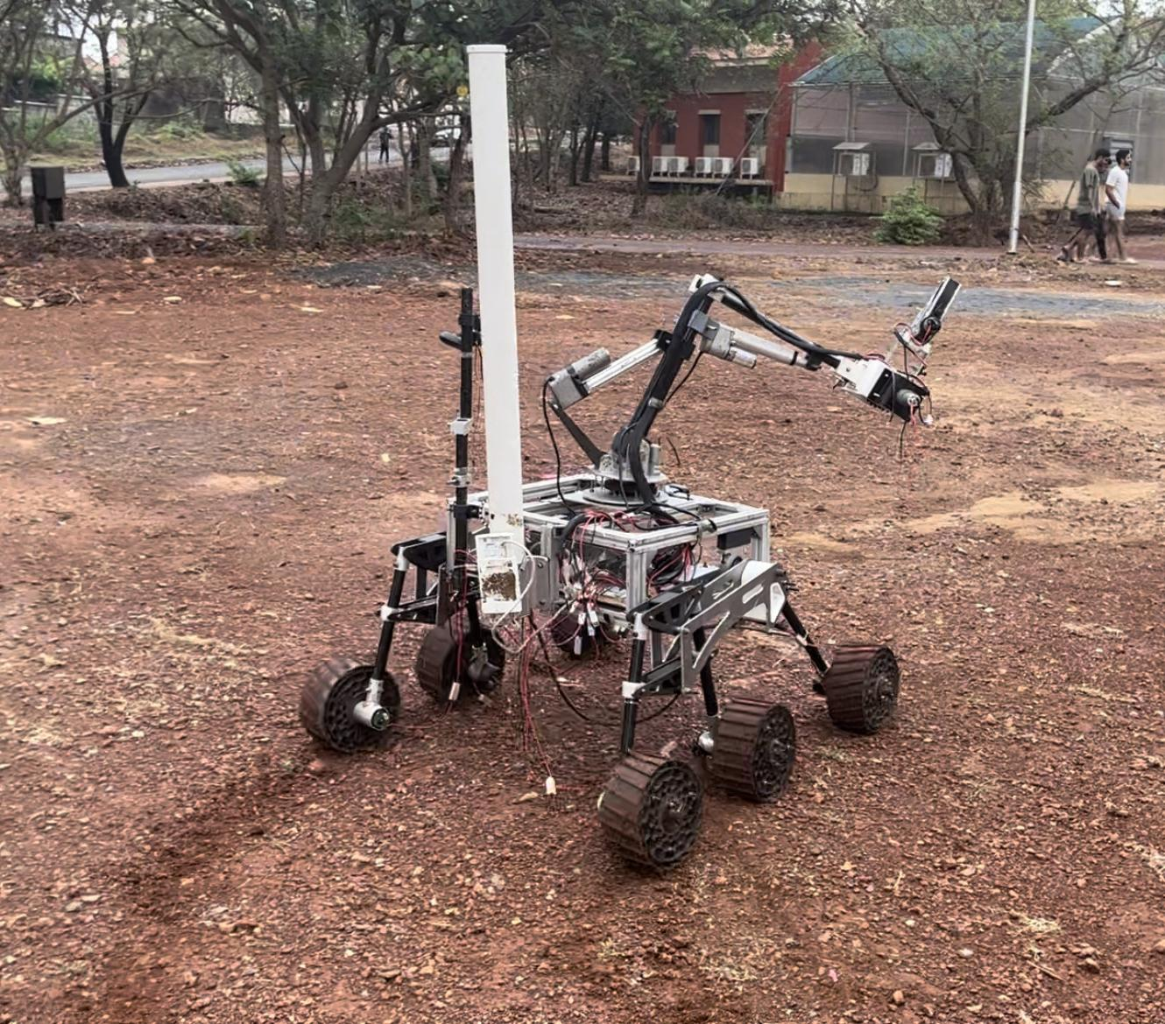
ROVER DESIGN
Mobility
System:
Visuals of the system
(2 photos/screenshots)

Slide 15
ROVER DESIGN
Mobility
System:
• Dimensions of the rover are 110x95x145 mm.
• The rover weighs 45 kg with the arm and 37.5 kg without the arm.
• Wheels are made up of TPU (thermoplastic polyurethane) and have a diameter of 23 cm.
• The chassis is made up of aluminum T-slots for light weight and provides a modular way to attach payloads.
• This system is adequate for this competition due to its stability on rough terrain and better control while driving.
• This mechanism uses differential drive which allows it to turn at a single point.
Technical Specifications including mass and size (3-5 sentences)
Discuss the system's adequacy for its role in competition missions. (3-5 sentences)

Slide 16
ROVER DESIGN
Electronics and power system:
• A combination of Lithium Ion and LiFePO4 batteries with built-in BMS and Cell balancing has been used to power the rover.We have custom derived and assembles a 2s-2p configuration battery pack for the Drive. This has been integrated with BMS with Voltage & Current requirements.
We have made custom PCBs for every major electronic system present.We use MMDS30 cytron Motor drivers to control the wheels
The cytrons receive input through an esp32 chosen for its fast processing.The Jetson Communicates to the esp32 via serial communication
• Lithium-based batteries has been opted owing to their high energy/kg. Custom PCBs and wire connectors are chosen due to their ease of use once integrated, along with making easy to debug. Making the electronics on board more modular is the motive.
What is used? Describe the system
(3-5 sentences)
Why the system is chosen? What are the considerations? What are weaknesses and strengths?
(3-5 sentences)

Slide 17
ROVER DESIGN
Electronics and power system:
• Coulomb counting method is implemented to determine the State of Charge (SOC) of batteries . Voltage sensors is connected between motors to detect whether the robot is killed or not. Our unique electronics box encapsulates all the components with its purpose to protect the components from dust, heat, water etc.
• The inspiration behind this system was the modularity of a laptop. We wanted our system to be as modular as possible, with each component being hot swappable like the peripherals in a laptop, with the PCBs being the core of the system.
Unique points and inspirations
(3-5 sentences)

Slide 18
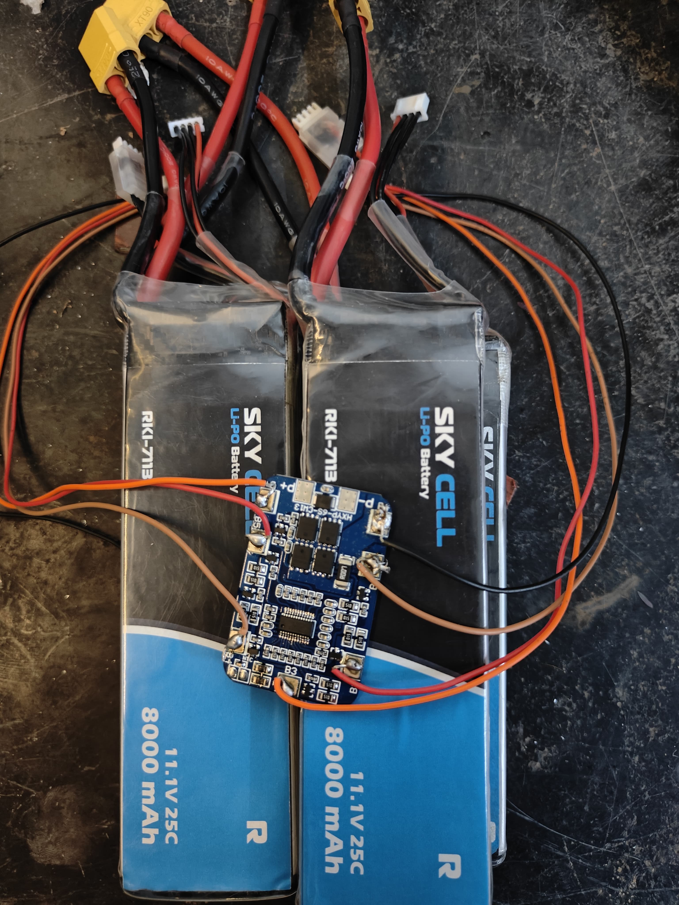
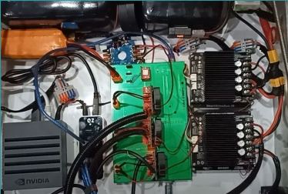
ROVER DESIGN
Electronics and power system:
Visuals of the system
(2 photos/screenshots)

Slide 19
ROVER DESIGN
Electronics and power system:
• The rover has a Li-Io battery and a LiPo battery, each with 6 cells that weigh 1.5 kg and 1650 g respectively. Our unique electronics box encapsulates all the components with its purpose to protect the components from dust, heat, water etc. The motors for the bogie in the rocker-bogie suspension are coupled in the motor drivers to help with the differential drive mechanism.
• The rover has been tested for 90 mins of continuous traversal in multiple terrain. Electronics box has been manufactured keeping in mind the dusty and rocky terrain of competition site. Kill switch is employed to shutdown the rover in case of emergency.
Technical Specifications including mass and battery duration (3-5 sentences)
Discuss the system's adequacy for its role in competition missions. (3-5 sentences)

Slide 20
ROVER DESIGN
Manipulation system:
• The robotic arm has 5 degrees of freedom. It uses linear actuators for the movement of the shoulder and the elbow joints. A bevel gear mechanism is used for the pitch and roll of the end effector.
• The end effector uses a linear mechanism which offers a higher gripping force and more gripping surface.
• The arm links are made up of carbon fiber rods for lighter weight and increased strength.
• The base plate of the arm uses a planetary gear mechanism to rotate the arm.
What is used? Describe the system
(3-5 sentences)
Why the system is chosen? What are the considerations? What are weaknesses and strengths?
(3-5 sentences)

Slide 21
ROVER DESIGN
Manipulation system:
• Linear actuators with a proportional controller are used to give precise control, as they have minimal backlash and high strength to weight ratio.
• The end-effector is a two jaw gripper with Differential bevel gears to control its roll and pitch motion, enabling the rover to perform tasks like flipping switches, pushing buttons, operating a joystick and opening drawers.
• Our inspiration for this robotic arm is a human's arm itself. Just like our human arm has two links ( shoulder and elbow ) and a wrist, that can perform roll and pitch motion, our robotic arm is proficient in doing the same.
Unique points and inspirations
(3-5 sentences)

Slide 22
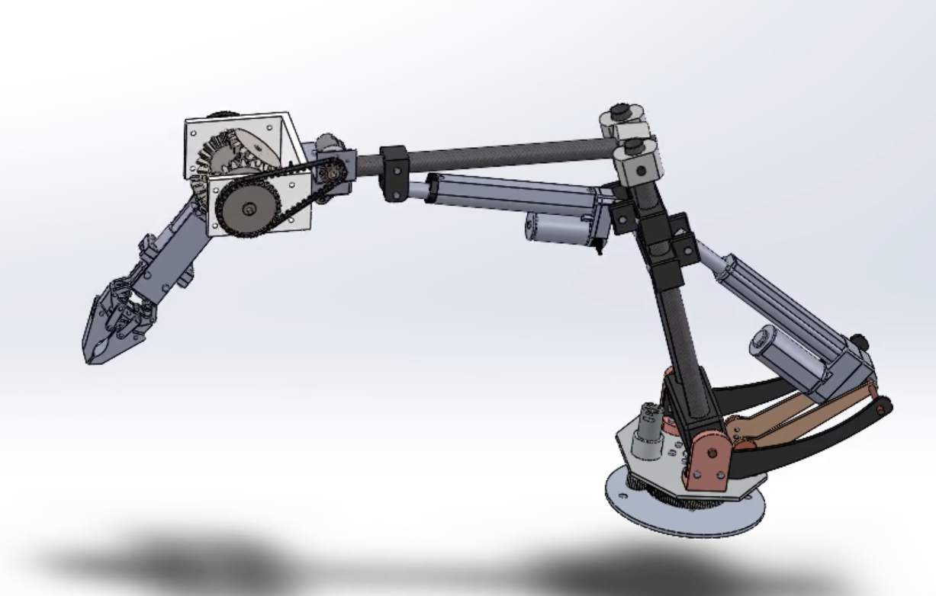
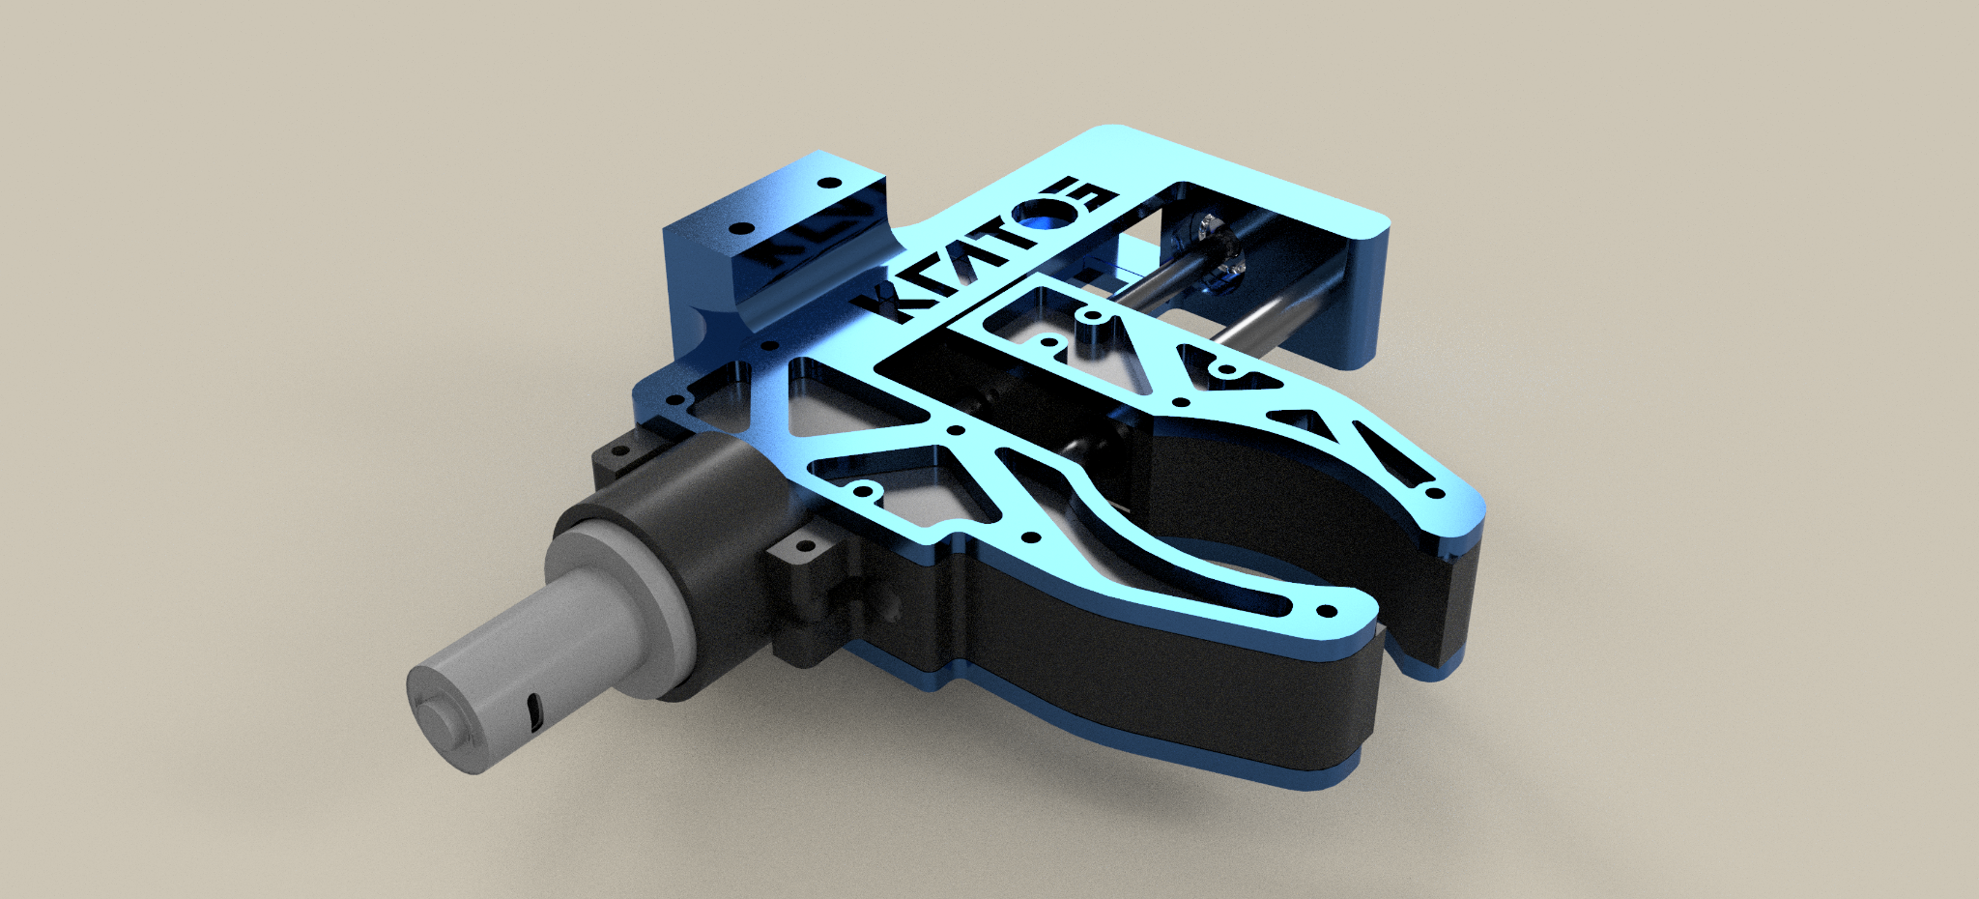
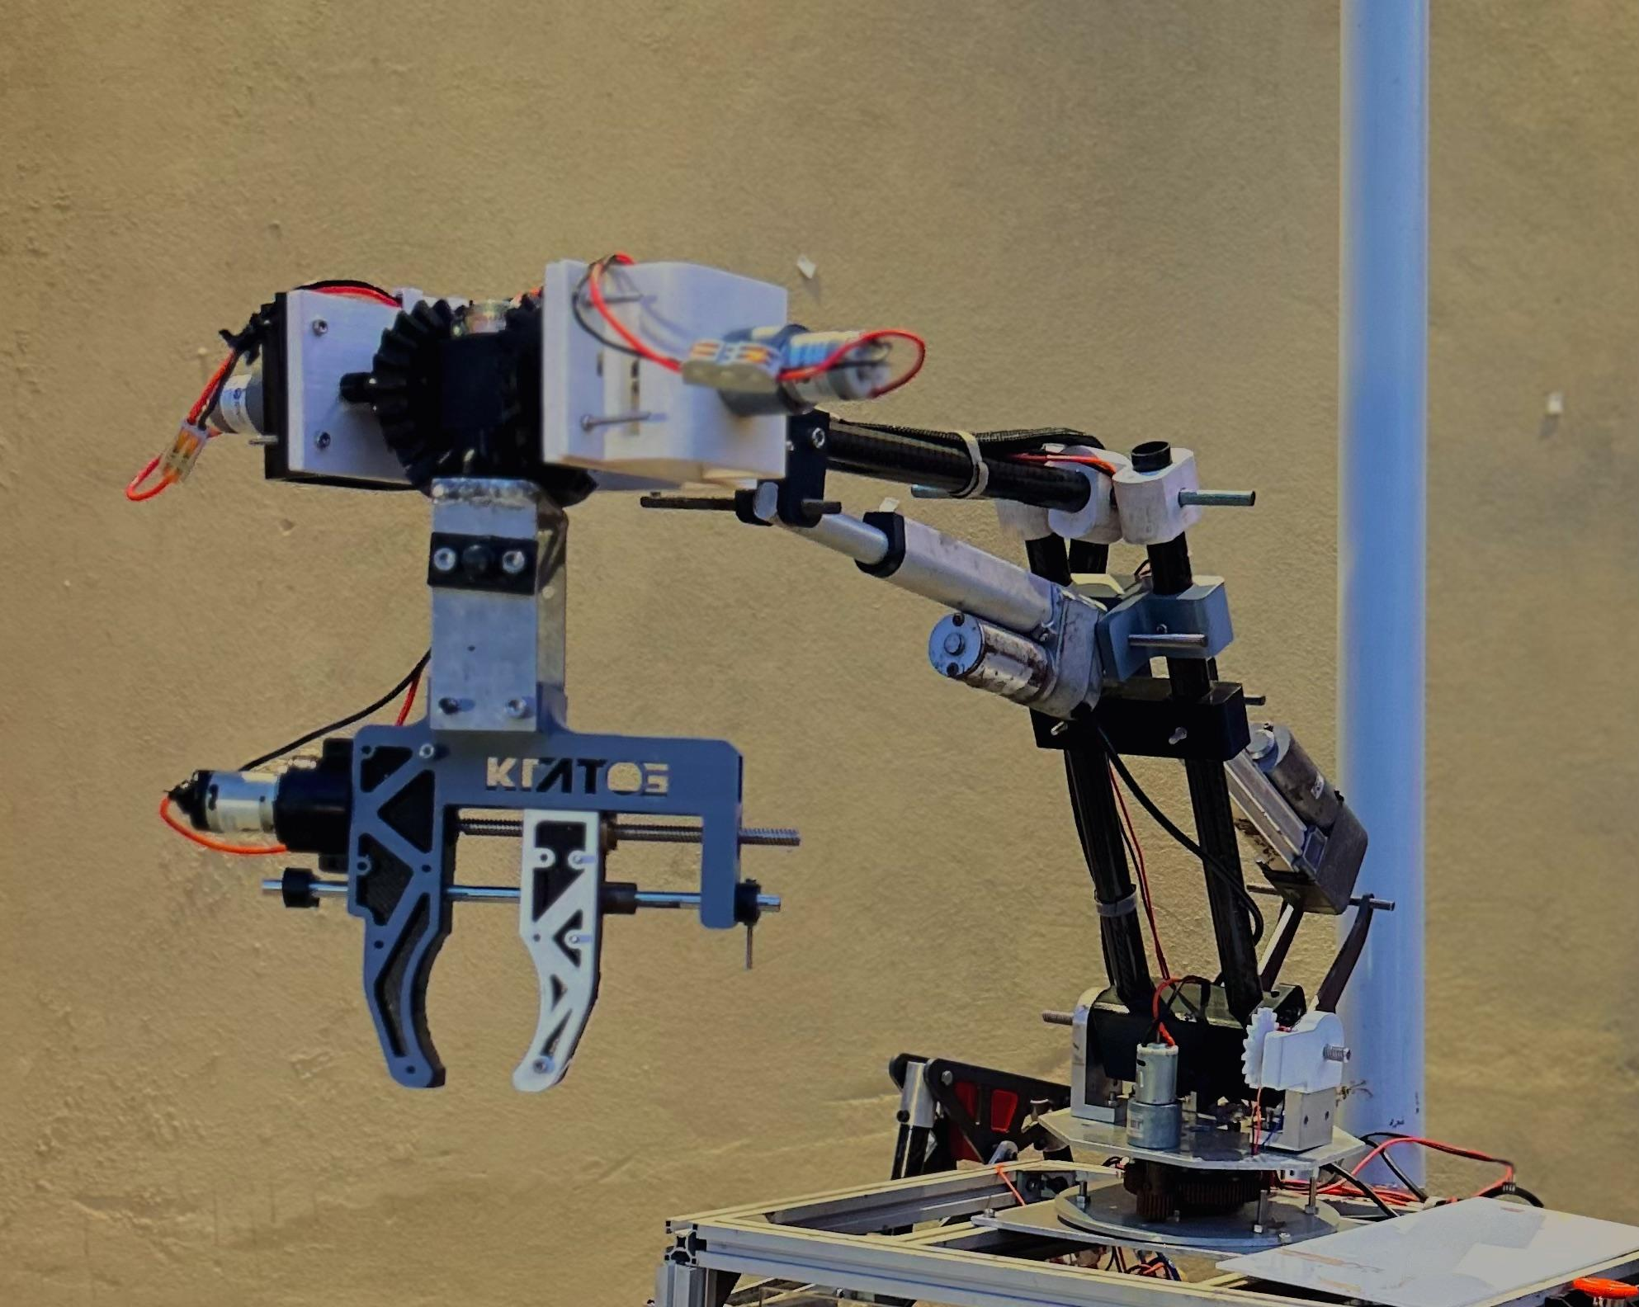
ROVER DESIGN
Manipulation system:
Visuals of the system
(2 photos/screenshots)

Slide 23
ROVER DESIGN
Manipulation system:
• The robotic arm weighs 7.5 kg and is mounted at the centre on the chassis.
• The arm is capable of lifting loads up to 12 kg.
• Our improved gripper is capable of gripping objects with a wider diameter which when measured comes out to be upto 10 cm.
• Our arm follows a linear trajectory during its movement, this is done using a PID controller which allows for tasks to be completed more accurately and faster.
• The two linear actuators used for the arm help us in precise motion and gives a maximum extension of 4 inches and 6 inches per actuator respectively.
• The base motors provide high loading torque which allows us to pull heavy objects with ease and accuracy.
Technical Specifications including mass, max payload and size
(3-5 sentences)
Discuss the system's adequacy for its role in competition missions. (3-5 sentences)

Slide 24
ROVER DESIGN
Science Payload:
• A robotic arm with an auger for an end effector is used to collect soil. Johnson motors are used to control the motion of the arm.
• Multiple containers are then used to store the samples for later chemical analysis.
• The auger system was implemented based on our learning from the previous iterations of ARC, IRC and URC, where we faced issues with soil collection using a ratchet wheel mechanism, The main weakness of that design was its weight and high power consumption. The arm design solves that issue and allows us to collect soil with more precision than before.
• Our auger allows us to drill into harder soil and collect samples from the expected depth of 5 cm and collect upwards of 30 g in soil.
• Our main weakness with the auger design is contamination, since our design does not incorporate multiple augers we are faced with a potential issue for cross contamination within sites, to minimize this we would make multiple sample extractions before extracting the final sample at each site to ensure that residual traces of previous collected soil are kept to a minimum.
What is used? Describe the system
(3-5 sentences)
Why the system is chosen? What are the considerations? What are weaknesses and strengths?
(3-5 sentences)

Slide 25
ROVER DESIGN
Science Payload:
• The arm base plate has the capability to rotate 180 degrees, thus making it easier to collect samples without worrying about lining up the extraction mechanism with the sample size. This cuts down the time required to carry out the task significantly.
• We use a ML model for rock detection on board the rover. Logitech cameras are used to capture the images, then they are processed by a CNN model trained on a homegrown dataset with 10 categories of rocks. We are working on increasing the categories.
Unique points and inspirations
(3-5 sentences)

Slide 26
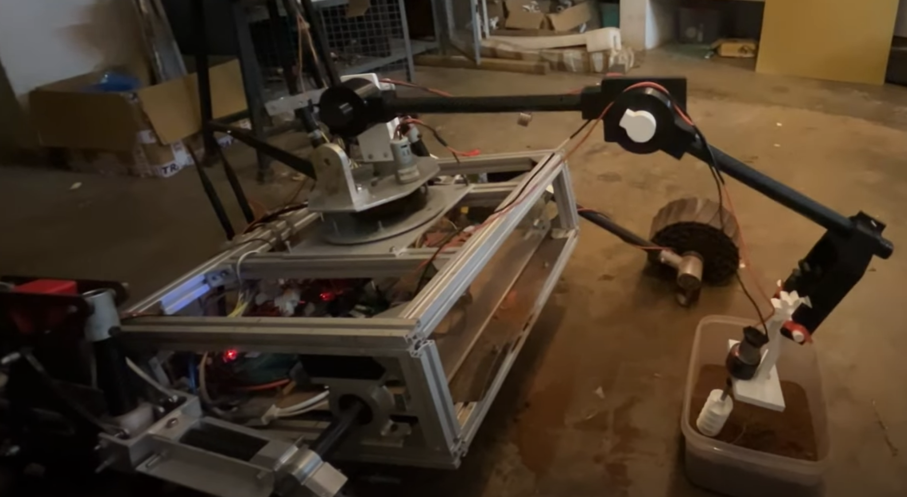
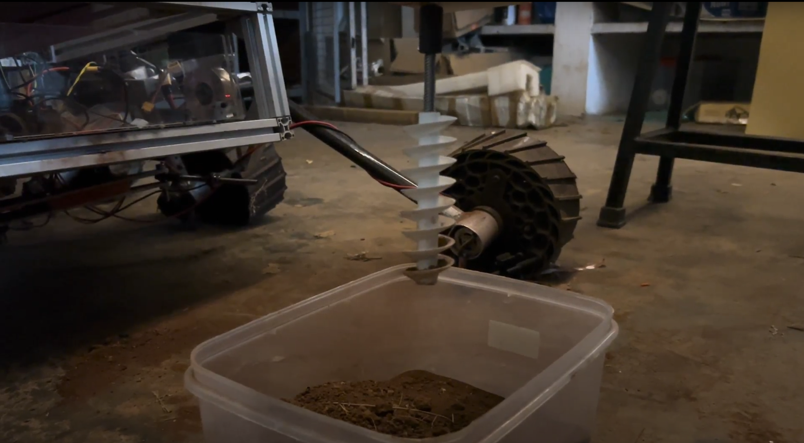
ROVER DESIGN
Science Payload:
Visuals of the system
(2 photo/screenshots)

Slide 27
ROVER DESIGN
Science Payload:
• Science payload is of 4 kg including arm and the container.
• The arm is capable of precisely depositing the soil in the container.
• The robotic arm is powered by a 12000 MaH 12.6V Jetfire LiPo Battery.
• The Science assembly also consists of 4 atmospheric and gas sensor assembled on a custom PCB using sensorboard PCB. The Arm PCB is integrated for motors on the assembly.
• Our batteries provides sufficient charge for the entire duration of the task.
• The whole rover along with the science assembly weighs around 40 Kg.
Technical Specifications including mass and battery duration (3-5 sentences)
Discuss the system's adequacy for its role in competition missions. (3-5 sentences)

Slide 28
ROVER DESIGN
Ground station equipment and communication system:
• A combination of Lithium Ion and LiFePO4 batteries with built-in BMS and Cell balancing has been used to power the rover.We have custom derived and assembles a 2s-2p configuration battery pack for the Drive. This has been integrated with BMS with Voltage & Current requirements.
We have made custom PCBs for every major electronic system present.We use MMDS30 cytron Motor drivers to control the wheels
The cytrons receive input through an esp32 chosen for its fast processing.The Jetson Communicates to the esp32 via serial communication
• Lithium-based batteries has been opted owing to their high energy/kg. Custom PCBs and wire connectors are chosen due to their ease of use once integrated, along with making easy to debug. Making the electronics on board more modular is the motive.
What is used? Describe the system.
(3-5 sentences)
Why the system is chosen? What are the considerations? What are weaknesses and strengths?
(3-5 sentences)

Slide 29
ROVER DESIGN
Ground station equipment and communication system:
• The arm base plate has the capability to rotate 180 degrees, thus making it easier to collect samples without worrying about lining up the extraction mechanism with the sample size. This cuts down the time required to carry out the task significantly.
• We use a ML model for rock detection on board the rover. Logitech cameras are used to capture the images, then they are processed by a CNN model trained on a homegrown dataset with 10 categories of rocks. We are working on increasing the categories.
Unique points and inspirations
(3-5 sentences)

Slide 30
ROVER DESIGN
Ground station equipment and communication system:
Visuals of the system
(2 photos/screenshots)

Slide 31
ROVER DESIGN
Ground station equipment and communication system:
• The robotic arm is powered by a 12000 MaH 12.6V Jetfire LiPo Battery.
• The Science assembly also consists of 4 atmospheric and gas sensor assembled on a custom PCB using sensorboard PCB. The Arm PCB is integrated for motors on the assembly.
• Our batteries provides sufficient charge for the entire duration of the task.
• The whole rover along with the science assembly weighs around 40 Kg.
Technical Specifications including resilience to noise and communication range (3-5 sentences)
Discuss the system's adequacy for its role in competition missions. (3-5 sentences)

