Slide 1
2024
Design Report

Slide 2
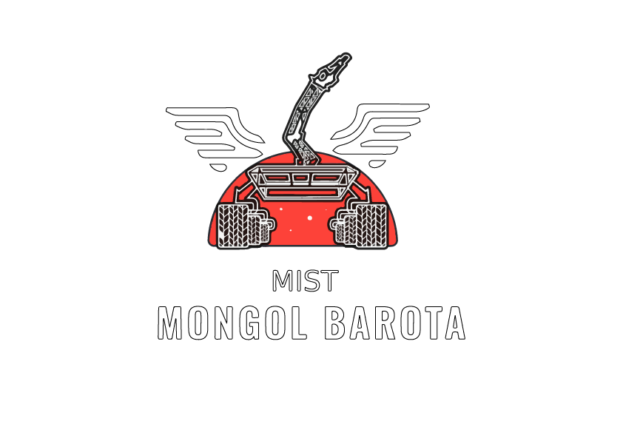
TEAM INFO
Team Name:
MIST MONGOL BAROTA
Rover Name: MAVERICK
Contact:
Email: mars.rover.mist@gmail.com
Contact No: +8801538257003
Team Lead(Jawad Rahman): +8801538257003
Academic Consultant(Lecturer Shah Md Ahasan Siddique): +8801710301593
Facebook Page: https://www.facebook.com/mongolbarota.mist
LinkedIn: https://www.linkedin.com/company/mist-mongol-barota
Instagram: https://www.instagram.com/mist_mongolbarota/

Slide 3
TEAM INFO
Academic
Institution:
Military Institute of Science and Technology(MIST)
Mirpur Cantonment, Dhaka, Bangladesh
Academic
Consultant:
1. Lt Col Muhammad Nazrul Islam, PhD
Associate Professor, Department of CSE ,Military Institute of Science and Technology(MIST)
Email: nazrul@cse.mist.ac.bd
Phone: +8801725560099
2. Dr. Md Akhtaruzzaman
Assistant Professor, Department of CSE ,Military Institute of Science and Technology(MIST)
Email: akhter900@cse.mist.ac.bd
Phone: +8801754823989
3. Shah Md Ahasan Siddique
Lecturer, Department of ME ,Military Institute of Science and Technology(MIST)
Email: ahasan.sid42@gmail.com
Phone: +8801710301593
4. Md Rashid Ul Islam
Lecturer, Department of CSE ,Military Institute of Science and Technology(MIST)
Email: ahasan.sid42@gmail.com
Phone: +8801969844062

Slide 4
TEAM INFO
History of the Team:
MIST Mongol Barota, a robotics team formed in 2013, has an impressive track record of achievements in various prestigious robotics competitions. In 2014 for the first time from MIST, the team with a rover named “Mongol Barota” participated in URC 2014 and placed 12th position worldwide. In 2015 the team participated in URC 2015 again and placed 9th position globally and was nominated the Best Team from Asia.
In 2016 the team with their rover “Explorer-0100” participated in European Rover Challenge (ERC) 2016 and placed 21th position globally. In 2021 the team with their rover named “PHOENIX” participated in URC 2021 virtual Final and placed 1st position globally and was achieved the Champion title of URC 2021.
In 2022, the team scored 92.85% marks in SAR which is the highest among all teams of Bangladesh and was selected for the Final Round of URC 2022. The subsequent year, in URC 2023, they yet again qualified for the final with the highest score, further cementing their status as a force to be reckoned with.
Notably, in ARC (Anatolian Rover Challenge) 2022, MIST Mongol Barota secured an impressive 3rd position after participating in the competition for the first time, a remarkable achievement for a newcomer. Most recently, in ARC 2023, they achieved the 5th position globally, demonstrating their consistent performance and ability to excel in various arenas.

Slide 5
TEAM INFO
History of the Team:

Slide 6
TEAM INFO
Name | University Major | Role
Md Jawadur Rahman | CSE | Team Lead
Al-Amin Rashid Tarek | ME | Team Co-lead
Mansib Hasan Rohan | EECE | Electrical Lead
MD Maruful Islam | EECE | Electrical
Md. Mahfuzur Rashid Ullash | EECE | Electrical
Md. Faizul Islam Leon | EECE | Electrical
MD.Shahrear Nafees Kamal | ME | Electrical
Tanvir Ahmed | ME | Electrical
Areeb Ayman Haq | EECE | Electrical
Md. Hasınur Rahman Hasın | EECE | Electrical
Istiaque Ahmed Arik | CSE | Communication & Software Lead
Labiba Ibnat Matin | CSE | Communication & Software
Fatima Ashraf Abiha | CSE | Communication & Software
Mrinmoye Das Piu | CSE | Communication & Software
Raisul Islam Rahad | CSE | Rover Autonomy & Navigation Lead
Abdulla Al Shahariar | CSE | Rover Autonomy & Navigation
Active
Members List:

Slide 7
TEAM INFO
Name | University Major | Role
Ahmed Ahnaf Saqafi | ME | Mechanical Lead
Md. Faysal Hossain | ME | Mechanical
Md. Jamil Ahmed | ME | Mechanical
Saymoon Zaman Sayeem | ME | Mechanical
Quazi Shadid Rashid | ME | Mechanical
Md. Reduan Ahmed Bappy | ME | Mechanical
Abrar Shahria | ME | Mechanical
Saprativ Karmaker | ME | Mechanical
Mayesha Farzana | ME | Mechanical
Orko Basak | ME | Mechanical
Anika Tahsin Raisa | EWCE | Science Lead
Progga Laboni Ray | CSE | Science
Anindita Das Swarna | ME | Science
Sadia Islam | CSE | Science
Reefah Tasnia Haque | CSE | Management Lead
Maliha Farhin Chhoa | ME | Management
Shahriar Abid Swapnil | EECE | Management
Mahir Tajwar Shabab | PME | Management
Active
Members List:

Slide 8
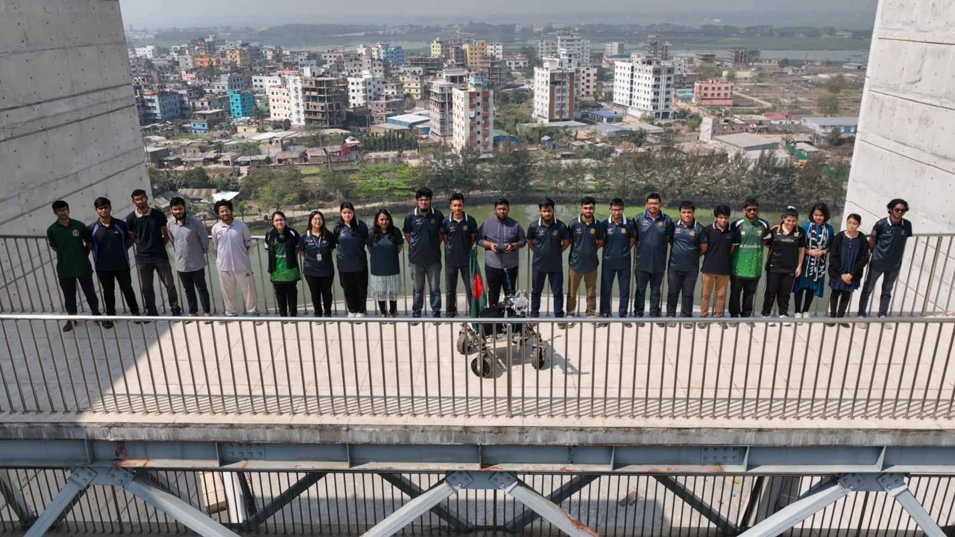
TEAM INFO
Team Photo

Slide 9
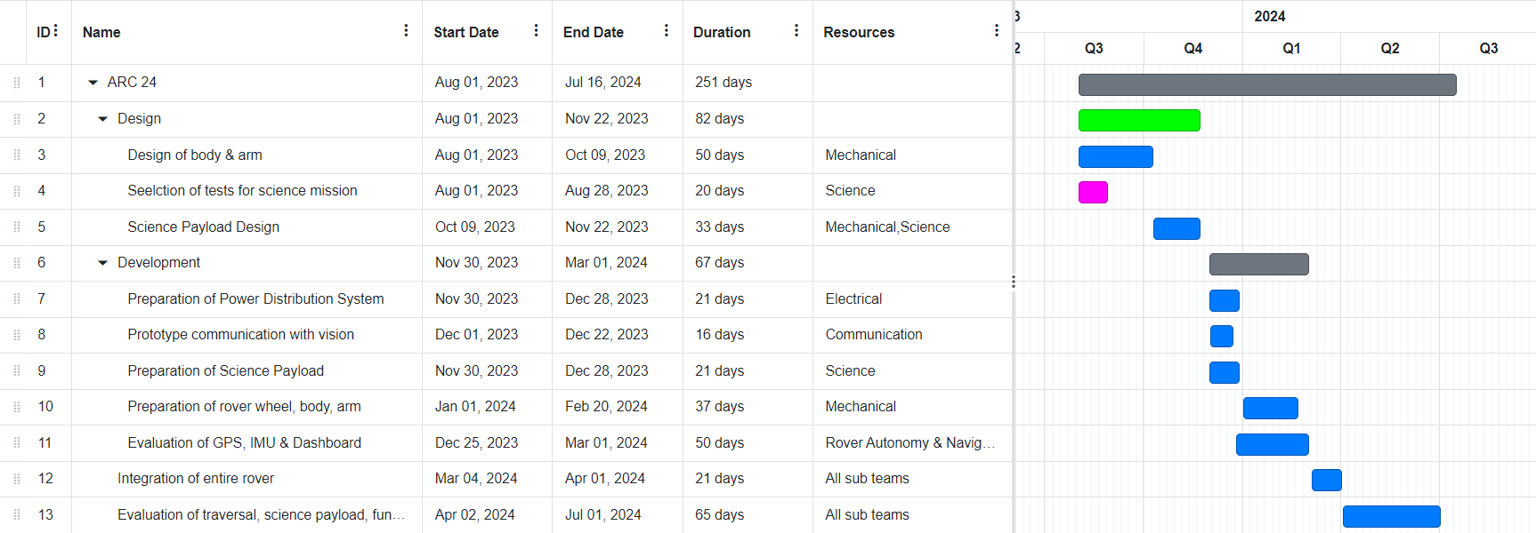
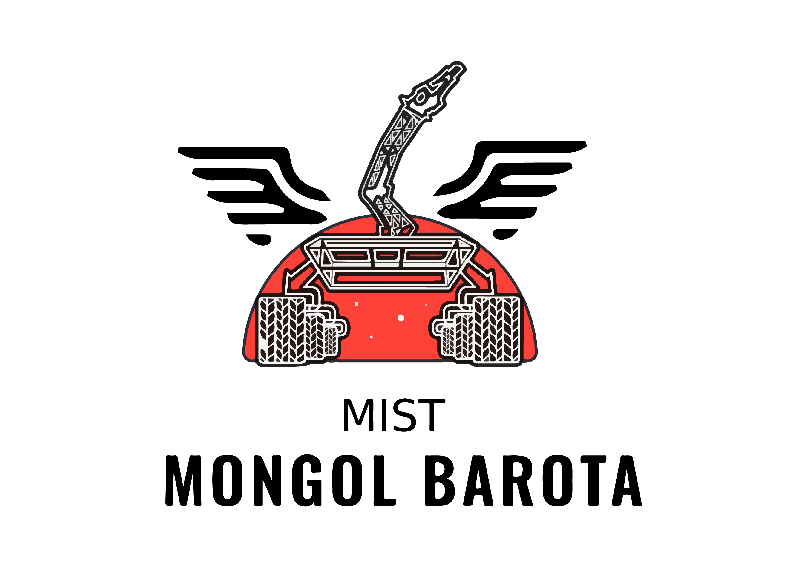
MANAGEMENT
Work Calendar:

Slide 10
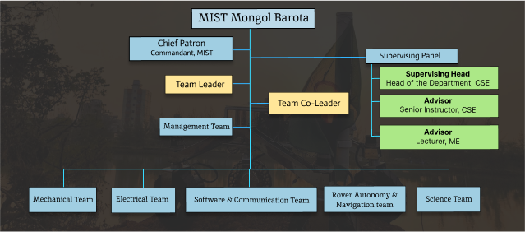
MANAGEMENT
Team
Formation:
MIST Mongol Barota is a robotics team of over thirty individuals, each bringing their unique skills and expertise to the table. The team is divided into six sub-teams: Mechanical, Electrical, Software & Communication, Rover Autonomy & Navigation, Science, and Management. Each of these sub-teams contributes to the diverse skill set of the overall team. The team has flourished under the guidance of a Team Leader and Co-Leader, attracting members from a wide range of backgrounds and specialties which is one of the team’s greatest strengths.

Slide 11
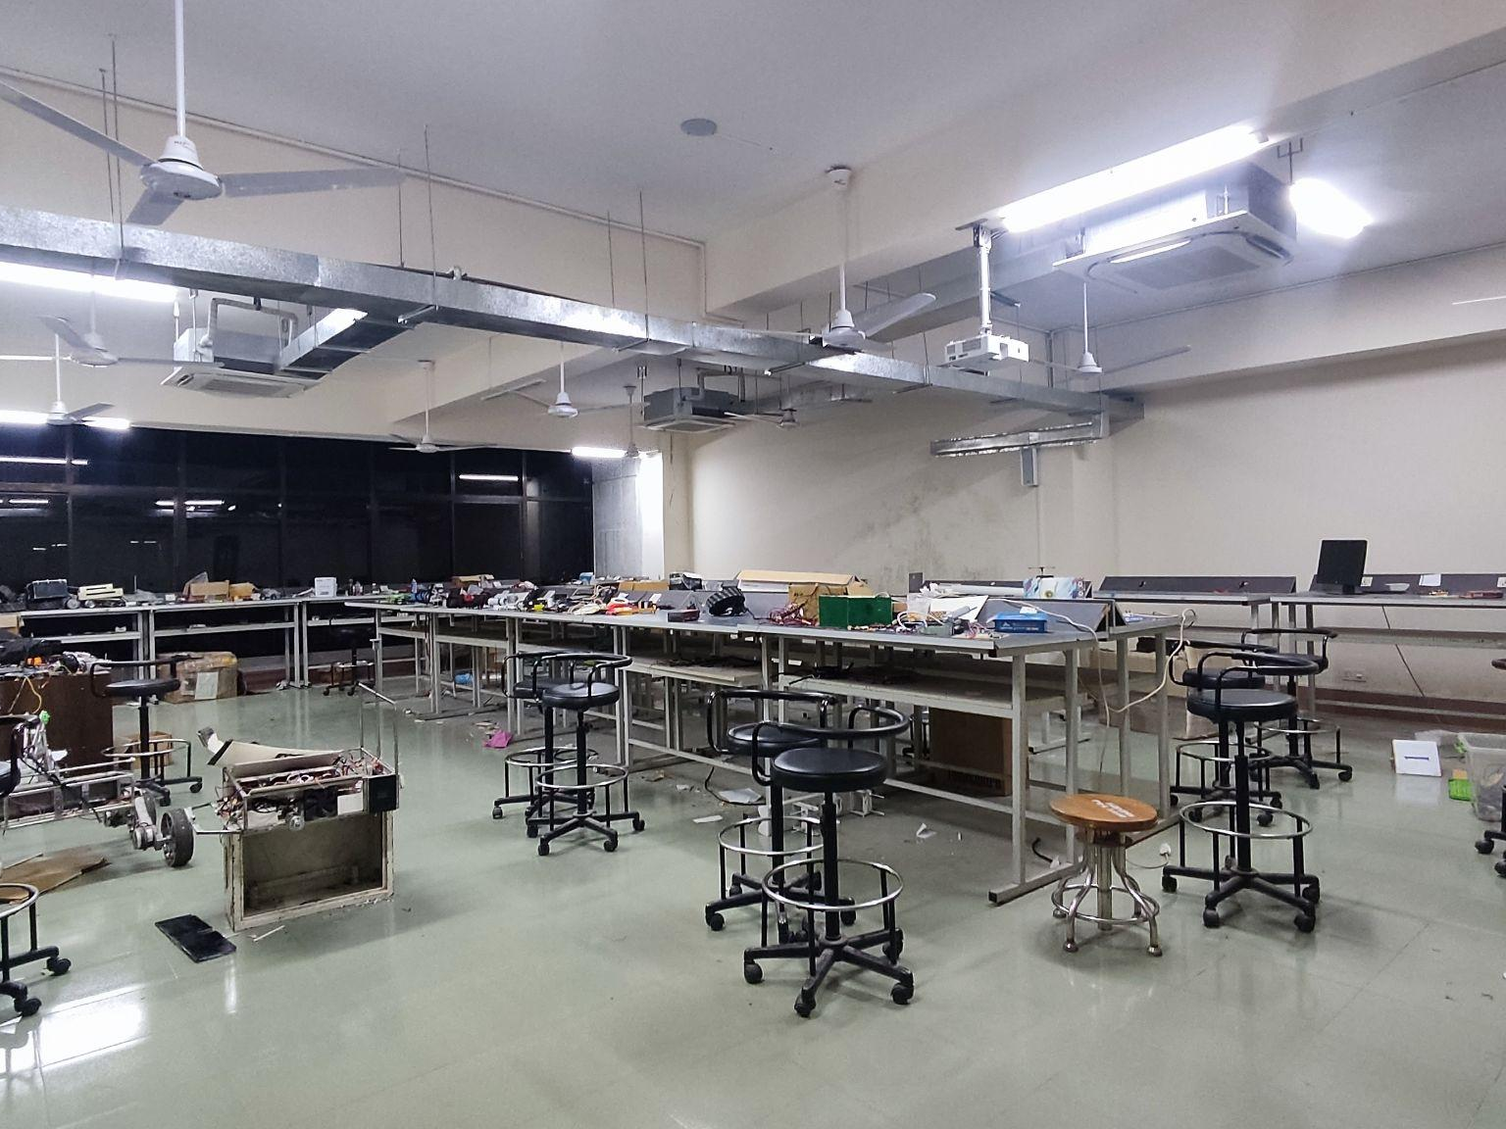
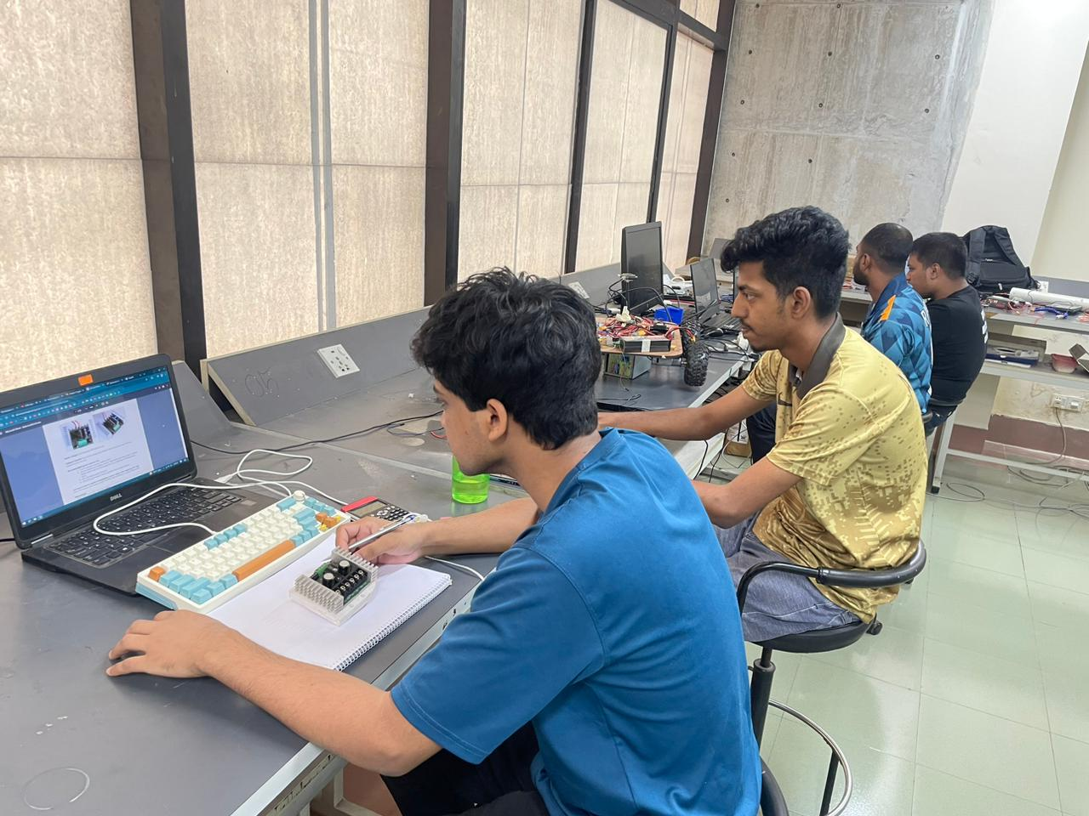
MANAGEMENT
Workplace:
We are have dedicated laboratory exclusively for the MIST Mongol Barota team. Our campus field serves as a versatile testing ground for various types of field tests. Additionally, we occasionally utilize the ample space available at construction sites and fields in close proximity to our campus for conducting our field tests.

Slide 12
MANAGEMENT
Funding :
At the start, we were allocated a certain amount of funds : 42,000 USD. To date, we have spent 10,500 USD on development costs. The remaining funds are earmarked for additional testing, practice, and competition-related expenses..
Our team has allocated a budget of 18,000 USD for the development of the rover, encompassing various aspects such as the rover body, processing & control Modules, science module, communication equipment and more. Additionally, we have secured funds to cover the travel expenses of 22,000 USD for our 14-member team’s participation in ARC 2024 in Turkey.
Our rover is fully operational and we are prepared to compete in the forthcoming ARC. In the event of a funding shortfall, we have a reserved budget specifically for such Research & Development Projects. Historically, our university’s sponsorship proposals have been well-received by various industries and banks. We have already initiated the process by sending out sponsorship proposal forms and have received encouraging responses. Therefore, we can rely on their support if necessary.

Slide 13
MANAGEMENT
Logistics:
In order to guarantee the punctual and dependable transport of the rover, we have strategized to segregate it into multiple modules, which will be transported in our personal baggage. Each of these modules will be adequately packed with materials to reduce any potential damage. This method not only facilitates the swift assembly and disassembly of the rover but also proves to be more efficient compared to conventional shipping services, which often needs longer durations. Furthermore, this approach provides us with greater control over the handling of the rover components, reducing the risk of mishandling by third parties.

Slide 14
ROVER DESIGN
Mobility
System:
The rocker bogie suspension system along with a bevel gear differential mechanism is used to keep all the wheels in contact with the surface even when driving on severely uneven terrain. For the steering system we have used stepper motors and thrust bearings in each of the wheels, which ensure independent steering for all four wheels. Apart from this, our rover wheels are made of 3D-printed TPU to ensure maximum traction and shock absorption.
Instead of only stainless steel, we used a combination of carbon-fiber and stainless steel links in the rocker arm for a high strength-to-weight ratio and better stiffness. The steerable wheel subsystem ensures better maneuvering and precise movements of the rover. A thrust bearing has been implemented to carry the axial load to the wheel, while minimizing friction during steering.

Slide 15
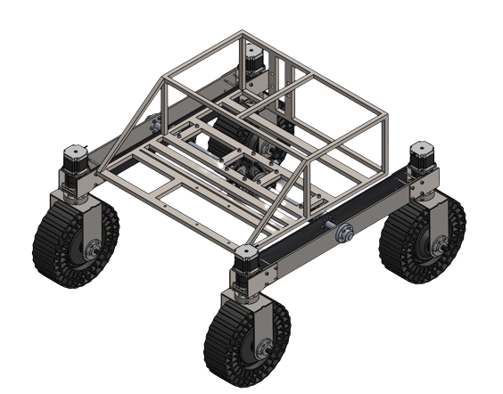
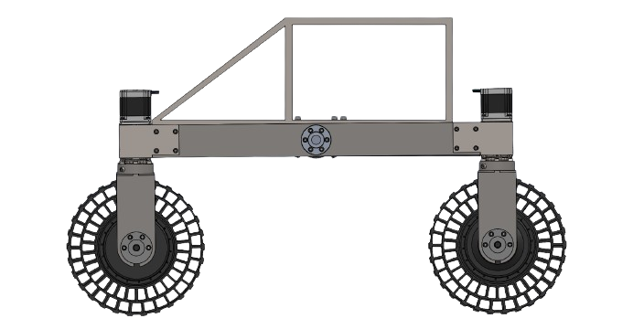
ROVER DESIGN
Mobility
System:

Slide 16
ROVER DESIGN
Mobility
System:
Maverick weighs 50 kg in total.
The full rover size is 87 cm x 86 cm.
The chassis is 55 cm x 45 cm x 15 cm in dimension.
The diameter of the wheel is 23 cm.
The rover is well-equipped with better suspension and shock absorption. The rover navigates rough terrain and ascends elevations smoothly, avoiding complications. It maneuvers through narrow spaces without collisions or damage. Furthermore, it executes precise movements along predetermined paths with accuracy.

Slide 17
ROVER DESIGN
Electronics and power system:
The rover is powered by 6 Li-Po batteries combining 36V having 20000mAh capacity. This 36V is converted to 36V, 24V, 16V, 12V and 5V using a power distribution board with a battery management system for different types of loads. The wheel motors run on 36V, stepper motors for steering, base of arm and antenna run on 24V, all other motors, actuators, fans and camera run on 12V. Jetson and logic circuits are powered using 16V and 5V respectively. Each circuit uses custom PCBs which enables modular architecture of the electronics subsystem and is implemented by simulating the real time electrical circuits of the rover.
The electronic subsystem is divided into two modules to facilitate rapid and effortless plug-and-play functionality. This means that each module can be connected to the rover individually for configuration and operation, without impacting the functionality of other modules when electrical components are swapped during missions. Essentially, the modular design guarantees portability, minimizes maintenance time, and simplifies fault detection processes.

Slide 18
ROVER DESIGN
Electronics and power system:
A battery management system has been implemented for stabilizing the voltage supply of the rover.
Multiple temperature sensors are integrated throughout the system, continuously monitoring temperature levels. If the temperature surpasses a predefined dangerous threshold, the system will automatically initiate a shutdown procedure and signal it with an LED indicator.
Some cooling fans are used to cool down the electronic components of the rover for safety and better performance.
Rover safety is guaranteed through the incorporation of a fail-safe mechanism in the code, enabling remote shutdown of all rover operations when necessary.
A kill switch is used to shut down all the moving components of the rover in any emergency.

Slide 19
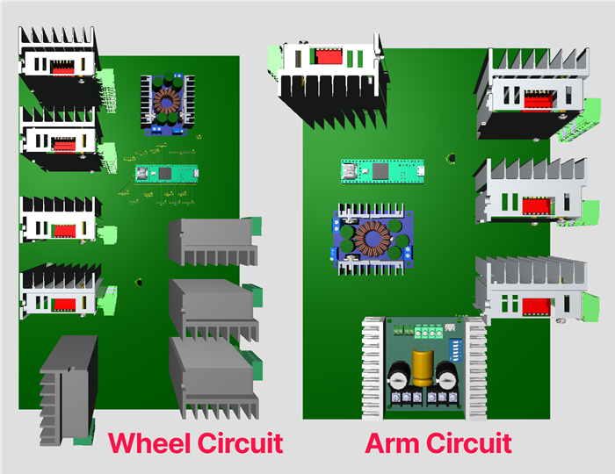
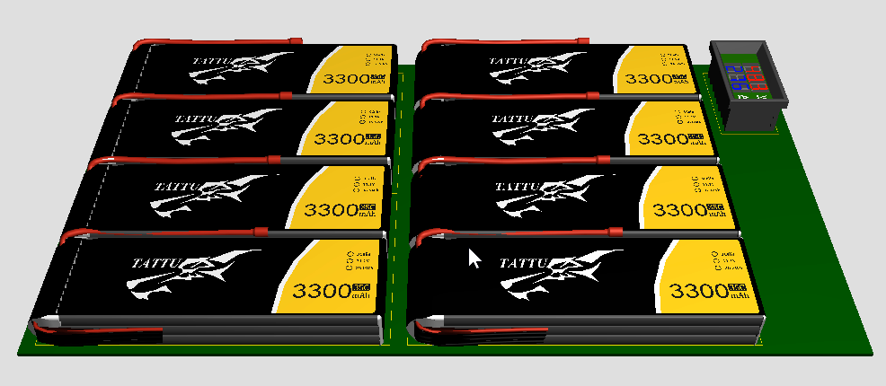
ROVER DESIGN
Electronics and power system:

Slide 20
ROVER DESIGN
Electronics and power system:
Voltage | 36V ( (12V+12V+12V) || (12V+12V+12V) )
Capacity | 20000mAh
Technology | 3S Li-Po
Weight | 6 x 378g
Operating Time | 45 minutes
The maximum mission duration is set at 30 minutes. Our rover's wheels and arm can operate at full power for 45 minutes, ensuring the capability to accomplish any ARC mission. Furthermore, our system is engineered to withstand rough terrain traversal without causing harm to electronic components.

Slide 21
ROVER DESIGN
Manipulation system:
To ensure an effective grip, the ideal claw design was determined through experimentation with different shapes. A worm gear mechanism is utilized to provide the claws with a secure hold. The worm gear mechanism is driven by two stepper motors that provide rolling and pitching motion to the end effector.
Carbon fiber is used in the arm links due to its high strength-to-weight ratio reducing the arm's overall weight. The exact length of the arm link is connected to linear actuators to enhance the arm's payload capacity.

Slide 22
ROVER DESIGN
Manipulation system:
The manipulation system is driven by two linear actuators for their payload capacity, reasonable cost and reduced complexities, and allows for precise and versatile movement. The arm is equipped with an interchangeable end effector with differential mechanism driven by stepper motors, suitable for both science and equipment servicing missions. Custom made bearing housing and 3D printed spacers are used for link joints to ensure best fit and reduce backlash.

Slide 23
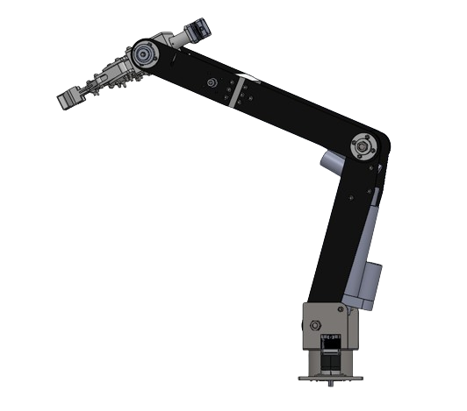
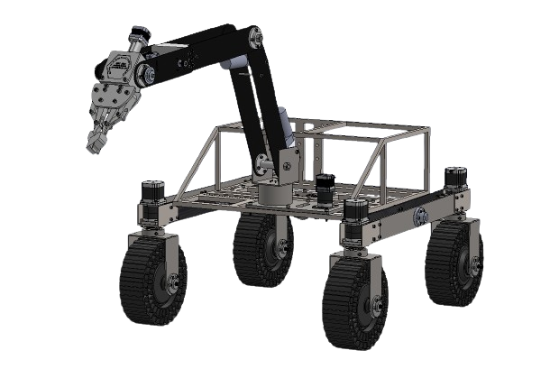
ROVER DESIGN
Manipulation system:

Slide 24
ROVER DESIGN
Manipulation system:
Mass: 8.5 kg
Max payload: 6 kg
Max reachable height: 1390 mm
Operating Radius: 830 mm
Size: 1200mm X 250mm X 150mm
The articulated arm features 5 Degrees of Freedom (DOF) and is designed using inverse kinematics principles. To ensure precision in waist motion, multiple gear ratios were examined, ultimately selecting a 5:1 ratio spur gear in the arm base. A worm gear mechanism is employed to deliver a secure grip to the claws, optimizing their structure for performance.

Slide 25
ROVER DESIGN
Science Payload:
The rover's science payload is designed to test soil and rock samples to determine the presence or absence of life, whether it's extant or extinct. Soil is drilled by an auger drill bit and collected using a gripper, while rocks are inspected with a USB microscope and sensors. Data and images of the rover's science payload are designed to test soil and rock samples to determine the presence or absence of life, whether it's extant or extinct. Soil is drilled and collected using a gripper. Data and images are processed and analyzed to provide valuable insights processed and analyzed to provide valuable insights.
The system was chosen for its ability collect multiple soil samples with minimal cross-contamination and processes data from rock samples to detect life presence (extinct, extant, or none). Soil sampling is cost-effective, less complex, and compatible with rover systems. Rock analysis relies on machine learning for life detection, diverging from traditional mineral detection methods.

Slide 26
ROVER DESIGN
Science Payload:
The rover employs a 5 DOF arm with a specialized gripper to collect soil samples from depths of at least 5 cm. Samples are identified through Benedict’s and iodine tests for carbohydrate, the Biuret test for protein detection and an Ammonia gas sensor for Ammonia detection . Onboard sensors track soil moisture, pH, temperature, wind speed, and radiation, while rock sample images are transmitted to the base station for analysis. Total organic carbon levels in rocks are detected using a Munsell chart and color sensor.

Slide 27
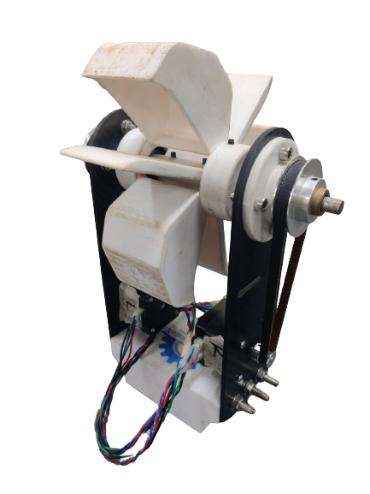
ROVER DESIGN
Science Payload:

Slide 28
ROVER DESIGN
Science Payload:
Size of the soil sample container: 170mm X 80mm X 100mm, Mass: 360 gram
Size of the scoop: 160mm X 160mm X 80mm, Mass: 200 gram
Battery Duration : 45 Minutes

Slide 29
ROVER DESIGN
Ground station equipment and communication system:
The ground station consists of 3 feedback monitors, transmitting antenna and rover controller. 2 separate transmitting antennas have been used for 2 different bands 5.8 and 2.4 GHz.
5.8 GHz band is used for video streaming and radio control. A significant drawback of this system is its high latency over long distances. If the 5.8 GHz connection is lost, a 2.4 GHz joystick control takes over for teleoperation. When the 2.4 GHz connection is disrupted, data reception halts, and all information is temporarily stored in a device until the connection is restored, at which point the data is transmitted.

Slide 30
ROVER DESIGN
Ground station equipment and communication system:
The communication system uses two distinct bands for communication. The 5.8 GHz (ISM) band is designated for video transmission and radio control. 2.4 GHz (ISM) band is utilized for data and command transmission through Wi-Fi. We also have a backup joystick control and camera feedback through Wi-Fi.
The system provides lag free video, data and command transmission for monitoring and controlling of the rover in real time. But still In this system the weakness is 5.8 GHz system can fail in long range. If it is lost, rover can be operated with the backup system at 2.4 GHz as it will cover better range than 5.8.

Slide 31
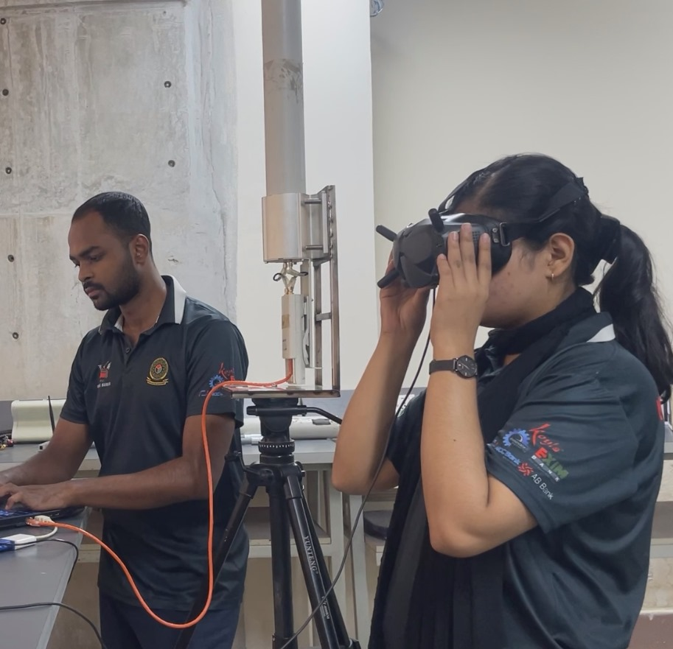
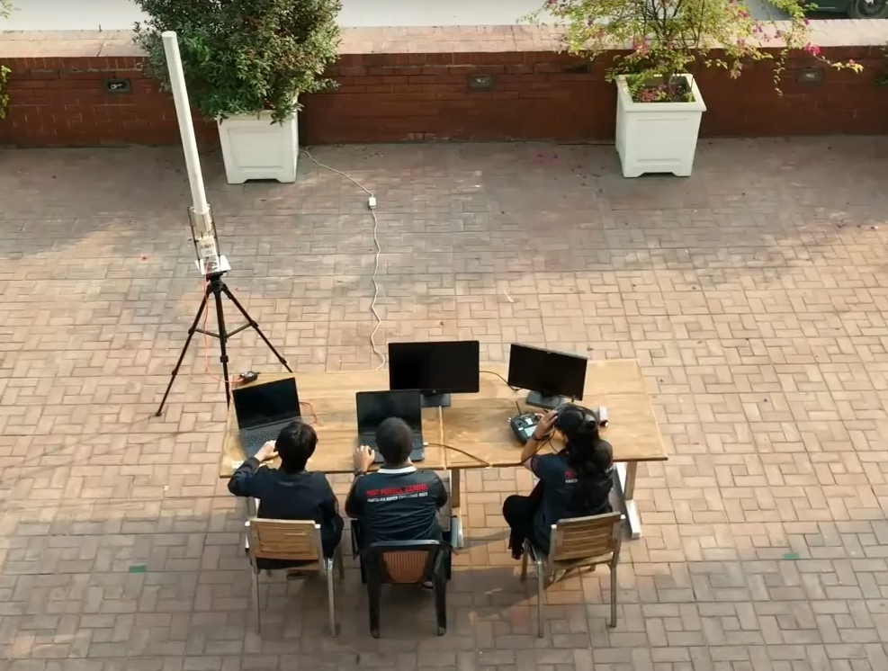
ROVER DESIGN
Ground station equipment and communication system:
In the event of a connection failure, the system retains sensor data as a backup. During communication disruptions, the rover comes to a halt and patiently awaits the restoration of the connection.

Slide 32
ROVER DESIGN
The use of the 5.8 GHz band for video streaming and radio control provides a higher bandwidth but is more susceptible to interference and noise over longer distances. To mitigate potential signal loss, the system employs a failover mechanism using a 2.4 GHz connection for joystick teleoperation control when the 5.8 GHz link is disrupted. Additionally, the system has a data buffering capability that temporarily stores information locally when both the 5.8 GHz and 2.4 GHz connections are lost, allowing for seamless data transmission once the connection is re-established. This redundancy and buffering enhance the system's resilience to communication disruptions and noise over varying ranges.
Ground station equipment and communication system:
While the dual-band communication system with failover capabilities provides a level of resilience, the high latency over long distances on the 5.8 GHz band could pose challenges during the autonomous navigation and sampling tasks in the Anatolian Rover Challenge. The buffering mechanism helps mitigate brief communication dropouts, but extended periods without a live video feed or control link may hinder effective teleoperation across the rugged terrain.

