Slide 1
2024
Design Report

Slide 2
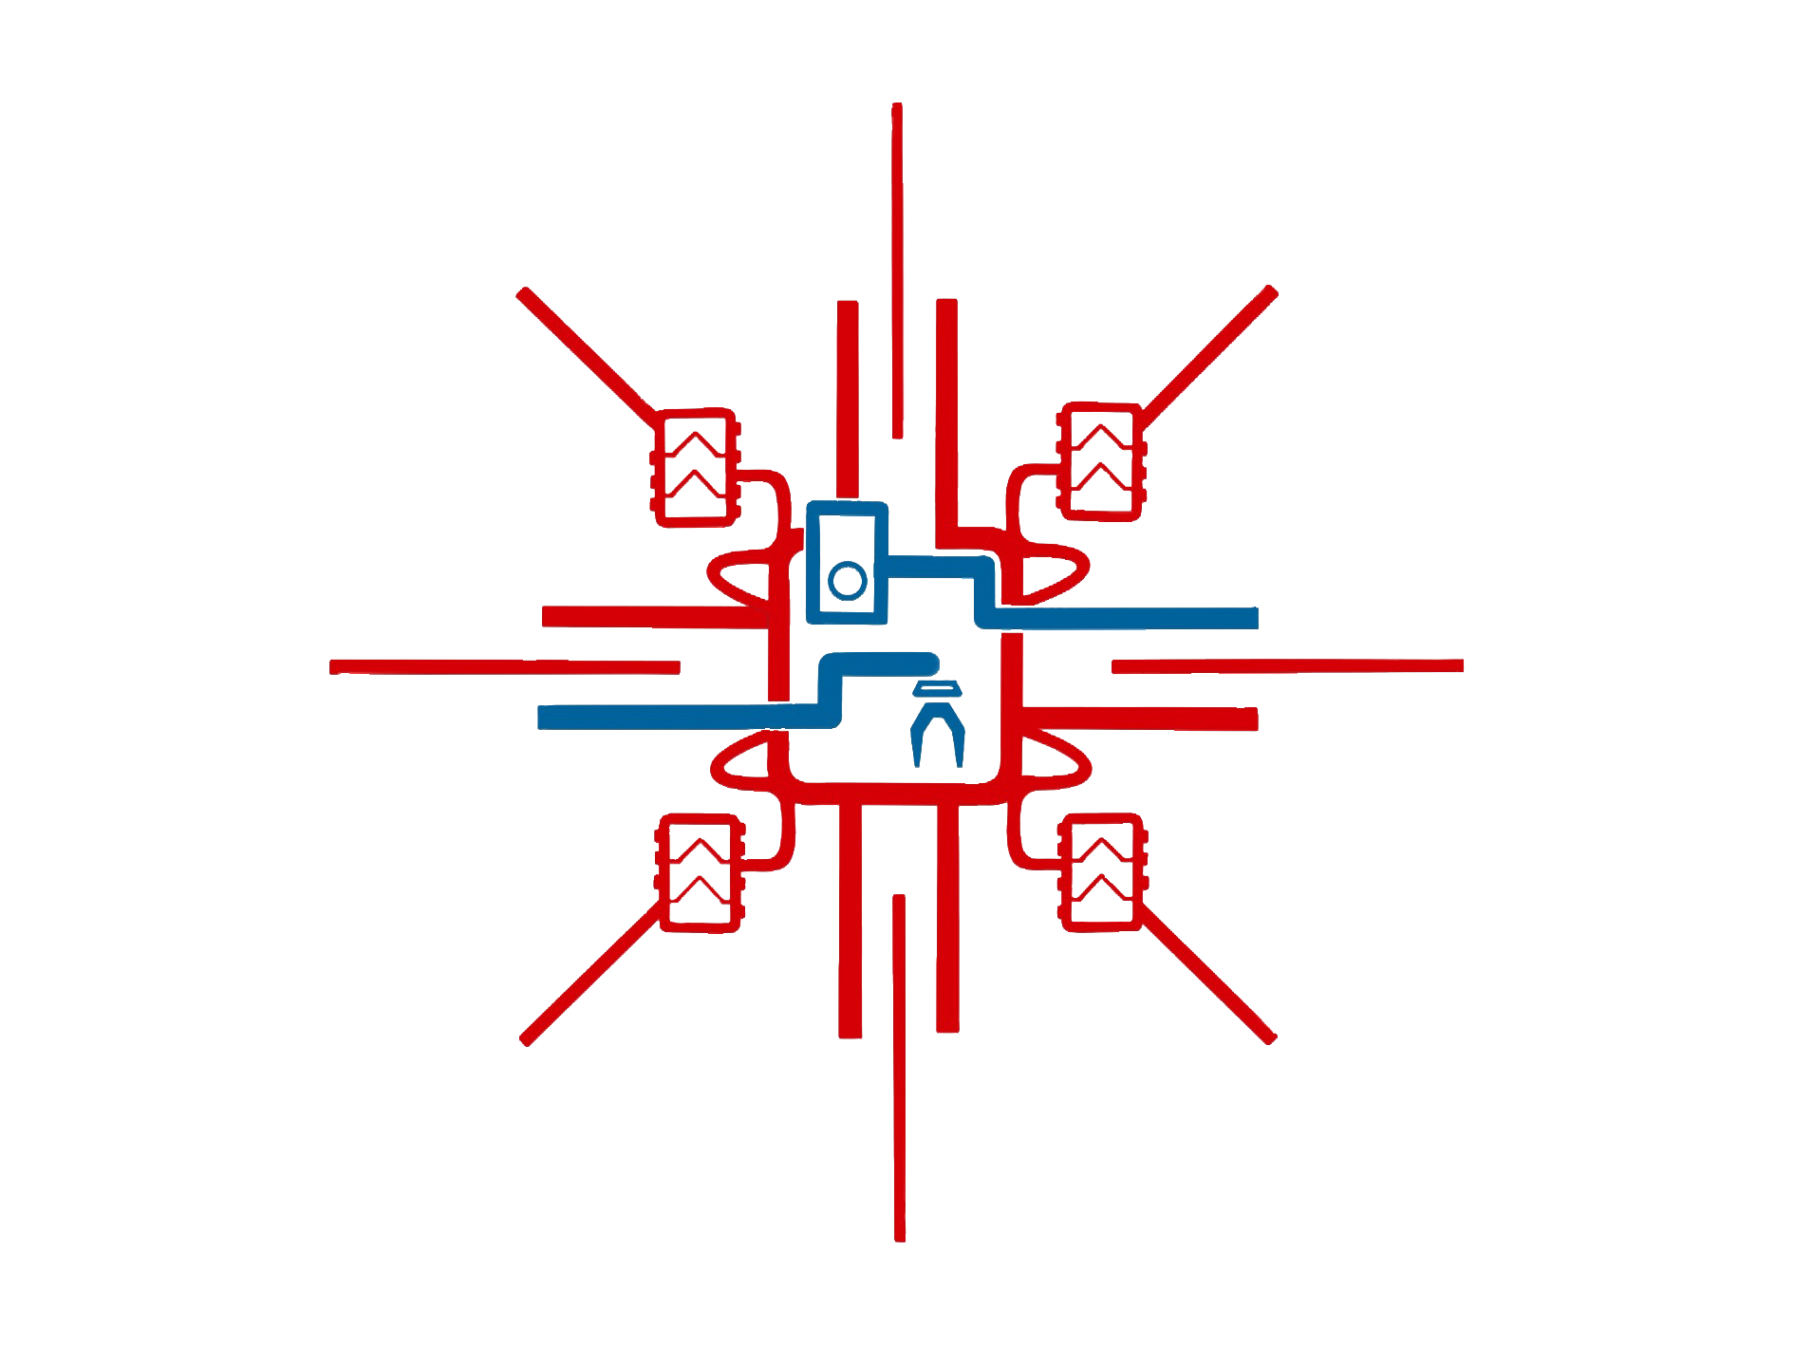
TEAM INFO
Team Name:
IZTECH Cengaver Rover
Name of the team and if applies,
name of the rover.
Contact:
mehmetsener.work@gmail.com
cengaverrover@iyte.edu.tr
cengaverrover@gmail.com
Contact information and
social media links of the team.

Slide 3
TEAM INFO
Academic
Institution:
Izmir Institute of Technology
Name and address of the affiliated academic institution.
Academic
Consultant:
Gökhan Kiper, PhD
Name, affiliated academic institution and contact information of academic consultant.

Slide 4
TEAM INFO
History of
the Team:
IZTECH Cengaver Rover is a student based robotics team at İzmir Institute of Technology. The team consists of 35 members from 3 faculties and 15 different departments. The team has founded for to create a place for students to improve their technical and theoretical skills on real life situations. For this purpose, since the foundation at 2022, the team itself training new members while preparing for international rover competitions. Throughout team’s 2 years of experience, team achieved to selected for the finals in Anatolian Rover Challenge (ARC23’), with a small budget and with 9 members. After the competition, team found new sponsorships and create a new model design for 2024 competitions. Team applied for University Rover Challenge 2024, and passed the Preliminary Design Review, but final version of the rover could not be produced and not provided the video materials at the due date of System Acceptance Review. Even though the team has failed on getting ready for the URC24’, team has applied to Anatolian Rover Challenge, European Rover Challange, and TEKNOFEST Agricultural Unmanned Land Vehicle Competition.
A paragraph of teams history including foundation date, attended competitions and experience.

Slide 5
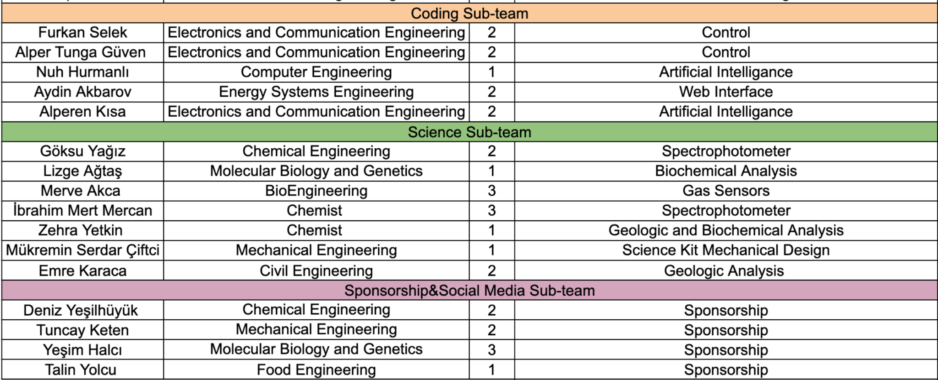
TEAM INFO
Active
Members List:
A table of active members including following information: Name, University Major*, and duty in the team.
* University majors should be written without abbreviations.

Slide 6
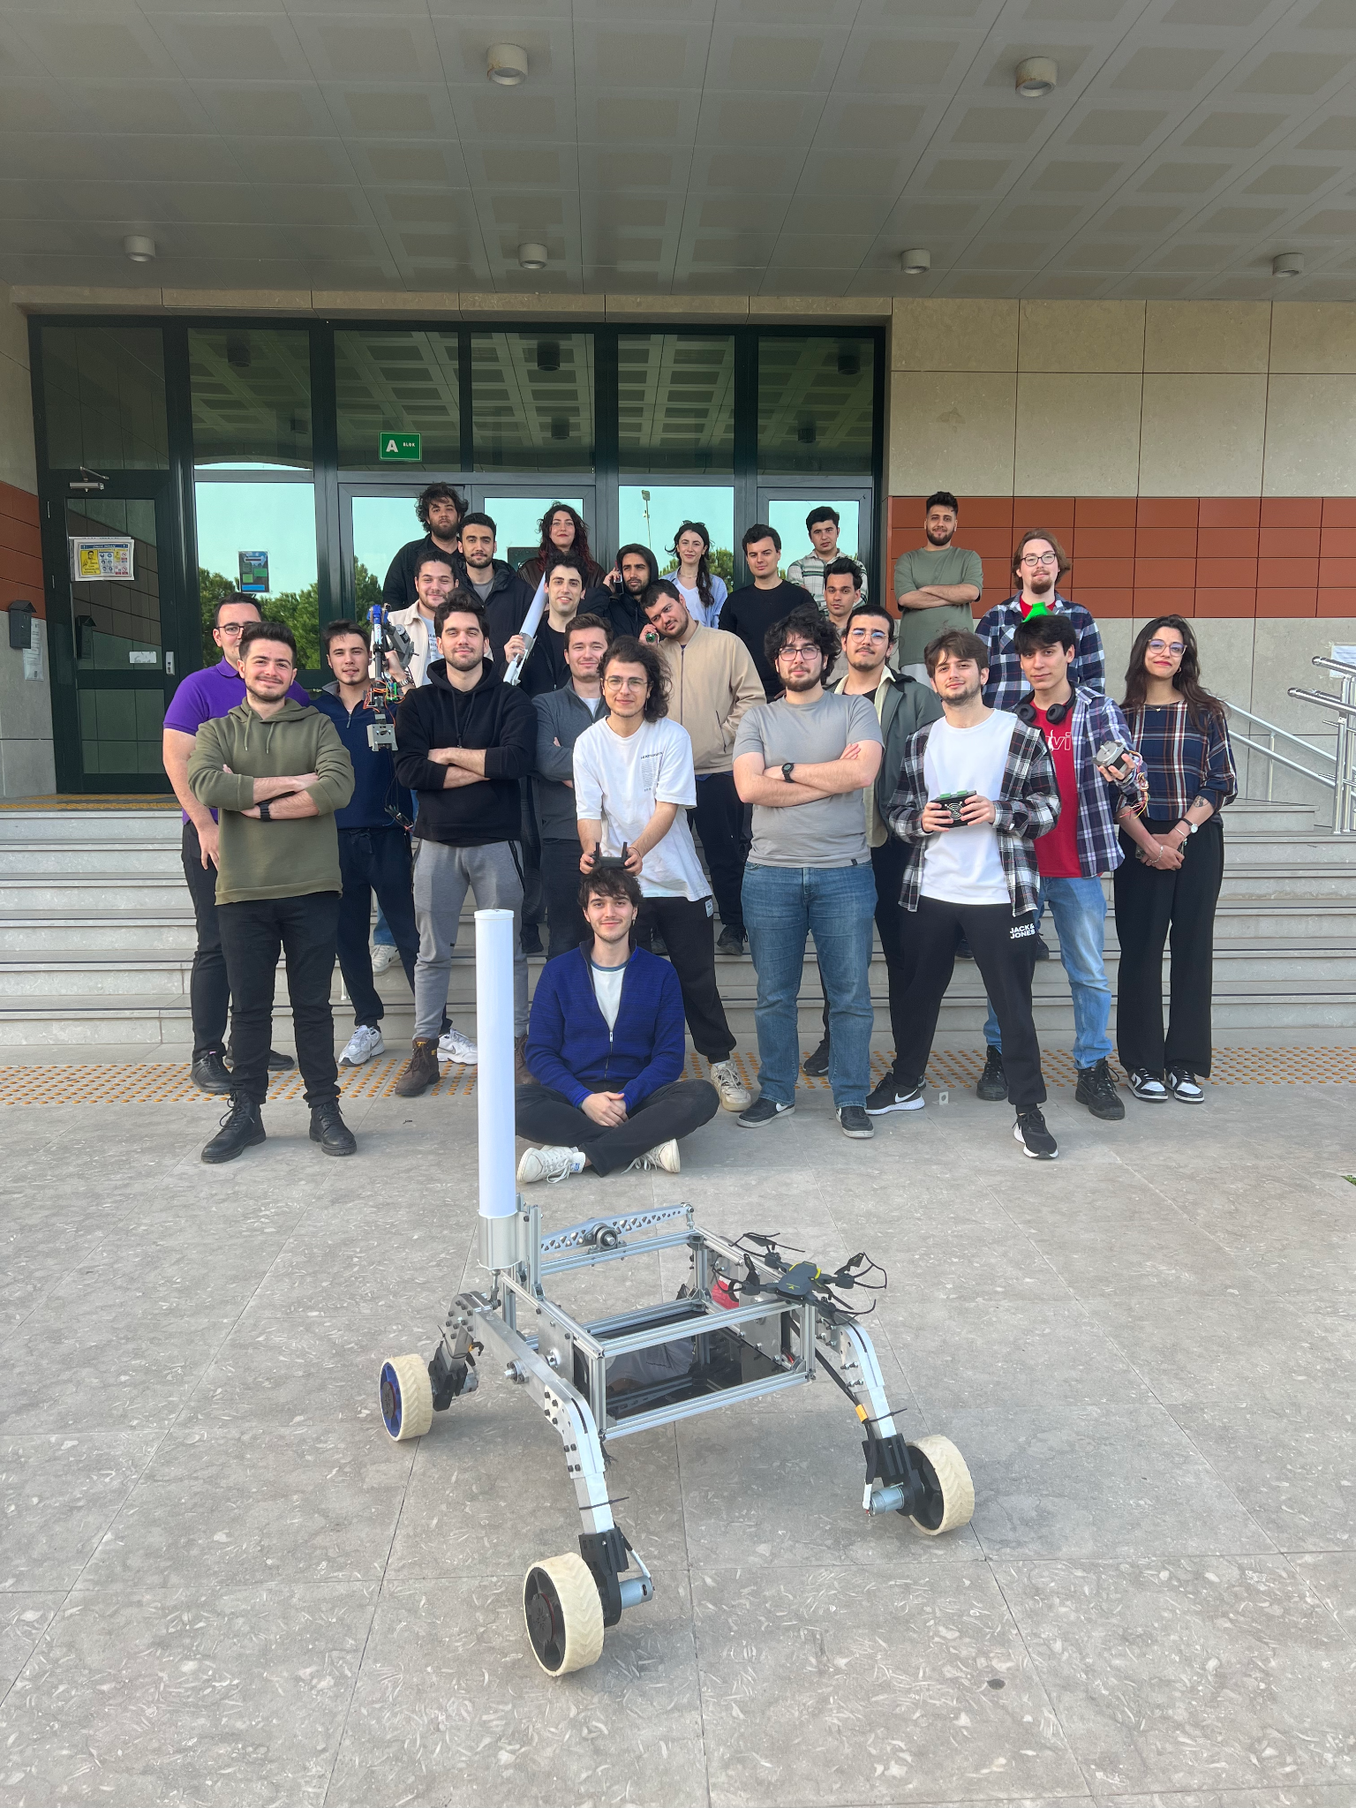
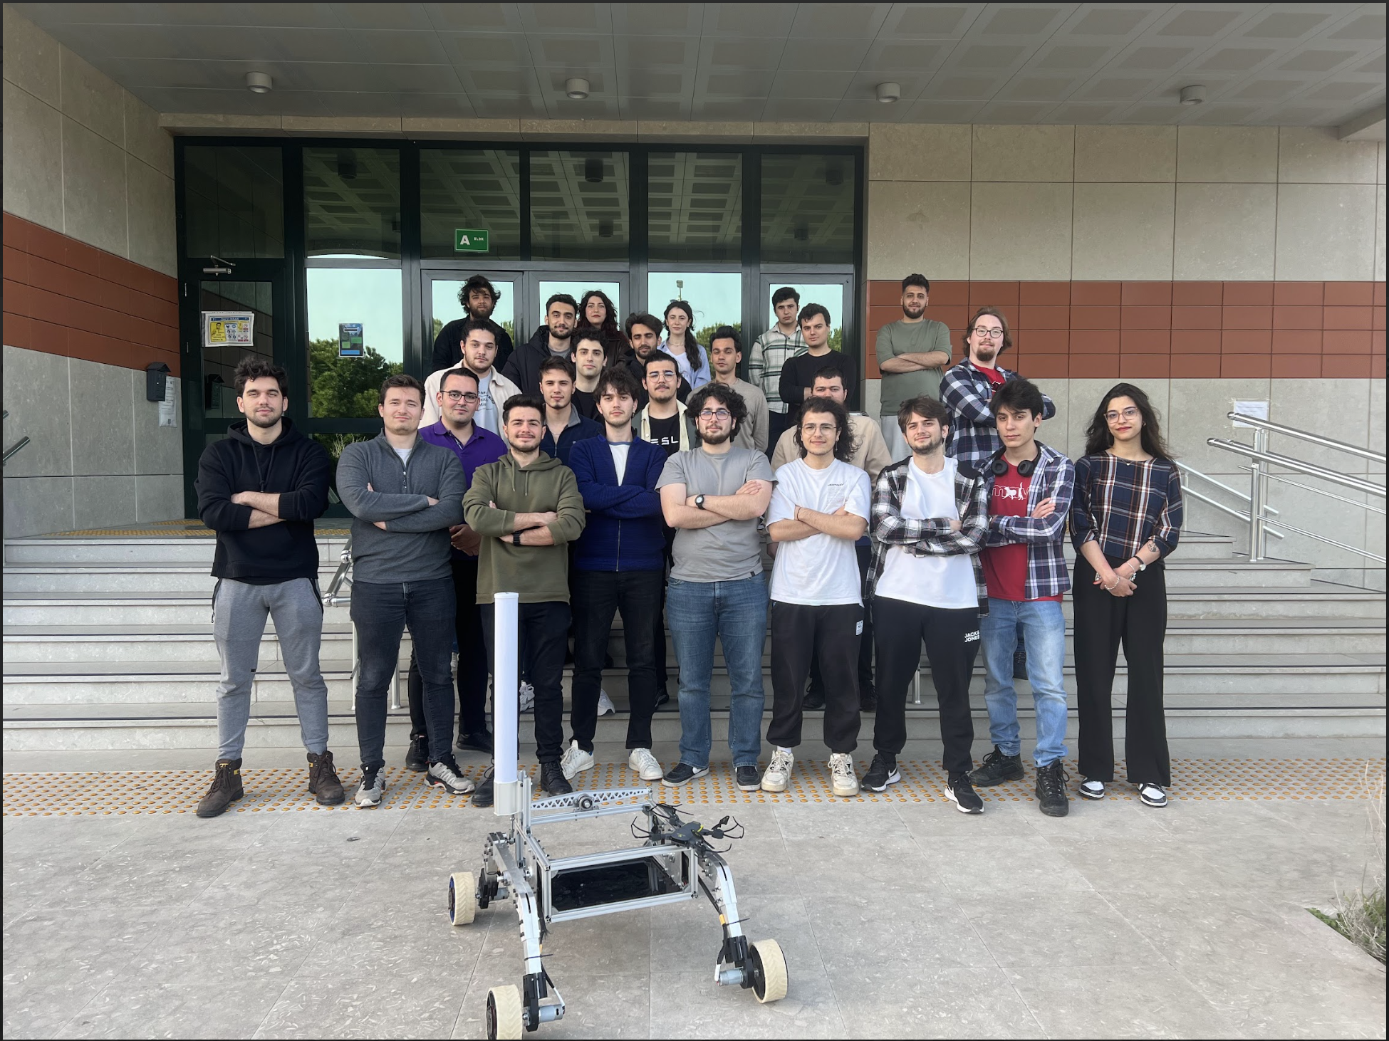
TEAM INFO
Team Photo
A photo/screenshot of the whole or part of the team.

Slide 7
MANAGEMENT
Work
Calendar:
Explain the work on the project by a Gantt chart. Include 10-15 items in the Gantt chart.

Slide 8
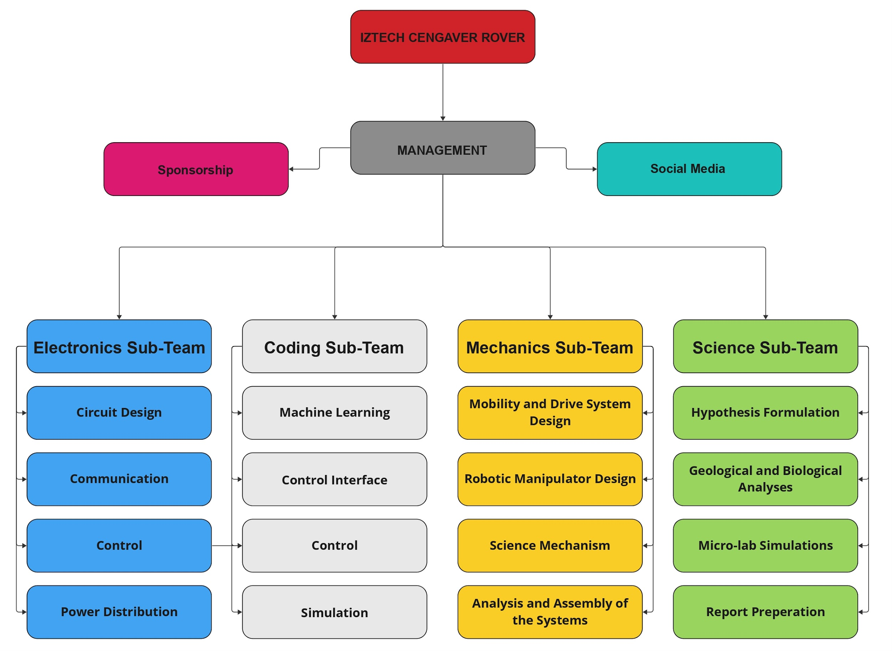
MANAGEMENT
The rover team is structured into three main teams: Management, Sponsorship, and Social Media. Each of these teams oversees different aspects of the project. Within the Management team, there are four sub-teams focusing on Electronics, Coding, Mechanics, and Science, allowing for specialized attention to key areas of rover development.
Team
Formation:

Slide 9
MANAGEMENT
Workplace:
IZTECH Cengaver Rover has it’s own Cengaver’s design inspired by lots of different ideas. While building the rover
we had used IZTECH IEEE’s workshop’s materials and thanks to our university
we used lab materials. We testing the rover in IZTECH’s hard environmental
conditions in Mechanical Engineering Building of IZTECH.
Our approach to design is centered around simplicity. We strive to create parts that can be 3d printed whenever possible. If that's not feasible, we search for solutions that rely on readily available components, like aluminium extrusions with minimal modifications. Custom machined parts are only used as a last resort. This streamlined methodology is not only efficient, but also enables us to handle most of the manufacturing process in-house with just a 3d printer and a pedestal drill.
How the team design, build and test the rover physically? Explain the workplace. (2-4 sentences) Include a photo/screenshot of the workplace.

Slide 10
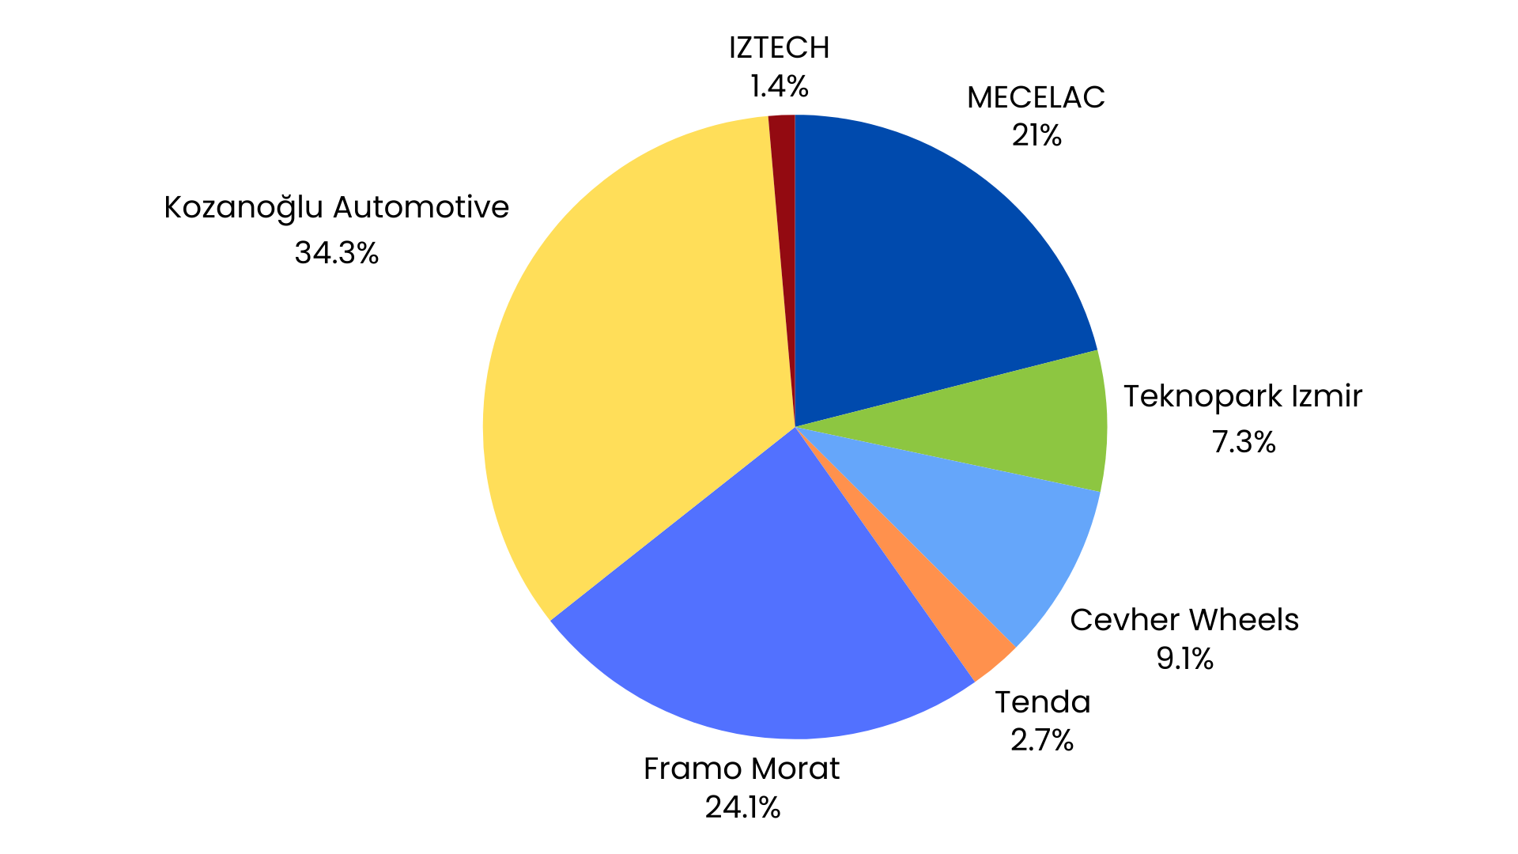
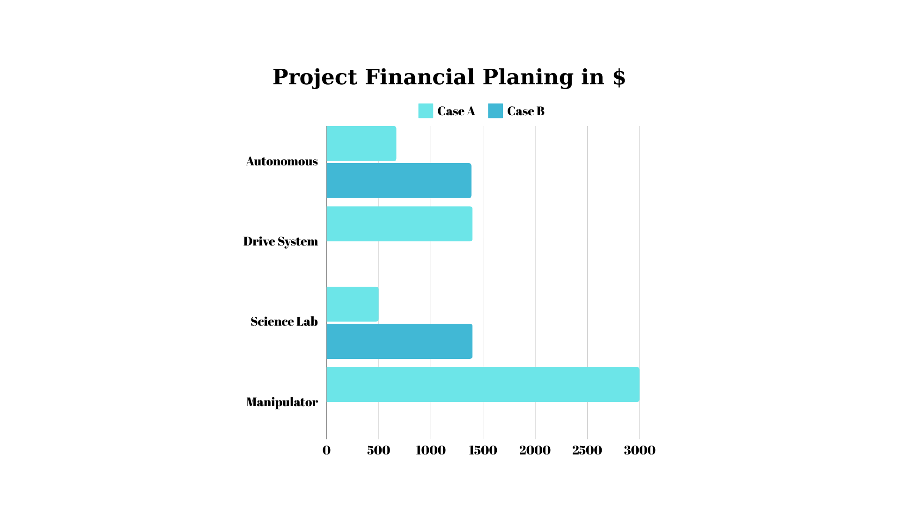
MANAGEMENT
Funding :
Present the funds of the project at the time of submission of this document? (In dollar currency)
How much spending is expected for the development costs? How much spending is expected for the travel costs?
Before finding financial support, the team created a list of materials needed for the competition and alternatives
to these materials. Products with multiple options are listed in the list. The resulting budget is 11640 dollars in
total. Most of this budget is result-oriented supports such as production and supply of missing materials. The
direct funding is $4100. Other products specified in the budget are written based on the sales and cost prices of
the products purchased from the companies.
IZTECH Cengaver Rover receives support from 6 different sponsors. The rates of support received from
sponsors are stated in the table above. One of these sponsors, Kozanoğlu Automotive, provided full sponsorship to the team for the production of the robotic arm. The reducers used in mobility engines are produced by Framo Morat. Following the sponsorship agreement with Tenda, the team supplies products such as modems and antennas related to communication, thanks to Tenda. MECELAC and Cevher Wheels and Teknopark İzmir provided financial support. University resources are used for some of the production and material supply.
What is the team's plan in an insufficient funding situation by the competition date?

Slide 11
MANAGEMENT
Logistics:
IZTECH Cengaver Rover designed its design this year so that it can be easily divided into multiple parts. For this reason, it is possible to travel with suitcases. Transportation to the competition area will be provided by buses available from university resources. The Rover will be loaded in suitcases under the bus. We hope to come to the competition with more than 20 members.
What is the team's plan to package and bring the rover to competition site by July? (4-6 sentences)

Slide 12
ROVER DESIGN
The rover chassis is constructed from aluminum sigma profiles, interconnected using T-Slot Nuts, triangular support parts, and fasteners, ensuring robust structural integrity and customization. It is enveloped in a sheet metal enclosure to prioritize safety and security while adding structural reinforcement. The rocker system utilizes a dependent four-wheel suspension with rockers interconnected by rod end bearings, allowing the rover to navigate extreme terrain. The drive system incorporates all-wheel drive functionality with DC motors and customized tires for enhanced traction and maneuverability.This system is chosen for its robustness, adaptability, and performance under diverse conditions. Considerations include material selection for durability and weight optimization, as well as the integration of protective measures environmental hazards.The meticulous construction using aluminum sigma profiles and T-slot nuts ensures structural integrity while allowing for easy customization. Precision-engineered connectors with O-rings guard against moisture infiltration, while the rocker suspension system and all-wheel drive enhance mobility and stability over rough terrain.
Mobility
System:
What is used? Describe the system
(3-5 sentences)
Why the system is chosen? What are the considerations? What are weaknesses and strengths?
(3-5 sentences)

Slide 13
ROVER DESIGN
Mobility
System:
Durability and ease of customization are guaranteed by the rover's painstaking construction with aluminum sigma profiles and T-slot bolts, and the addition of a thin sheet metal shell improves structural strength and protection against hazards. The rover is protected from moisture and other external factors by well-designed connectors with O-rings and detachable epoxy coatings, which guarantee operational integrity in a variety of scenarios. The Rocker designed to manage stress and prevent material deformation with precision and reliability. This design incorporates four rod end bearings and utilizes a specialized unloading method to effectively manage bending moments and inertia. The driving module designed with integration of two slim bearing with hub’s and sheet metals to provide assembly rigidity and power transmission efficiency. The pattern selection process for TPU-manufactured tires involves rigorous press tests on various pattern. As a result, the chosen pattern excels not only in rigidity but also in its flexibility and durability, ensuring superior performance and longevity.
Unique points and inspirations
(3-5 sentences)

Slide 14
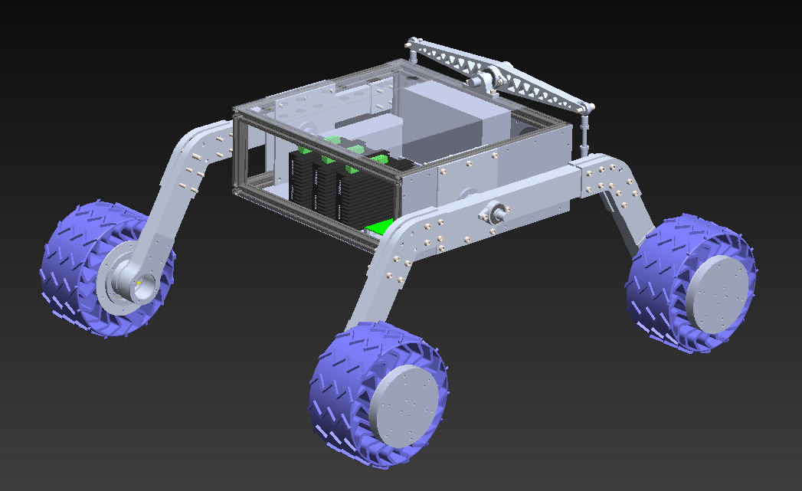
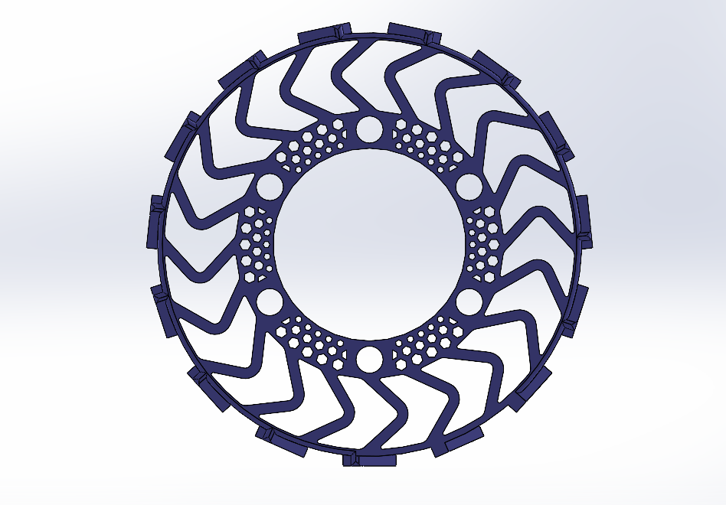
ROVER DESIGN
Mobility
System:
Visuals of the system
(2 photos/screenshots)

Slide 15
ROVER DESIGN
The Cengaver 2.0 rover, planning to be around 55-60kg,features a meticulously manufactured chassis constructed from 20x20 aluminum sigma profiles.The inclusion of a 0.7mm sheet metal enclosure provides an added layer of security, safeguarding internal components from potential hazards while enhancing structural reinforcement. In terms of the rover's mobility, the dependent four-wheel rocker suspension system, crafted from Aluminum alloy T-6082, is designed to withstand heavy loads of up to 300 kg from the robotic manipulator position. Moreover, the low center of mass enables the rover to navigate extreme terrain and steep angles up to 45 degrees, ensuring adaptability to various competition environments. The drive system of the Cengaver 2.0 rover integrates all-wheel drive functionality, powered by 15000 rpm DC motors with 100:1 planetary gear systems. This setup enables efficient traversal of slopes within the competition zone, while customized tires made from TPU95-A material enhance traction and maneuverability. Overall, with its meticulous construction, advanced suspension and drive systems, and attention to detail in component selection, the Cengaver 2.0 rover is well-equipped to excel in competition missions.
Mobility
System:
Technical Specifications including mass and size (3-5 sentences)
Discuss the system's adequacy for its role in competition missions. (3-5 sentences)

Slide 16
ROVER DESIGN
Electronics and power system:
The rover's electronic system comprises a motherboard, manipulator card,science sensor board card,voltage measurement points, power distribution board, and a 7S BMS. This setup utilizes Raspberry Pi Pico and Arduino Mega Pro for control, integrates voltage regulators and fuses for component protection, and employs logic level converters for compatibility. The BMS ensures safe charging of the lithium-ion battery pack and regulates voltage levels for optimal performance.The electronic system is chosen for its versatility and adaptability to the rover's diverse needs, aiming to mitigate cable complexity. Considerations include efficient power management, component protection, and compatibility between different control platforms. Its strengths lie in comprehensive functionality and streamlined cable management.
What is used? Describe the system
(3-5 sentences)
Why the system is chosen? What are the considerations? What are weaknesses and strengths?
(3-5 sentences)

Slide 17
ROVER DESIGN
Electronics and power system:
The integration of multiple voltage regulators and fuses throughout the rover's motherboard and control cards demonstrates a robust approach to safeguarding the components from potential damage due to power fluctuations or overcurrent situations. The inclusion of voltage measurement capabilities at key points, such as monitoring the battery's state of charge and conducting scientific experiments, enhances the rover's functionality and adaptability for various tasks. The utilization of a 7S BMS for safe charging and discharging of the lithium-ion battery pack showcases a commitment to battery management and longevity, crucial for the overall reliability and performance of the rover during missions. These design choices prioritize safety, versatility, and efficiency, aligning with best practices in robotics and electrical engineering.
Unique points and inspirations
(3-5 sentences)

Slide 18
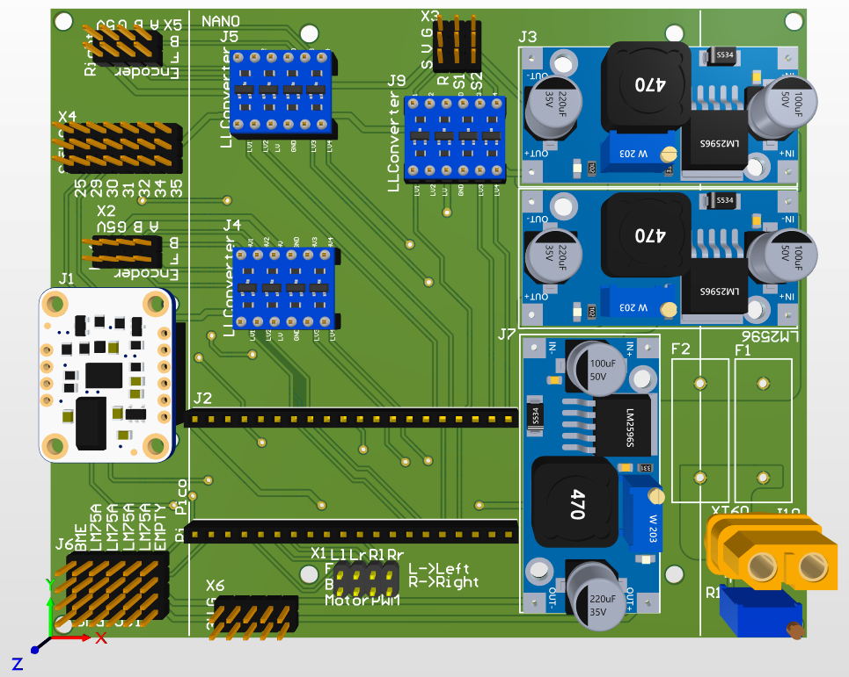
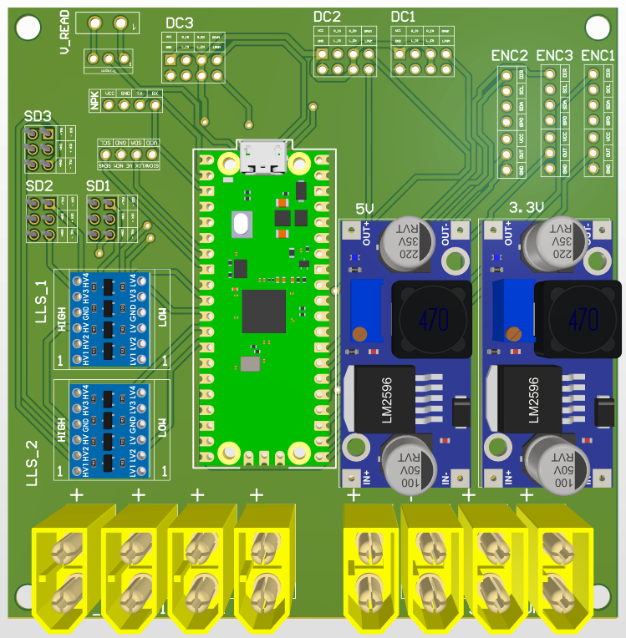
ROVER DESIGN
Electronics and power system:
Visuals of the system
(2 photos/screenshots)

Slide 19
ROVER DESIGN
Electronics and power system:
The rover is powered by a 29 Amp hour lithium-ion battery, configured in a 7 series and 10 parallel setup, providing power for its operations. The battery's power is regulated by a distribution board to supply 24 volts, 20, and 5 volts outputs, meeting the diverse power needs of the rover's components. An emergency stop button ensures safety by disabling the manipulator and mobility system during unusual situations. Additionally, a modular 100 watt power LED integrated into the front of the rover enables operation in dark environments. The battery pack, weighing approximately 3 kilograms, meets the rover's power requirements, providing adequate energy for sustained operation during competition missions. The distributed power regulation and emergency stop functionality enhance safety and reliability, crucial for navigating various challenges and scenarios encountered in competitions. The integration of a high-powered LED allows for enhanced visibility in low-light conditions, while the custom PCBs and microcontrollers ensure efficient and reliable communication and control within the rover.
Technical Specifications including mass and battery duration (3-5 sentences)
Discuss the system's adequacy for its role in competition missions. (3-5 sentences)

Slide 20
ROVER DESIGN
The 5 degree of freedom robotic manipulator utilizes a combination of stepper motors with planetary gearboxes for link actuation and DC motors for gripper control, providing precise and robust movement capabilities. Integration of a five bar parallelogram mechanism enhances stability and reduces energy consumption, prolonging operational lifespan. Ball and thrust bearings ensure efficiency and minimize wear and tear, while a hybrid control system combining inverse and forward kinematics simplifies operation and enhances user experience.
This system was chosen for its precision, agility, and energy efficiency, critical factors in robotic manipulation tasks. To decrease the torque requirement of the system we used a parallelogram mechanism and carried one of the actuator to base and used 3 bevel gears to create a swing mechanism. Strengths include precise control, operational stability, long lifespan due to aluminum links and enhanced user experience through hybrid control. However, weaknesses may include complexity in design and potential maintenance requirements for the intricate mechanisms involved.
Manipulation system:
What is used? Describe the system
(3-5 sentences)
Why the system is chosen? What are the considerations? What are weaknesses and strengths?
(3-5 sentences)

Slide 21
ROVER DESIGN
Manipulation system:
The manipulator's integration of a five bar parallelogram mechanism, coupled with concentric shafts and bearings, showcases innovative engineering to enhance stability, efficiency, and precision. The hybrid control system, blending inverse and forward kinematics, reflects a forward-thinking approach to simplify operation and empower users with intuitive control capabilities. Additionally, the incorporation of multiple motor systems throughout the rover, from high-performance DC motors for mobility to precise stepper motors for manipulation, highlights a holistic approach to achieving reliability and accuracy across various tasks and terrains. These unique points underscore a commitment to excellence in design and functionality, driven by a dedication to advancing robotic capabilities for scientific endeavors.
Unique points and inspirations
(3-5 sentences)

Slide 22
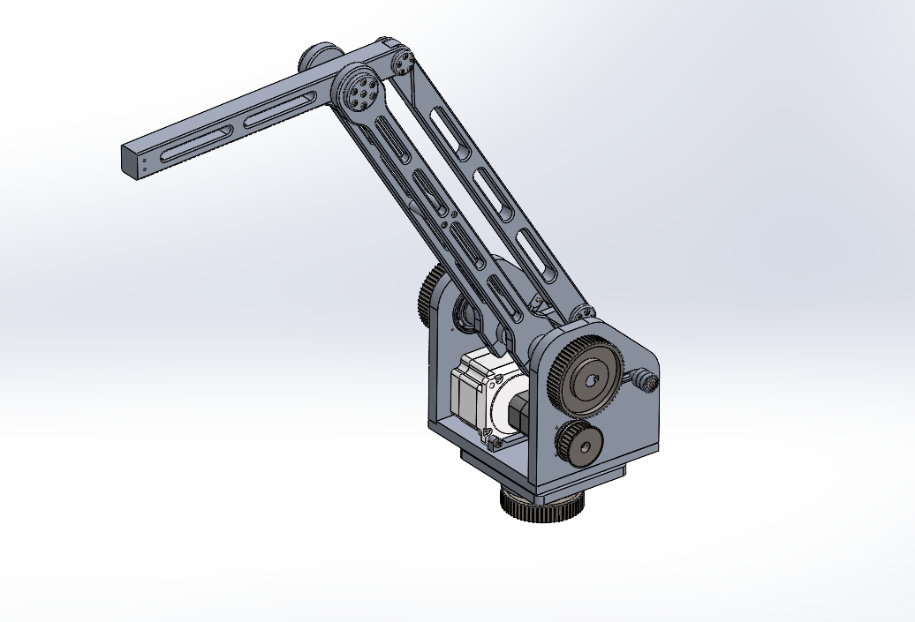
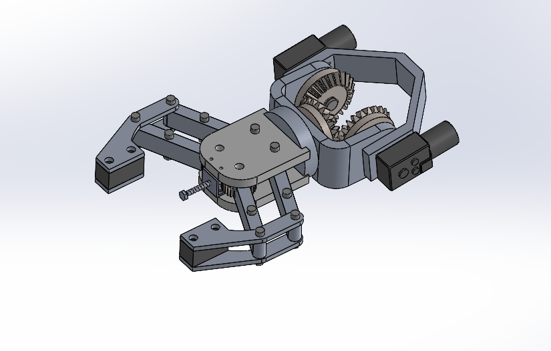
ROVER DESIGN
Manipulation system:
Visuals of the system
(2 photos/screenshots)

Slide 23
ROVER DESIGN
Manipulation system:
The 5-degree-of-freedom manipulator weighs 15 kg and extends up to 110 cm, manufactured from lightweight aluminum and chrome-strengthened steel shafts. It boasts a maximum payload capacity enabled by 3.5 Nm stepper motors with 50:1 planetary gearboxes for link actuation and DC motors for gripper control. The integration of a five bar parallelogram mechanism and precision bearings ensures stability, efficiency, and minimized energy consumption, while the hybrid control system combines inverse and forward kinematics for enhanced usability.Its lightweight yet sturdy design allows for maneuverability in various environments, while the sophisticated control system empowers users with intuitive operation and precise movement. The system's versatility and reliability make it well-suited for tasks requiring manipulation and dexterity, contributing to the rover's overall performance and success in competition missions.
Technical Specifications including mass, max payload and size
(3-5 sentences)
Discuss the system's adequacy for its role in competition missions. (3-5 sentences)

Slide 24
ROVER DESIGN
Science Payload:
The sampling system comprises two main mechanisms: the surface sampling mechanism and the deep sampling mechanism. The surface sampling mechanism employs a 5-degree-of-freedom robotic manipulator with an advanced end effector for sample collection, complemented by a motorized cover controlled by a Servo Controller (MG995R) for precise sample distribution. In contrast, the deep sampling mechanism utilizes a high-performance 3DC motor and a rotary encoder for efficient and precise soil sampling, featuring a controlled descent and an Archimedes Screw for soil extraction. This system is chosen for its scientific precision, incorporating integrated motors and encoders to ensure reliable and precise sample collection while measuring humidity and temperature. However, operational complexities, maintenance requirements, and the need for precise calibration pose potential challenges, despite the system's robust design and meticulous execution.
What is used? Describe the system
(3-5 sentences)
Why the system is chosen? What are the considerations? What are weaknesses and strengths?
(3-5 sentences)

Slide 25
ROVER DESIGN
Science Payload:
The utilization of a 5DOF robotic manipulator enables precise movement and control, facilitating accurate surface sampling even in complex environments. Each joint of the manipulator offers a distinct range of motion, enhancing navigation capabilities. The motorized cover on the onboard containers provides an additional layer of protection, while the Servo Controller (MG995R) ensures smooth operation. In the Deep Sampling Mechanism, the integration of a 3DC motor and rotary encoder allows for precise depth selection and efficient soil sample collection, driven by an Archimedes Screw operated by motor 2. Fine adjustments for optimal container positioning are achieved through motor 3, showcasing the ingenuity and practicality of the system's design.
Unique points and inspirations
(3-5 sentences)

Slide 26
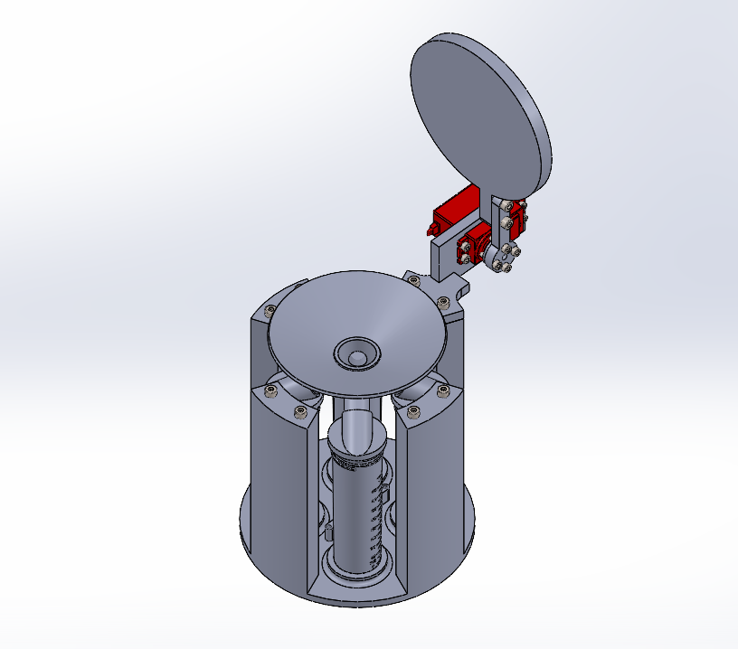
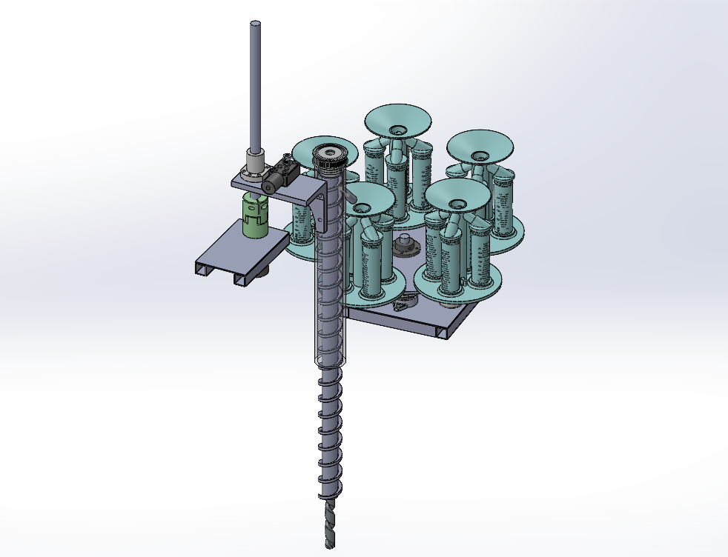
ROVER DESIGN
Science Payload:
Visuals of the system
(2 photo/screenshots)

Slide 27
ROVER DESIGN
Science Payload:
In the context of surface sampling, each container, weighing around 350 grams, is constructed with meticulous attention to detail and consists of four Falcon 50 tubes essential for conducting tests. Conversely, for deep soil sampling endeavors, a more robust system is required, tipping the scales at approximately 2.5 kilograms, encompassing all necessary mechanisms for comprehensive sampling.
In alignment with Arc Science's overarching mission, the establishment of an uncontaminated environment is paramount. To this end, our 5DoF Manipulator and Mechanism design philosophy emphasizes the integration of motorized components within the cover, facilitating a compressive action. This innovative approach not only ensures the integrity of the samples but also serves to shield the surrounding environment from any potential contaminants, thereby upholding the standards of environmental stewardship central to our objectives.
Technical Specifications including mass and battery duration (3-5 sentences)
Discuss the system's adequacy for its role in competition missions. (3-5 sentences)

Slide 28
ROVER DESIGN
The Tenda B6 Access Point utilizes the proprietary TD-MAX protocol for enhanced wireless performance. Equipped with omni-directional ANT12-5G360 antennas. Ethernet connections to the rover and controller computers utilize short Cat6 cables for efficiency. Additionally, UART facilitates asynchronous serial communication between devices, while I2C enables synchronous communication among integrated circuits, enhancing connectivity with various peripherals. These communication technologies, combined with specialized software optimizations and the Qualcomm AR9344 chipset, contribute to the B6's reliability and high-performance networking solutions.Considerations include its use of the TD-MAX protocol for extended frequency support and advanced modulation techniques, which improve signal quality and range, especially in congested 5GHz bands.Strengths lie in its specialized software optimizations and omni-directional antennas, providing a 360° coverage area and transmission range up to 2.
Ground station equipment and communication system:
What is used? Describe the system.
(3-5 sentences)
Why the system is chosen? What are the considerations? What are weaknesses and strengths?
(3-5 sentences)

Slide 29
ROVER DESIGN
Ground station equipment and communication system:
The integration of the Tenda B6 access point with the ANT12-5G360 omni-directional antenna showcases a commitment to providing comprehensive wireless networking solutions. By incorporating the TD-MAX protocol and Qualcomm AR9344 chipset, the system demonstrates a dedication to optimizing wireless performance, particularly in challenging environments such as congested 5GHz frequency bands. The use of omni-directional antennas further enhances the system's versatility, enabling 360° coverage and extending transmission range up to 2 kilometers. Overall, this solution reflects a fusion of advanced technology and practical design to meet the demands of modern wireless communication needs.
Unique points and inspirations
(3-5 sentences)

Slide 30
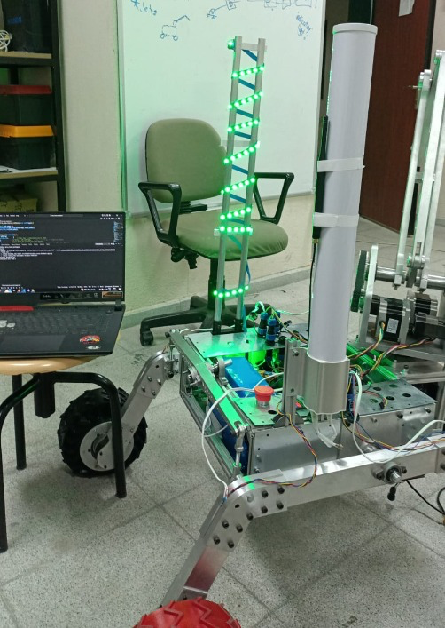
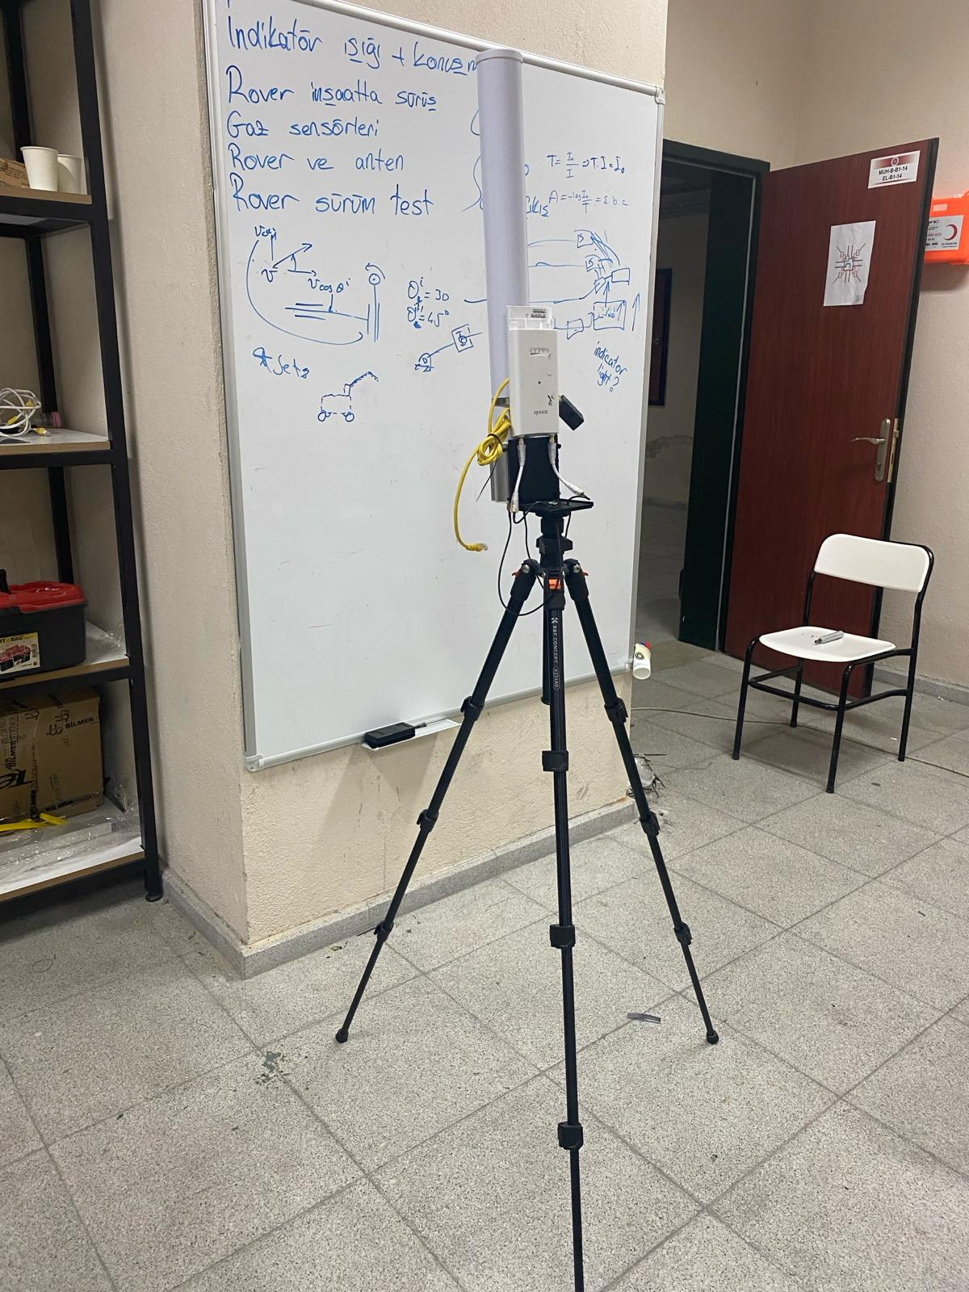
ROVER DESIGN
Ground station equipment and communication system:

Slide 31
ROVER DESIGN
Ground station equipment and communication system:
The system utilizes the Tenda B6 access point paired with the Tenda ANT12-5G360 omni-directional antenna to provide reliable and high-performance wireless networking solutions. The B6 access point features the TD-MAX protocol, Qualcomm AR9344 chipset, and specialized software optimizations for enhanced signal quality and extended range, particularly in congested 5GHz frequency bands. The ANT12-5G360 antenna complements the B6 by providing a 360° coverage area and extending the transmission range up to 2 kilometers, facilitating multi-directional communication.
The system is chosen for its robust wireless performance, extended range capabilities, and multi-directional coverage provided by the omni-directional antenna. Considerations include the compatibility of the B6 access point and ANT12-5G360 antenna, the specific networking requirements and environment where the system will be deployed, and potential interference from other wireless devices. Strengths include reliable signal quality, extended range, and flexibility in deployment scenarios.
Technical Specifications including resilience to noise and communication range (3-5 sentences)
Discuss the system's adequacy for its role in competition missions. (3-5 sentences)

