Slide 1

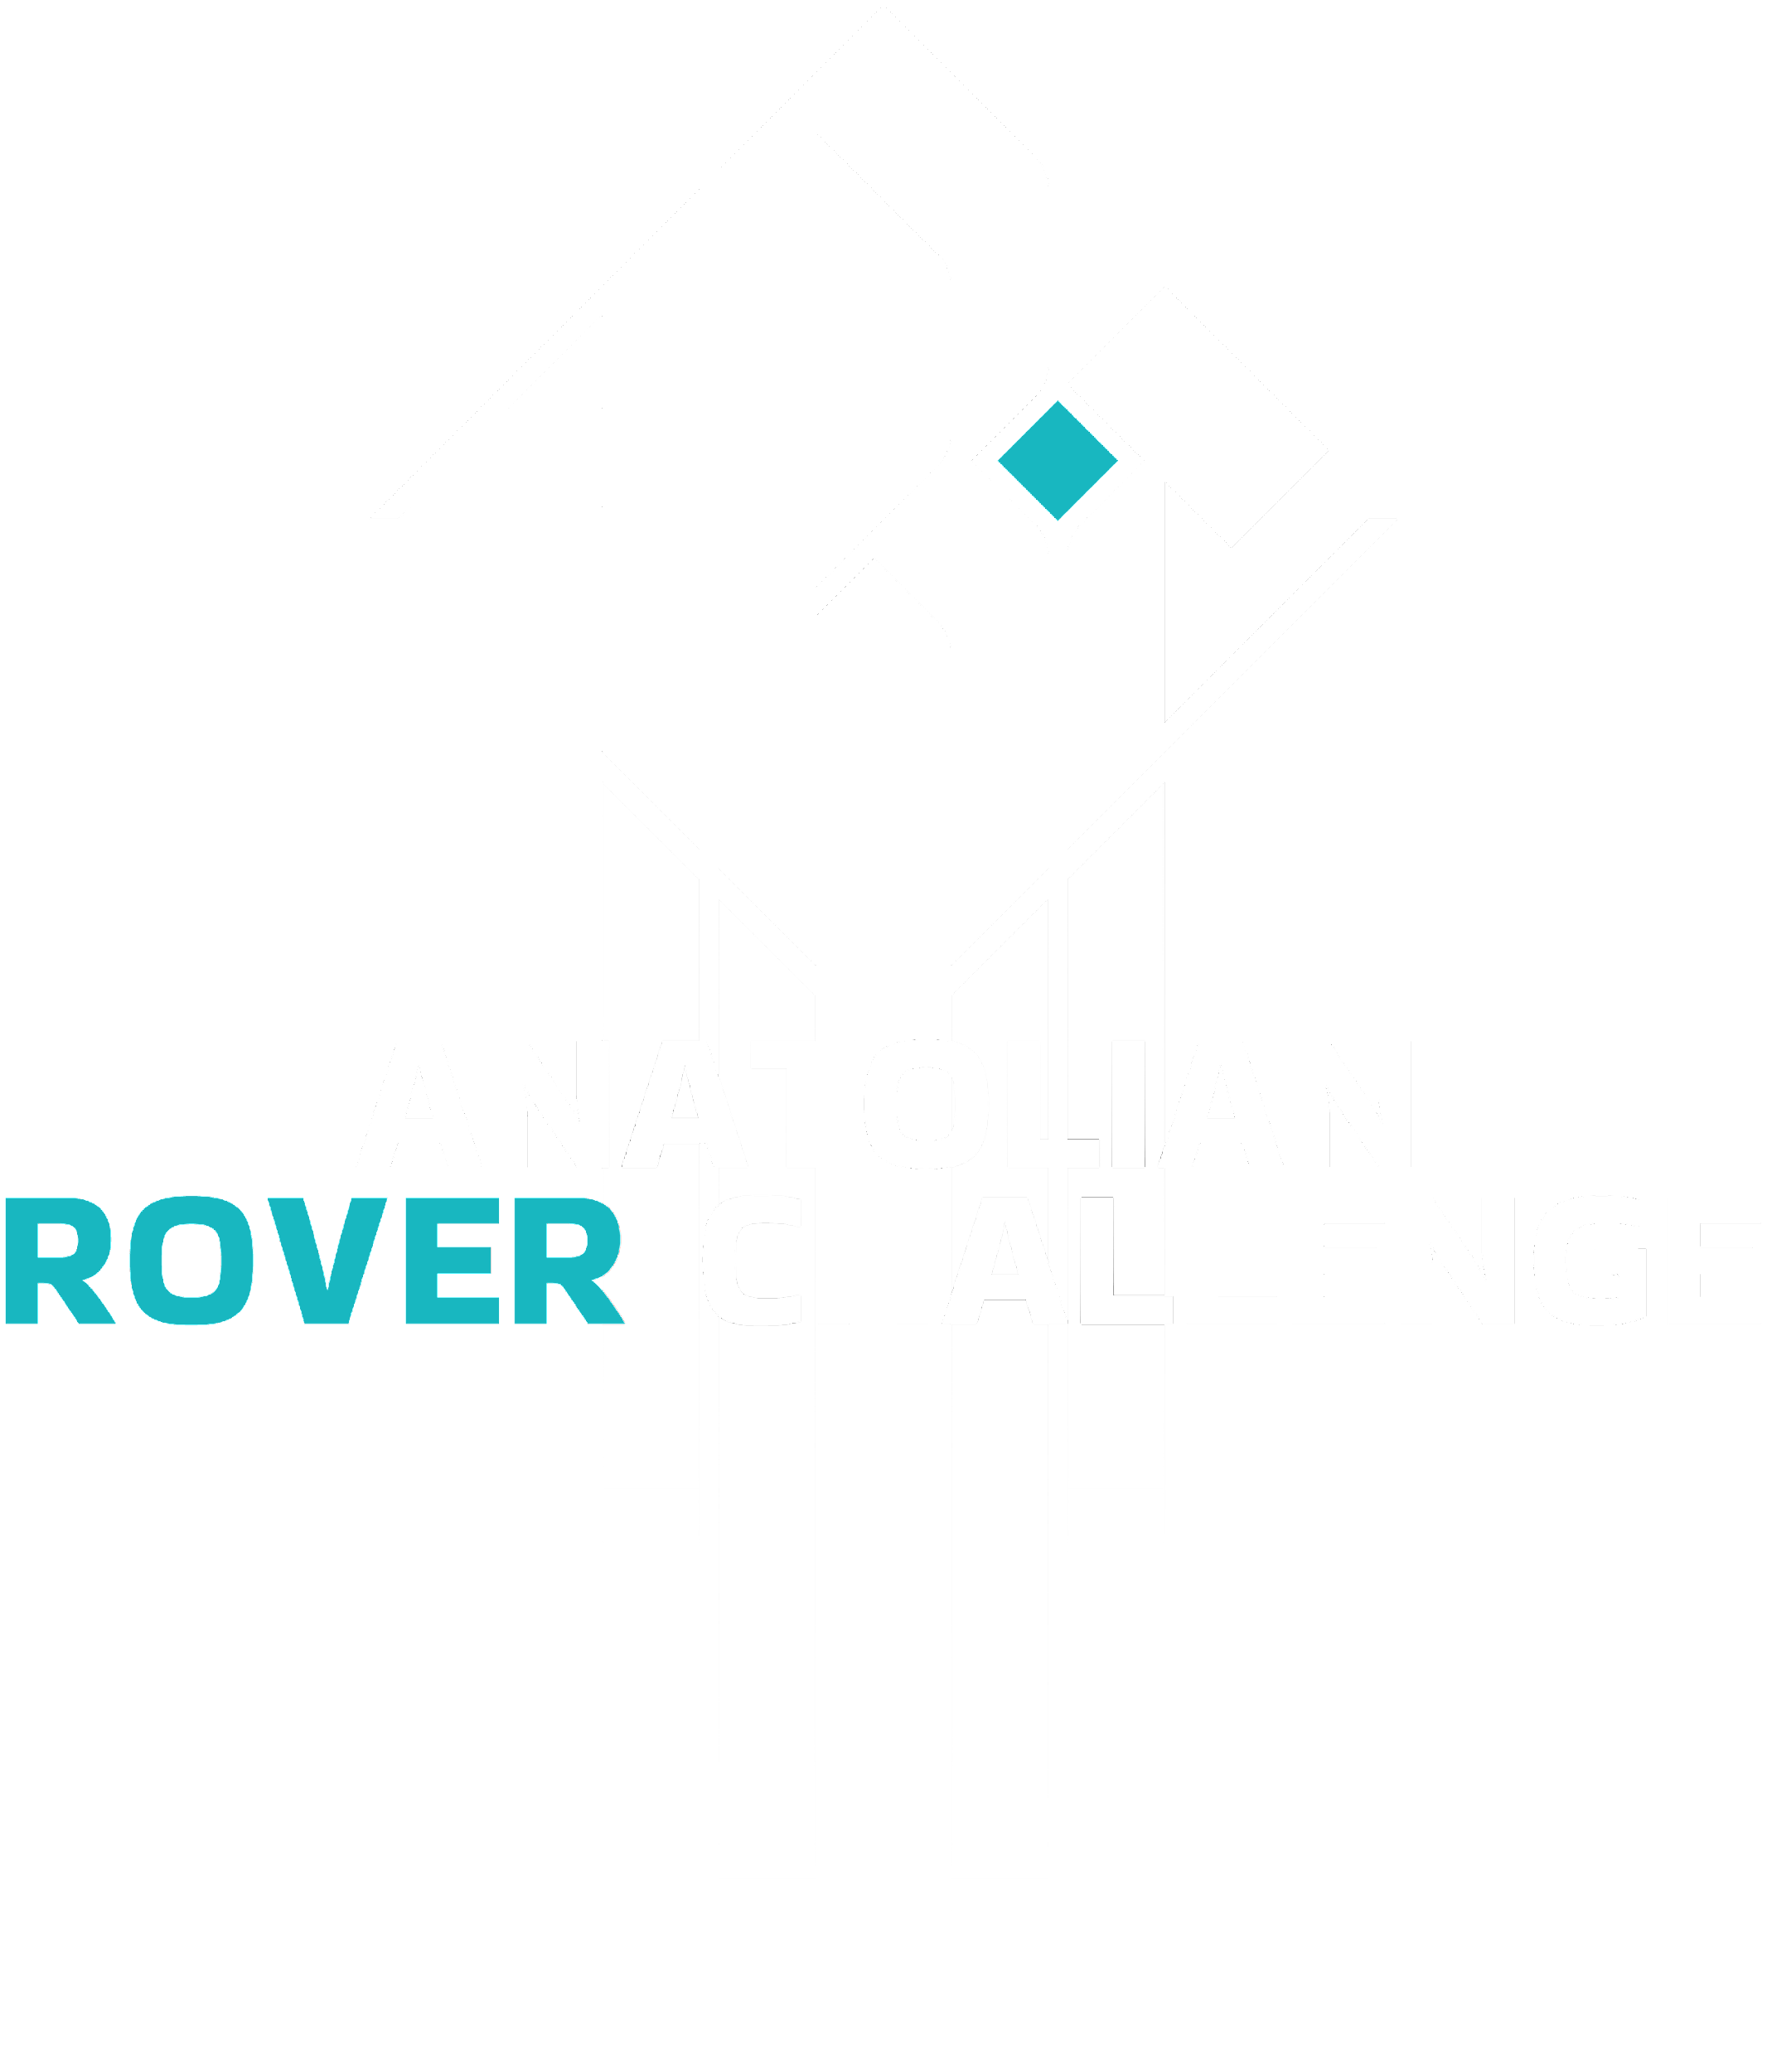
2024
Design Report

Slide 2



TEAM INFO
Team Name:
Technocrats Robotics
Contact:
Social Media links:
Mail ID: technocratsrobotics@vit.ac.in
LinkedIn: (27) Technocrats Robotics: My Company | LinkedIn
Instagram: Technocrats Robotics (@technocratsrobotics) • Instagram photos and videos
put your logo here

Slide 3
TEAM INFO
Academic
Institution:
Vellore Institute Of Technology, Chennai
Academic
Consultant:
Name: Dr. Jafferson J M
Affiliation: Vellore Institute of Technology, Chennai
Email ID: jafferson.jm@vit.ac.in

Slide 4
TEAM INFO
Technocrats Robotics is a student-led, self-funded, robotics-centered team from the campus of VIT Chennai. It was founded in 2013. Our yearly activities revolve around participating in renowned international competitions like University Rover Challenge, ABU Robocon, International Rover Challenge and many more. We are a team of tech-savvy college students who spend their time displaying ardent passion for robotics by learning about and building complex bots and a rover. As a result we have achieved some notable feats over the years:
International Rover Challenge 2020 - ranked 6th
ABU Robocon 2020 - score of 95.5/100 in the Tet round
International Planetary Aerial Systems Challenge 2021 - ranked 3rd
Technoxian 2019 - 7th rank internationally and finalist for fastest line following robot.
History of
the Team:
put your logo here

Slide 5
TEAM INFO - Core Team
NAME | MAJOR | ROLE
Harshit Chowdhry | Computer Science with Cyber Physical Systems | Team Captain
Manas Mehta | Mechatronics and Automation | Team Vice-captain
Shreyas Kumar | Computer Science | Team Manager
Kevin Bhagat | Mechatronics and Automation | Team Manager
Praharsh | Computer Science with Cyber Physical Systems | Rover Lead
Bharat Rathi | Electronics and computer | Electrical Lead
Prateek | Mechanical | Mechanical Lead
Zahran Sajid | Computer Science with Cyber Physical Systems | Software Lead
Vishnu | Computer Science with AI and Robotics | Science Lead
Active
Members List:
put your logo here

Slide 6
TEAM INFO - Mechanical Members
NAME | MAJOR | ROLE
Pranav Krishnan | Mechanical | Drive system
Prathvi | Mechanical | Drive system
Rahul Gadekar | Mechatronics and Automation | Robotic Arm
Abhay | Mechatronics and Automation | Science Module
Shravan | Mechanical | Science Module
Active
Members List:
put your logo here

Slide 7
TEAM INFO - Electrical Members
NAME | MAJOR | ROLE
Akhilesh | Electronics and computer | PCB design of subsystems
Shriya | Electronics and computer | PCB design of subsystems
Mayukh Majumder | Electronics and Electrical | Troubleshooting
Suvankar Dey | Electronics and Electrical | Circuit designing and testing
Joel | Electronics and communications | Circuit designing and testing
Pranav | Electronics and Electrical | Troubleshooting
Sanjay | Electronics and communications | PCB design of subsystems
Active
Members List:
put your logo here

Slide 8
TEAM INFO - Science Members
Active
Members List:
NAME | MAJOR | ROLE
Swathi | Electronics and communications | Spectrometer and chemical tests
Nadesh | Electronics and Electrical | Sensor codes and ROS Integration
Mukund | Electronics and Electrical | Sensor codes and ROS Integration
put your logo here

Slide 9
TEAM INFO - Software Members
NAME | MAJOR | ROLE
Sukesh | Computer Science with AI and Robotics | Autonomous Navigation
Sudeesh | Electronics and computer | Autonomous Navigation
Sujith | Computer Science with AI and Robotics | Panoramic Capture
Koushik | Electronics and computer | Robotic Arm and comms module
Girish | Computer Science with AI and Robotics | Science Module
Akshat | Electronics and computer | Command and control setup
Vyapti | Computer Science with AI and Robotics | Command and control setup
Shanmukh | Electronics and computer | Autonomous Navigation
Active
Members List:
put your logo here

Slide 10
TEAM INFO - Management Members
Active
Members List:
NAME | MAJOR | ROLE
Saanvi Shetty | Computer Science | General Manager
Kashish Parmar | Computer Science with AI and Robotics | General Manager
Sarthak Bansal | Computer Science with AI and Robotics | General Manager
put your logo here

Slide 11
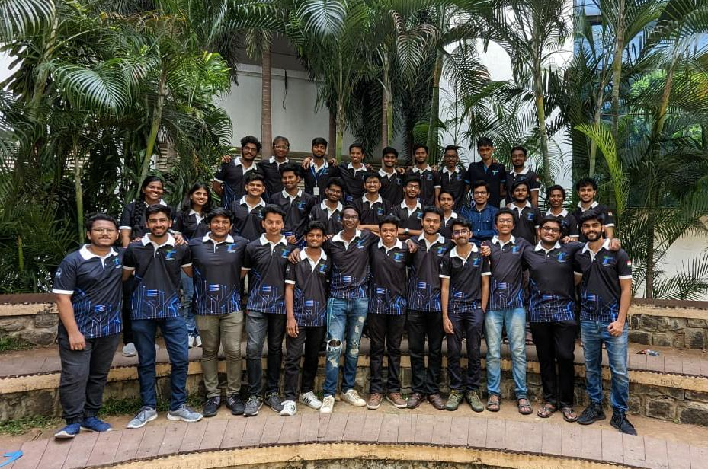
TEAM INFO
Team Photo
put your logo here

Slide 12

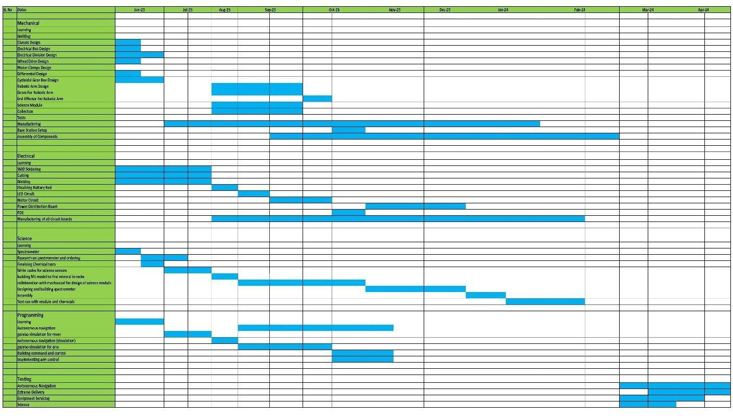
MANAGEMENT
Work
Calendar:
put your logo here

Slide 13
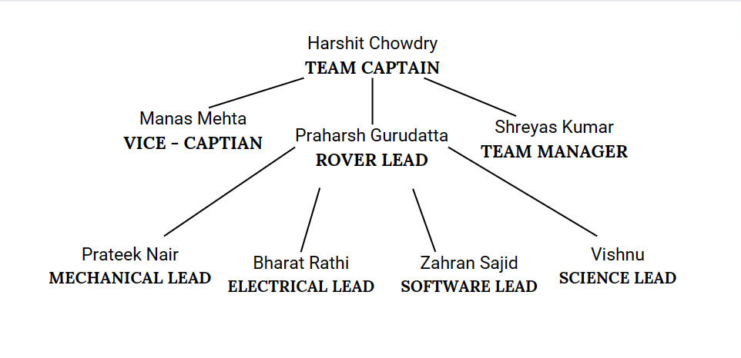
MANAGEMENT
Our team structure is comprised of a Captain, Vice Captain, and a dedicated Team Manager. The team is further divided into two departments, Rover and Robocon. Each department is spearheaded by a designated Lead, who oversees sub-teams specializing in Programming, Electrical Engineering, Mechanical Engineering, and Science. This departmental structure promotes focused expertise and collaboration across disciplines.
Team
Formation:
put your logo here

Slide 14
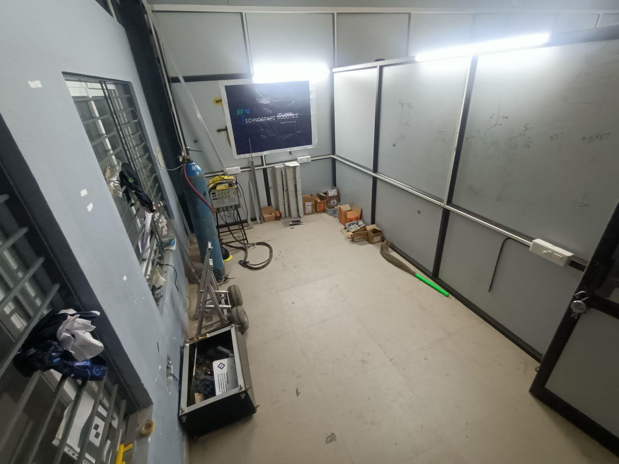
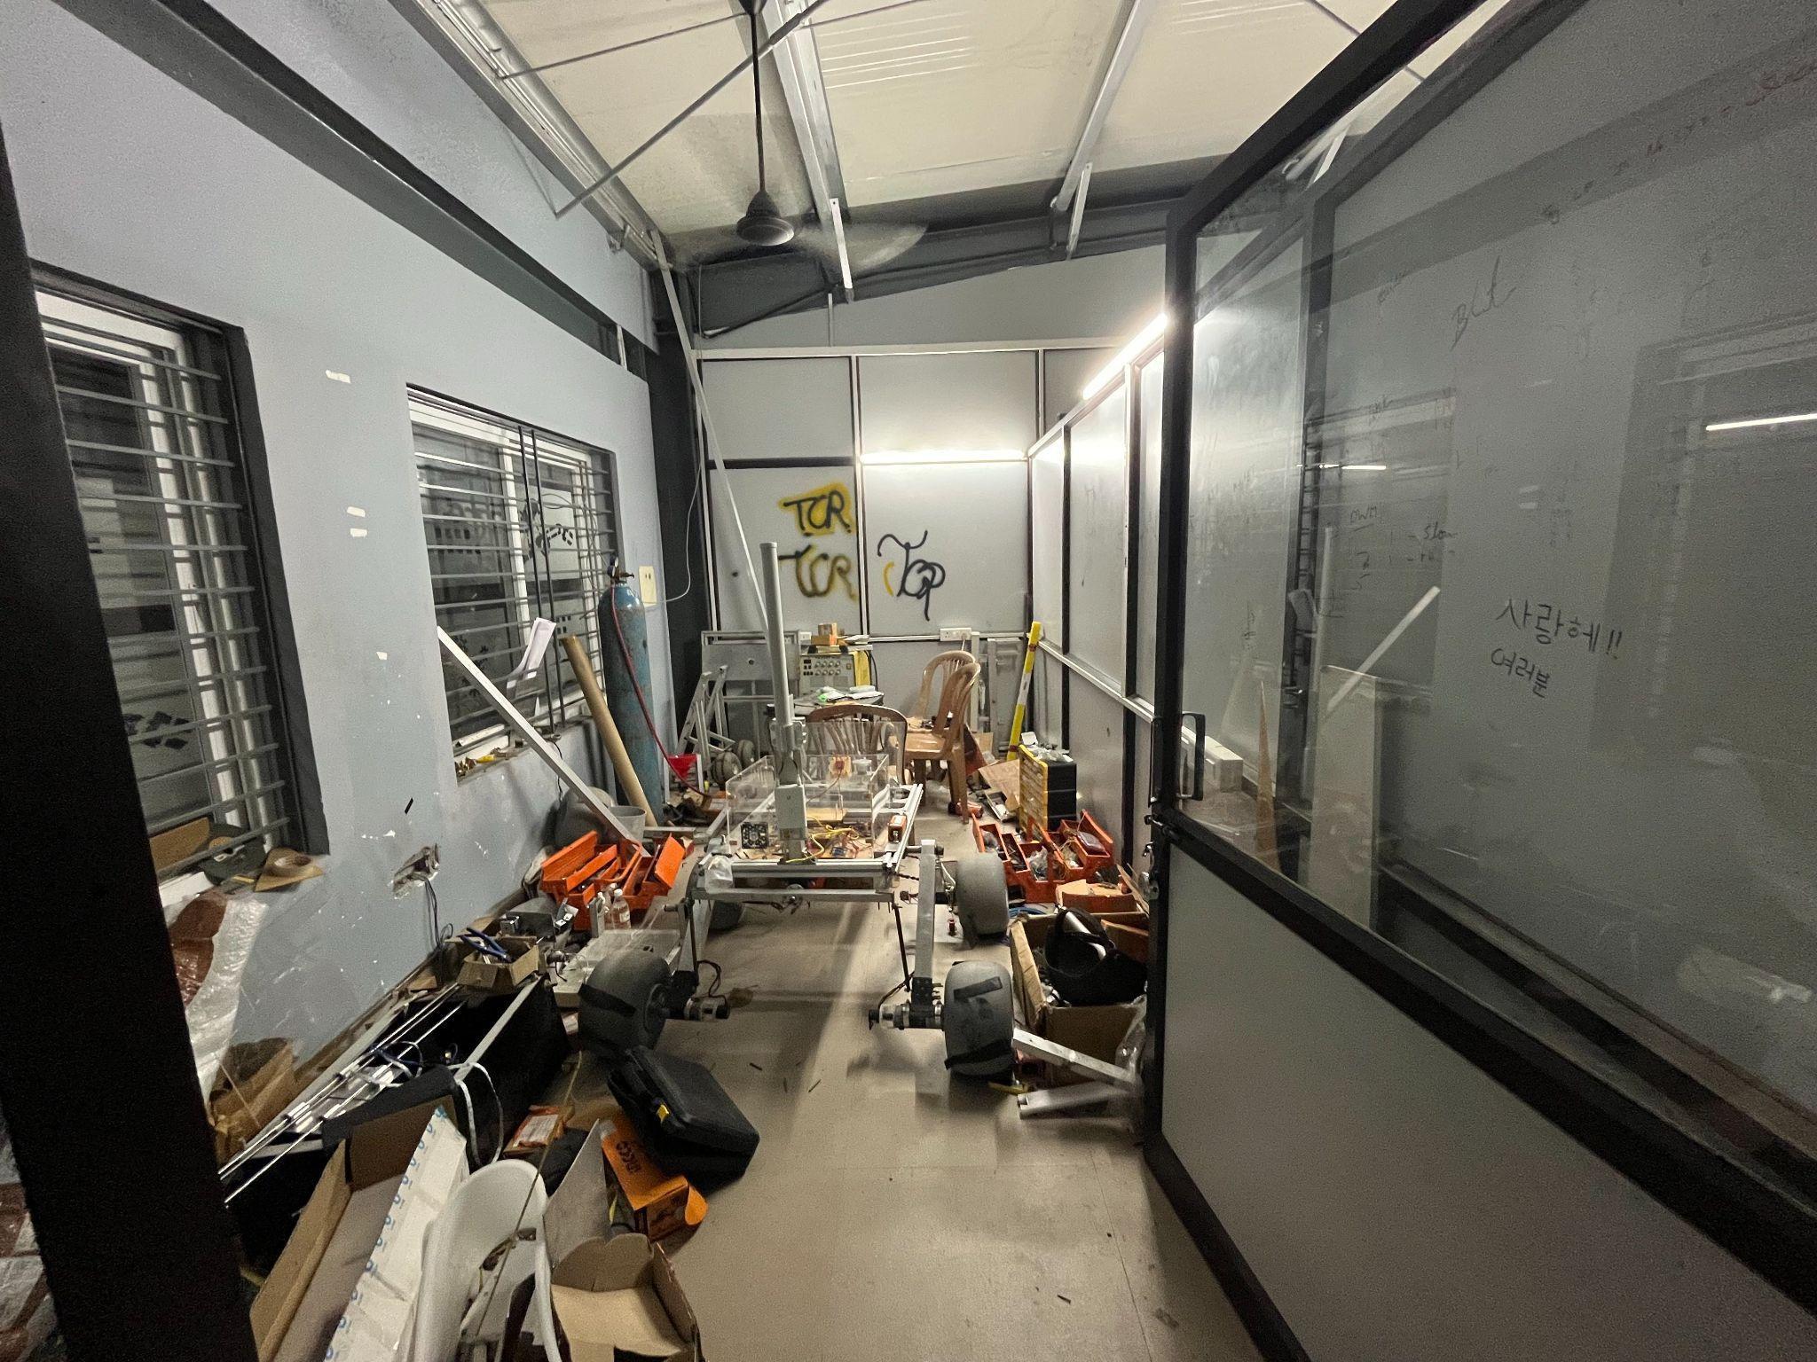
MANAGEMENT
Workplace:
Our rover was constructed entirely in the college garage, with each component meticulously assembled on-site. Following construction, the rover underwent rigorous testing on the uneven terrain and inclines of our campus to ensure its stability. The science testing were conducted in the University’s chemistry laboratory.
put your logo here

Slide 15
MANAGEMENT
Funding :
The estimated cost of developing the rover is approximately +2.5 lakhs Rs. Anticipated expenses for travel (10 students and the rover) range from Rs. 4 lakhs to Rs. 4.5 lakhs. Accommodation is expected to cost an additional Rs. 3 lakhs to Rs. 4 lakhs.
The team is also actively reaching out to additional sponsors for travel, accommodation, and technical support. Currently, the team leverages valuable technical support from Ansys and Solidworks. Other sponsors to our team includes Malkar Industries and Misumi.
In the face of insufficient funding close to the competition date, we need to adopt a strategic approach to navigate this challenge. The team will prioritize essential expenses in this case and intensify the efforts to secure more sponsors and collaborators.Also, in-house resources needs to be efficiently utilized.
put your logo here

Slide 16
MANAGEMENT
Logistics:
The team has meticulously planned the logistics for transporting the rover to the competition, employing a versatile approach involving either a courier service or integration with the students' luggage on the aircraft, or conceivably, a combination of both methods. In adherence to this plan, the rover will undergo disassembly into multiple parts, ensuring its safe and efficient transit to the competition venue. Upon reaching Istanbul, our team members will carefully reassemble the rover, readying it for the challenges ahead. This comprehensive logistical strategy underscores our commitment to meticulous planning and execution, guaranteeing the rover's timely arrival and optimal performance at the competition.
put your logo here

Slide 17

ROVER DESIGN
The mobility system adopted for ARC comprises a robust 4-wheel differential drive configuration, propelled by planetary geared DC motors. This setup offers agile maneuverability, essential for navigating diverse terrains encountered during the competition missions.The rover entails a dual-rocker suspension specifically engineered for enhanced stability across challenging terrains. For balance amidst obstructive obstacles, a differential bar is integrated within the suspension system. Furthermore, the rover utilizes balloon-type wheels, offering exceptional traction by dynamically conforming to the ground's topography at each contact point
Several considerations influenced the choice of this mobility system. Firstly, the differential drive mechanism ensures excellent traction and control, vital for negotiating challenging obstacles efficiently. Additionally, the planetary geared DC motors provide a balance between power and precision, facilitating smooth movement across varied surfaces.
This combination prioritizes maneuverability and control on uneven surfaces due to excellent traction and simplified control algorithms. However, payload capacity and potential motor failure remain considerations.
Mobility
System:
put your logo here

Slide 18
ROVER DESIGN
Mobility
System:
Our robot's design leverages bio-inspired principles, drawing upon the remarkable versatility of animal locomotion. By incorporating a differential drive mechanism that mimics this agility and adaptability, we aim to equip the robot for the diverse scenarios encountered in the competition. This approach prioritizes maneuverability and adaptability, ensuring the robot can navigate a wide range of challenges. Moreover, this design choice fosters fluid movement and precise control, enhancing performance in dynamic environments. Ultimately, we strive to create a robot that replicates the ease and flexibility of its natural counterparts in overcoming obstacles.
put your logo here

Slide 19
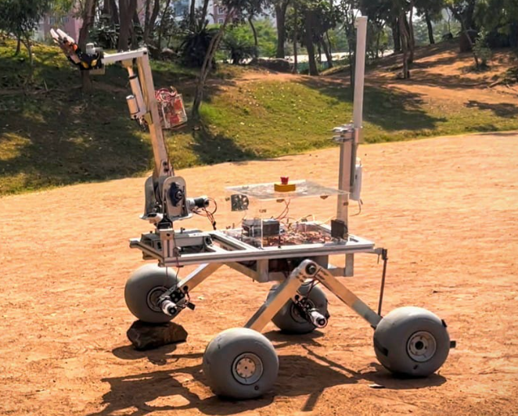
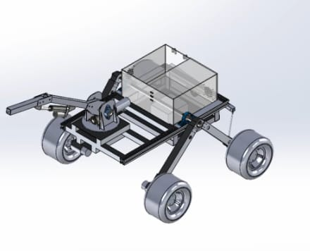
ROVER DESIGN
Mobility
System:
put your logo here

Slide 20
ROVER DESIGN
Mobility
System:
The meticulously engineered differential drive mechanism empowers the robot with exceptional maneuverability for navigating diverse ARC competition terrains. Its independent wheel control allows for pivoting, tight turns, and smooth traversal of complex landscapes. The planetary gear reduction system further enhances the performance of the motors, providing ample torque for traversing rugged terrains while maintaining a compact form factor ideal for integration within the robot's chassis.
put your logo here

Slide 21
ROVER DESIGN
Using the voltage divider board the 22.2V from battery is converted to 24V, 12V,5V restricting to 5A draw current for the 12 and 5V which in turn using the power distribution board are provided to various components for their operations.
Base Motors ,comms , mini pc requiring 24V, 2 fans(for ventilation )and arm motors ,encoders , led ,science module requiring 12V and the remaining 5V for the microcontrollers.
The ability to seamlessly switch to a fresh battery when one depletes ensures that the rover can continue operating without interruption. By using two batteries in parallel, the overall capacity of the system is doubled. This can provide longer runtime for the rover.
Although the system is very efficient, its complexity can cause some troubleshooting issues for someone who is not adapted to this system.
Electronics and power system:
put your logo here

Slide 22
ROVER DESIGN
Electronics and power system:
The electrical system bridges the software interface with the mechanical system. The three-buck converters are used to step down the voltage for different subsystems as an effective way to manage power distribution. Further, the Power Distribution Unit (PDU) plays a vital role in supplying the appropriate voltages to various components such as DC motors and their drivers, microcontrollers, and the onboard processing unit. The implementation of Power Over Ethernet (POE) for the antenna is a smart integration, reducing wiring complexity and improving reliability.
The dual battery configuration ensures uninterrupted operation by allowing for a seamless switch to a fresh battery when one depletes. Each board is linked to a specific module, enabling independent operation. This flexibility allows for interchangeable arm and science modules.
put your logo here

Slide 23
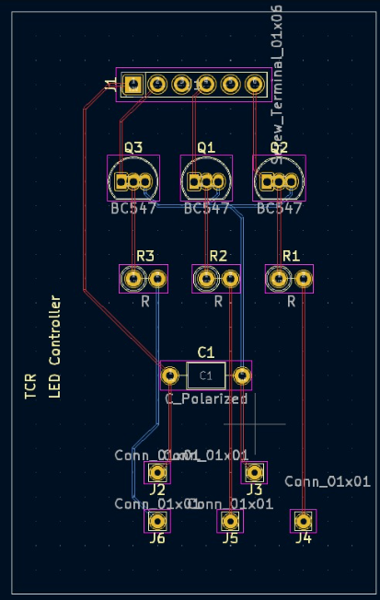
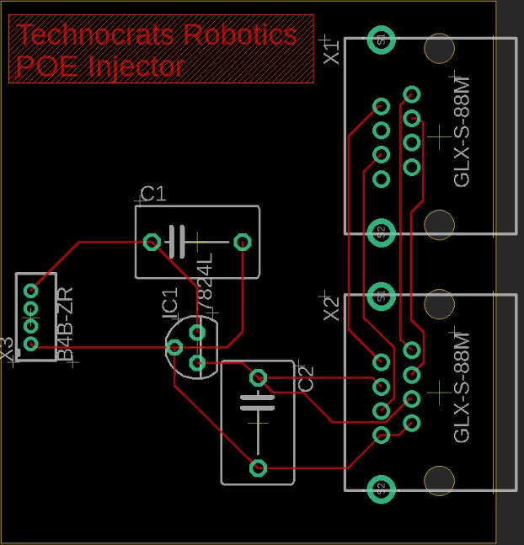
ROVER DESIGN
Electronics and power system:
put your logo here
LED Controller
POE injector schematic

Slide 24
ROVER DESIGN
The rover is powered by a dual battery system, each of 22.2V 25Amph. They run individually for 90 minutes, after which they can be recharged for the next mission.
For the missions, the rover incorporates a kill switch for immediate emergency shutdown. An ESP32 microcontroller controls our LED strip through a custom PCB with LED controller. The ESP32 sends 3.3v signals that act as dimmer switches via transistors for red, green, and blue channels. A higher signal translates to a brighter color.
Capacitors stabilize power while resistors manage current flow. Screw terminals simplify connections for power, ESP32, and the LED strip.
The robotic arm and science modules possess their own dedicated control circuits, while a central electrical enclosure functions as the primary power distribution unit, supplying current for all general operations.
Electronics and power system:
put your logo here

Slide 25
ROVER DESIGN
The robot's versatile arm offers precise manipulation with 6 degrees of freedom. The combination of different actuators and gearbox types is chosen to balance precision, power, and control. The gripper's design suggests functionality tailored for both delicate tasks, like USB insertion, and robust enough to handle objects up to 7 kg.
The specific components and configurations seem to be selected to satisfy the criterias of missions, where precision, weight capacity, adaptability, and operational time are critical. The factors considered were safety, weight and size and power efficiency. The dual-limit switch system prevents malfunction and potential damage to the arm and surrounding objects.
Ensuring both dexterity and safety, the robot arm holds six degrees of freedom for precise movement across all axes. This allows for intricate maneuvers and smooth object manipulation. To prevent damage during operation, the arm incorporates a two-stage limit switch system, safeguarding both the robot and its environment.
Manipulation system:
put your logo here

Slide 26
ROVER DESIGN
Manipulation system:
Our design takes inspiration from versatile and safe industry-grade robotic arms, prioritizing these strengths throughout its development. The two-finger gripper embodies this approach, offering adaptability for both delicate and robust tasks. Furthermore, the incorporation of a backlash-free worm gearbox reflects established industry practices, ensuring reliable and precise object manipulation during critical operations. This focus on proven solutions ensures the robot excels in the competition environment.
put your logo here

Slide 27
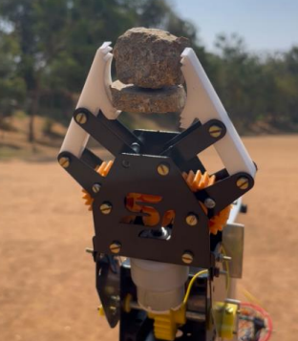
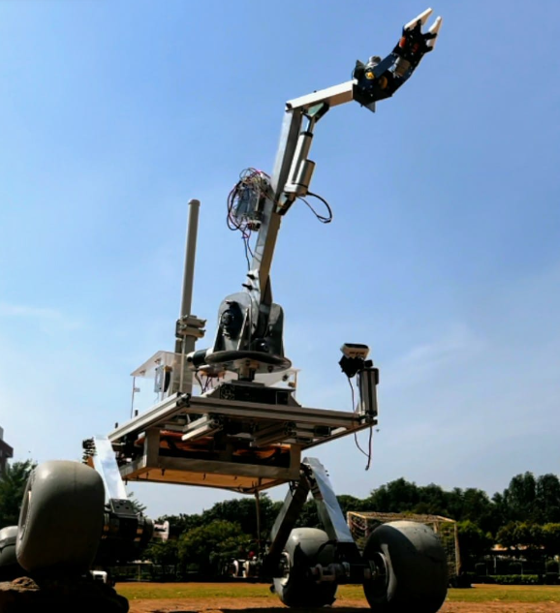
ROVER DESIGN
Manipulation system:
put your logo here
Two fingered Gripper
Arm attached to rover

Slide 28
ROVER DESIGN
Manipulation system:
With an overall mass of 8 kg, the arm is lightweight enough for mobility while maintaining the necessary stability.The battery life of 40 minutes ensures that it can complete tasks without frequent recharging, which is essential in a competition setting.
The rover arm boasts a winning combination for competition. The DC motor with a gearbox provides continuous base rotation for expansive searching, while the worm gear system in the first link offers precise control for delicate tasks. The second link's linear actuator extends reach for varied object distances, and the end effector's stepper motor allows for dexterous manipulation. Finally, the DC motor-powered gripper with limit switches ensures a secure grasp and operational safety. This well-rounded design tackles diverse competition challenges with versatility and control.
put your logo here

Slide 29
ROVER DESIGN
Science Payload:
We have developed a science sample collecting module featuring a closed, isolated container with internal separations. This configuration is designed to maintain the integrity of collected samples by preventing contamination during transport and storage. The module incorporates a robotic arm equipped with precision manipulation capabilities to facilitate the efficient picking and placing of samples within the container.
The closed, isolated container with internal separations minimizes the risk of samples contaminating each other during transport and storage. Moreover, the robotic arm with precision manipulation capabilities allows for efficient and accurate sample collection and placement. This reduces human error and ensures consistent handling, which is important for data quality.
On the other side, the internal separation may be a reason for taking limited samples.
put your logo here

Slide 30
ROVER DESIGN
Science Payload:
The Science payload has been inspired by the Curiosity rovers which carries with it a suite of scientific testing instruments while traversing the Martian surface.
The Science module features a robust mechanism employing a lead screw actuation system. This system comprises two steel support rods, a central lead screw, and planar guideways. Rotational actuation is provided by a planetary gearhead DC motor mounted atop the lead screw.
Lead screws offer very precise linear motion control. The threads act like a ramp, converting every rotation of the screw into a specific, consistent linear movement.
put your logo here

Slide 31
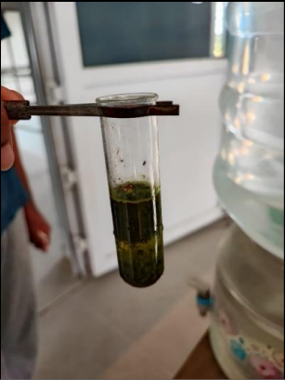
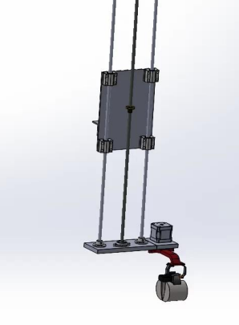
ROVER DESIGN
Science Payload:
Chemical Testing
Lead-Screw Mechanism
put your logo here

Slide 32
ROVER DESIGN
Science Payload:
The science payload weighs approximately 500g without considering the samples.
For the purpose of the missions, a dedicated motor system is located at the base to facilitate soil sample collection. This system utilizes three distinct scoops to mitigate cross-contamination and a stepper motor governs the scoop selection.
Having three different scoops can enable the rover to potentially collect samples from different depths or target specific soil layers. This allows for a more comprehensive analysis of the soil profile.
put your logo here

Slide 33
ROVER DESIGN
Ground station equipment and communication system:
The rover and the ground station maintain constant communication by the means of the advanced Ubiquiti Rocket Antennas. This antenna-mounted router supports both long-range point-to-point and point-to-multipoint links.
It features automatic channel selection and dynamic distance adjustment based on acknowledgement timing for optimal wireless performance.
For internal communication within the rover there are two distinct computing units: a mini PC running Ubuntu and two ESP32 microcontrollers operating with Micro ROS.
This system ensures seamless communication with minimized noise. The drawback can be found in the fact that the ground station depends solely on the Ubiquiti antennas and hence showcases a single point of failure.
put your logo here

Slide 34
ROVER DESIGN
Ground station equipment and communication system:
Space agencies like NASA use the Deep Space Network for communicating with distant spacecraft. The DSN utilizes high-gain antennas for long-range, directional communication with spacecraft. The Ubiquiti Rocket Antennas with their point-to-point focus and potential for long range echo similar principles.
put your logo here

Slide 35
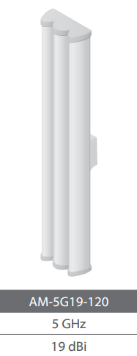
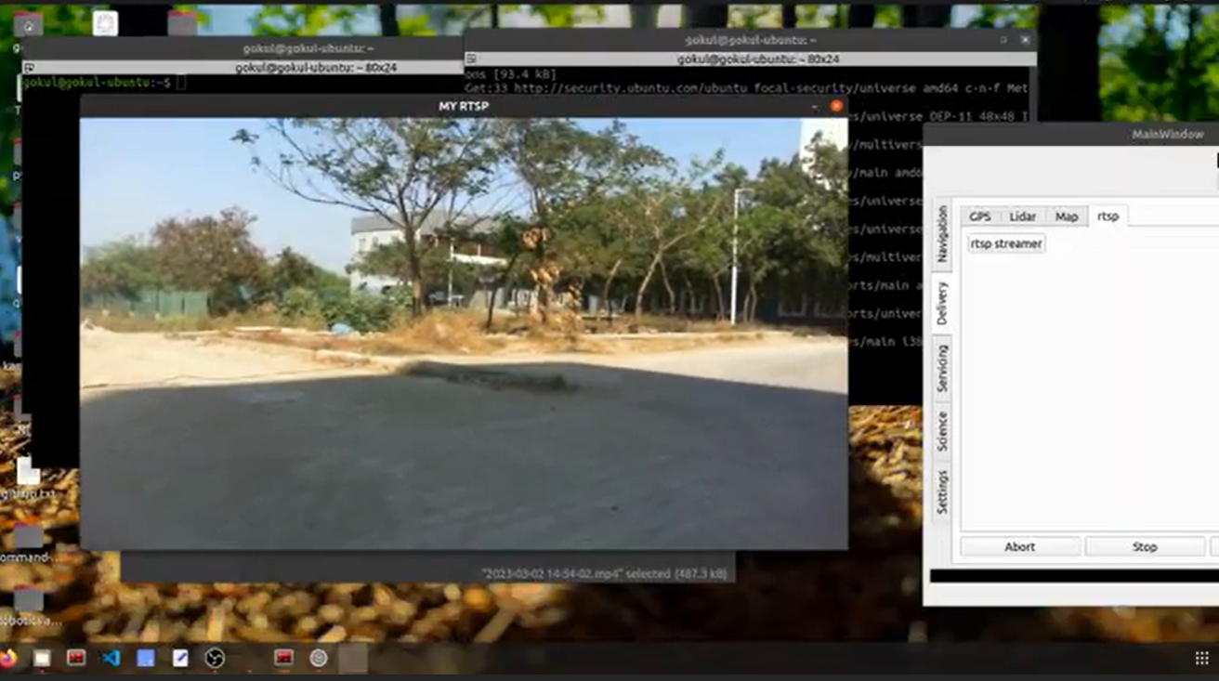
ROVER DESIGN
Ground station equipment and communication system:
Real-time feedback during autonomous navigation
put your logo here
Base Station Antenna

Slide 36
ROVER DESIGN
Ground station equipment and communication system:
The rover utilizes the AMO-5G13 antenna for omnidirectional communication. The base station leverages the AM-5G19-120 antenna for its high noise immunity on the 5GHz frequency band.
For Autonomous navigation the rover uses the Rover Satellite Communication - Client Module to relay messages between the host module and the rover. The host module send a task or an instruction for the rover. Once completed the rover returns a ‘Task Completed’ message.
The hardware setup of the client module includes a 9 hole DB9 female socket and utilizes a custom RS - 232 communication protocol with a 115200 baud rate.
put your logo here

